Slide 1
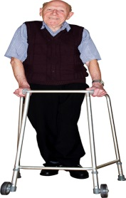
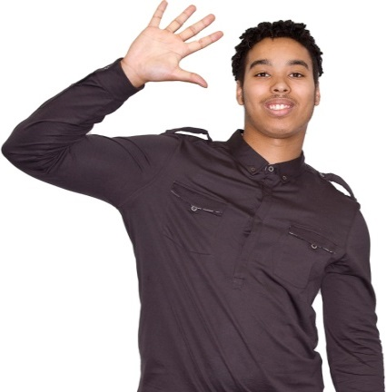
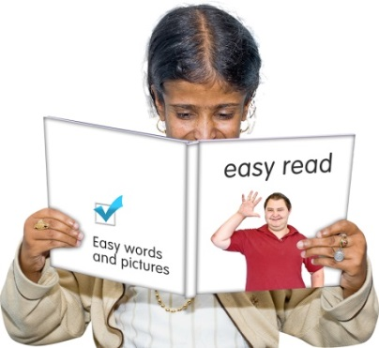
Welcome to:
The Waltham Forest
Community Learning Disability Team
(CLDT)
This leaflet is “Easy Read”

Slide 2
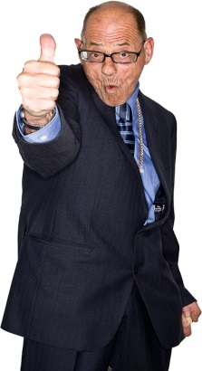
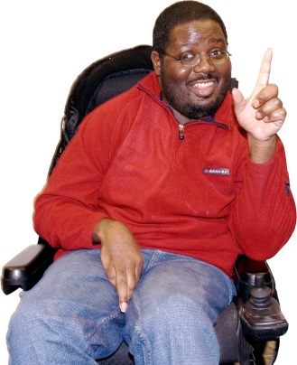
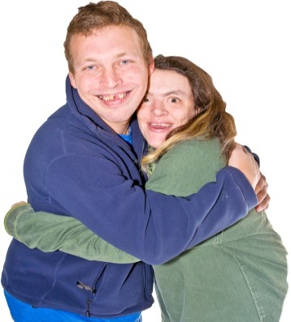
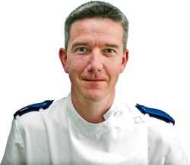
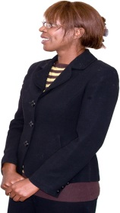
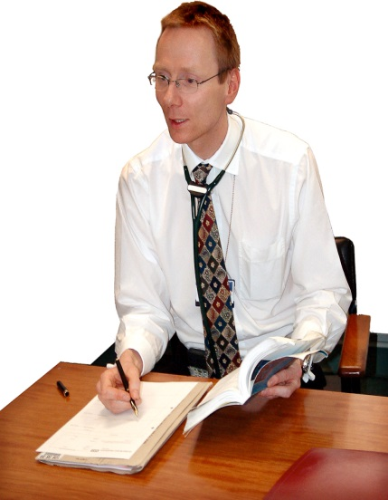
Welcome to the CLDT
CLDT stands for:
Community Learning Disability Team
The CLDT is an integrated team run by the council and the NHS.

Slide 3
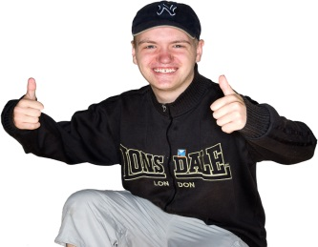
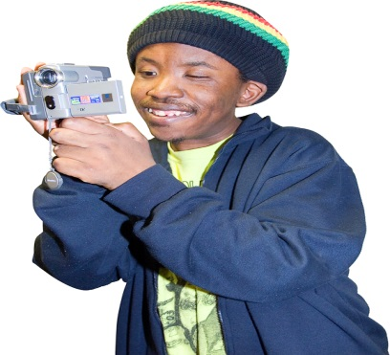
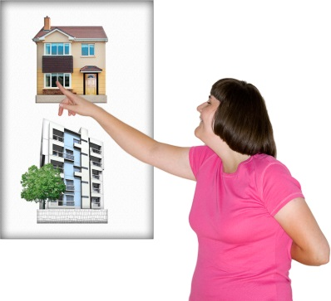
Welcome to the CLDT
What we do:
Help you live safely
Help you be independent
Help you make choices that are important to you
Make information easy to understand

Slide 4
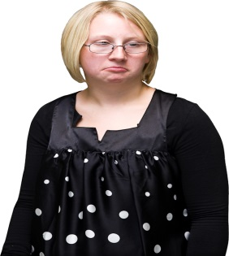
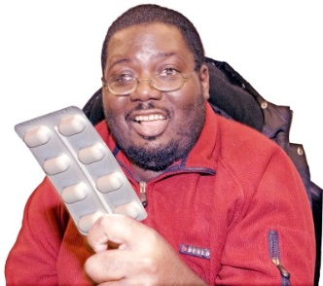
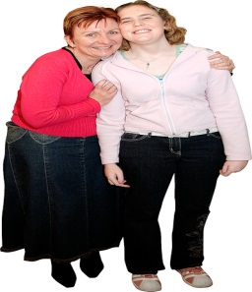
Psychiatrists: We help you manage your feelings and your mental health.
We can also give you the right medicines.
Nurses: We help you to be as healthy as possible
We can help with your diet, mental health, and relationships.
We can also help the people who support you

Slide 5
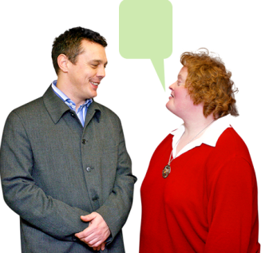
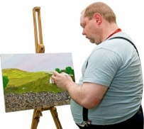
Speech and Language therapists: We help you to communicate with friends and family.
We can help you make choices about what you want to do.
We also help with eating and drinking.
Psychologists
We can help you feel well and happy.
We offer support through Art Therapy
We can help the people who support you

Slide 6
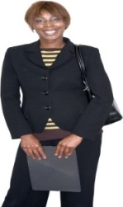
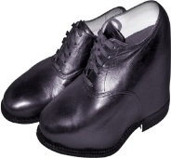
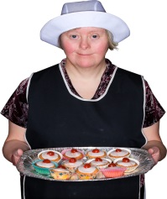
Social Workers:
We find out if your needs are met by our team.
We also organise money payments, help with housing problems, and plan courses.
Physiotherapists:
We help you to move and remain active.
We also help you feel comfortable with the equipment you use.
Occupational Therapists:
We help you care for yourself
We can help you do things that you like, including work, hobbies and activities.

Slide 7
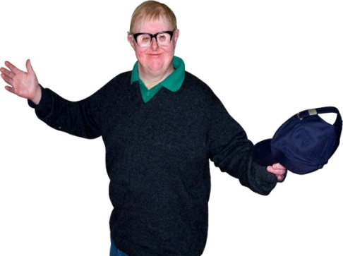
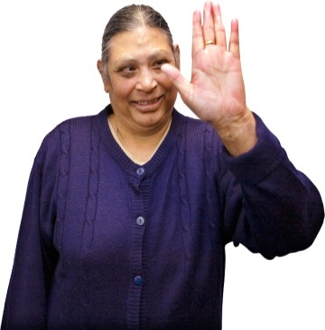
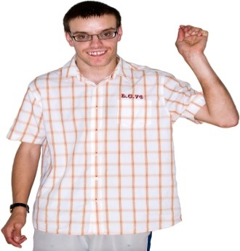
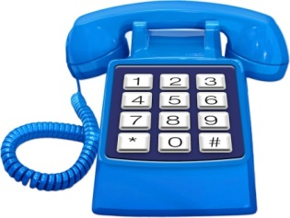
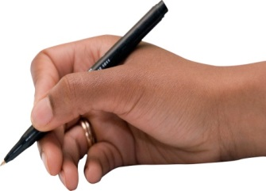
Thankyou!
If you have any questions or concerns, please contact us:
- By telephone:
0208 928 8300
- Or write to us:
30 Coleridge Road
Walthamstow, London
E17 6QU
Opening hours: 9:00AM – 5:00PM
Monday - Friday

