Slide 1
Section Break
Land Supply for Housing Delivery

Slide 2
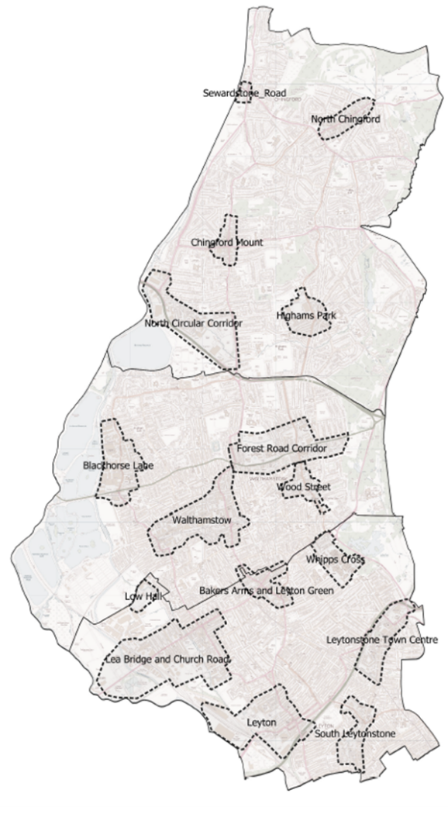
Spatial Strategy
NORTH
5 Strategic Locations
3,849 new homes
1,950 new jobs
CENTRAL
4 Strategic Locations
9,900 new homes
1,600 new jobs
SOUTH
7 Strategic Locations
16,996 new homes
3,250 new jobs
The Local Plan identifies 16 “Strategic Locations” across the borough. These are considered the most suitable locations for growth, informed by considerations such as public transport accessibility, existing or planned infrastructure, and availability of previously developed land.
The Local Plan promotes a “character –led intensification” approach to development in all locations, including strategic locations, and in line with national government planning reform
Currently, there are 75 site allocations in LP2:
31 in the south of the borough
23 in the central area of the borough
21 in the north of the borough

Slide 3
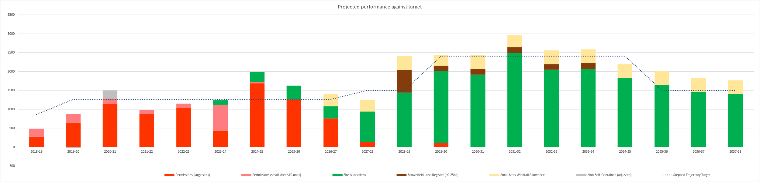
Housing Trajectory
Local Plan Period
New Homes
Financial Years
Permissions – large sites
Permissions- small sites
Site allocations
Brownfield land register
Small sites – windfall allowance
Stepped target

Slide 4
Housing Trajectory
Land Ownership
Land Ownership | Housing Supply | % of total supply
LBWF | 4930 | 16.1%
Mixed Ownership | 3604 | 11.7%
Private | 16045 | 52.3%
Public Body | 5951 | 19.4%
Unknown | 145 | 0.5%
Grand Total | 30676
Land ownership for all housing capacity identified in Local Plan 1 (NB: Small sites assumed to be in private ownership)

Slide 5
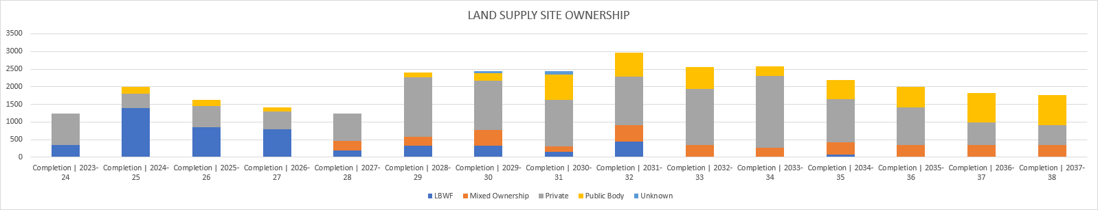
Housing Trajectory
Land Ownership
Land ownership for expected completions, for each year in the LP1 Housing Trajectory
(NB: Small sites assumed to be in private ownership)
Years | LBWF | Mixed ownership | Private ownership | Other public body | Unknown
Years 1-5 (2023/24 - 27/28) | 3,578 | 279 | 3,177 | 464
Years 6-10 (2028/29 -32/33) | 1,265 | 1,660 | 7,367 | 2,367 | 145
Years 11-15 (2033/34 – 37/38) | 89 | 1,665 | 5,507 | 3,121
Land ownership for expected completions, for each five year phase in the LP1 Housing Trajectory
(NB: Small sites assumed to be in private ownership)

Slide 6
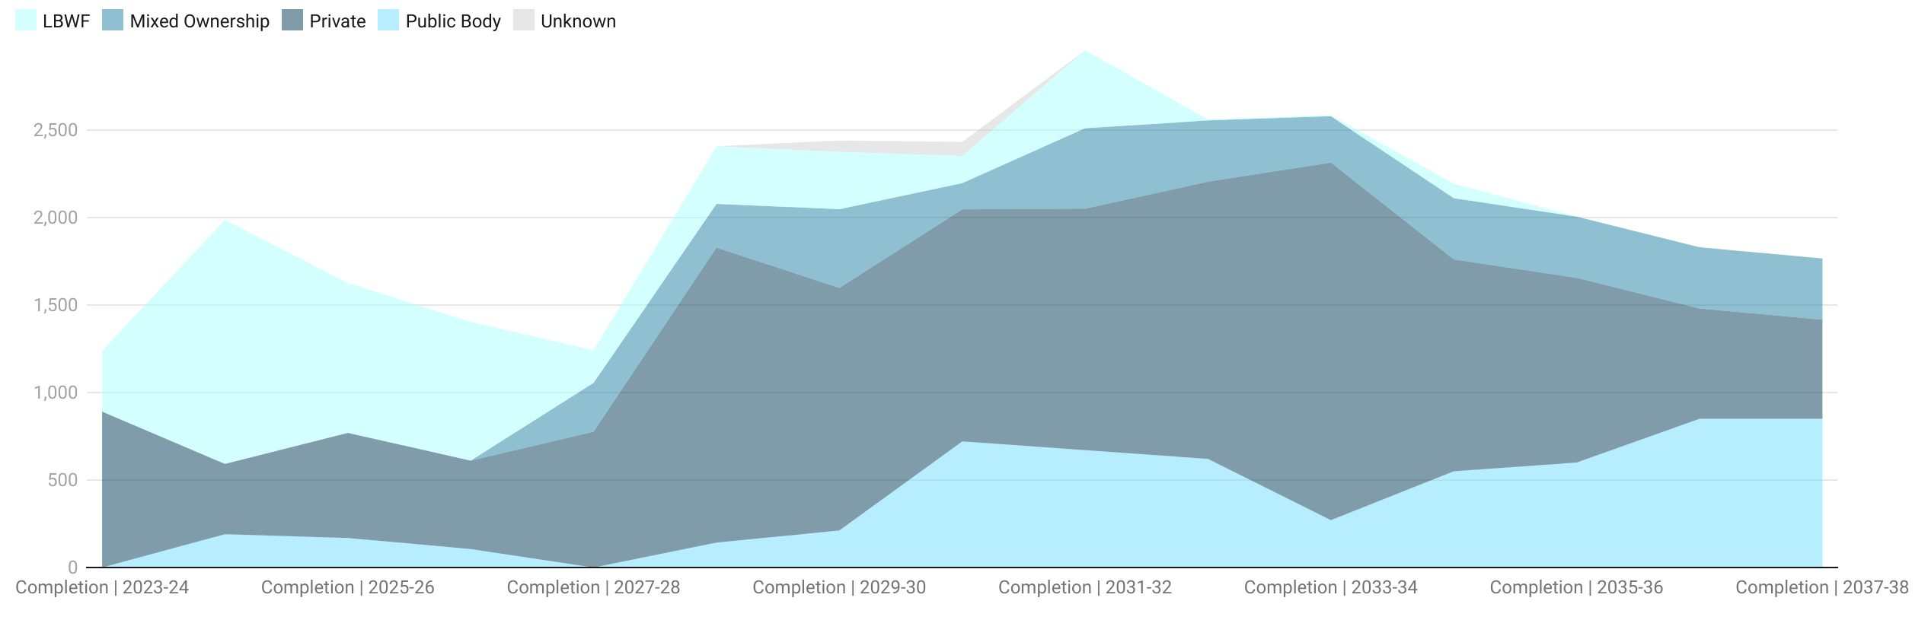
Housing Trajectory
Land Ownership
Land ownership for expected completions across the LP1 Housing Trajectory
(NB: Small sites assumed to be in private ownership)

Slide 7
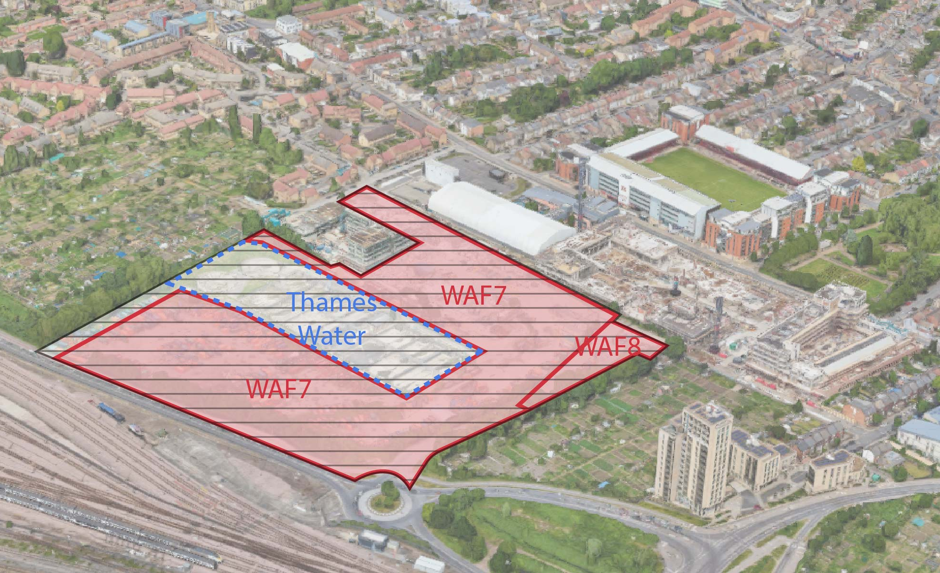
Complex Sites: Bywaters
Housing capacity: 1250 (plus 196 on Pocket site)
Incentivising collaboration with and between landowners
Relocation of Household Waste Recycling Centre (HWRC)
Access rights to Coronation Square development (Aukland Road)
Thames Water Land
Pocket Homes development
Aukland Road
Coronation Square development (LBWF)
Bywaters ownership
Bywaters ownership – operated as Local Authority waste site (HWRC)

Slide 8
Complex Sites: Supermarkets
Housing capacity on supermarket sites (and other large format retail) across the borough: 5411
Incentivising landowners to bring redevelopment forward
Land assembly
Continuity of supermarket trade
Car parking vs car free

Slide 9
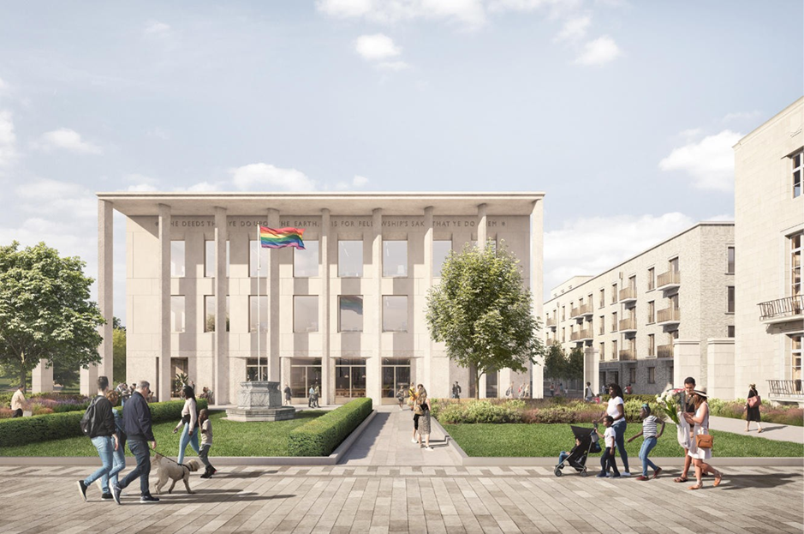
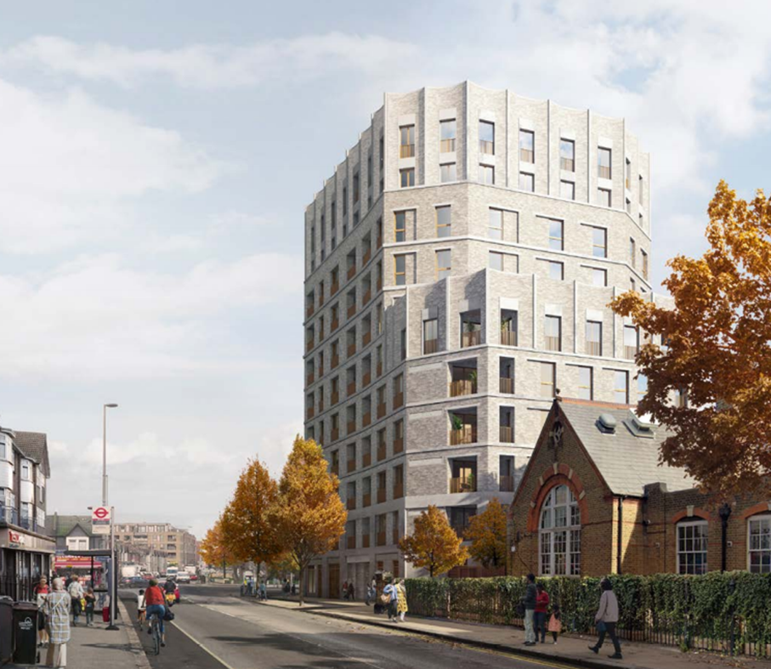
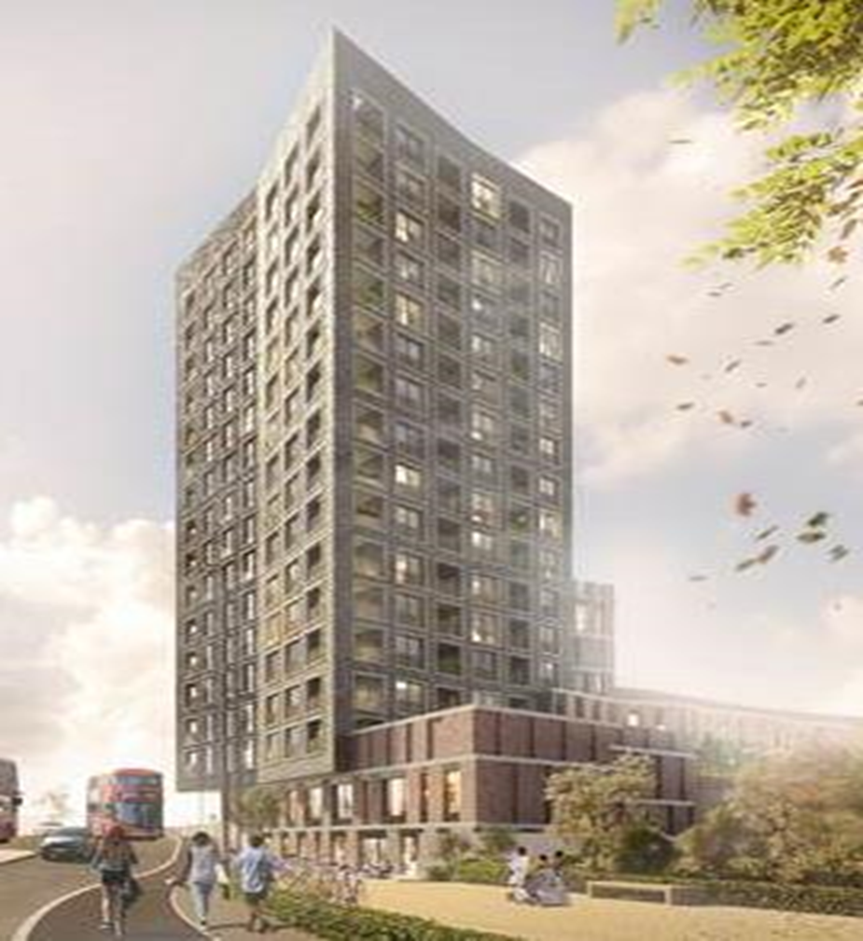
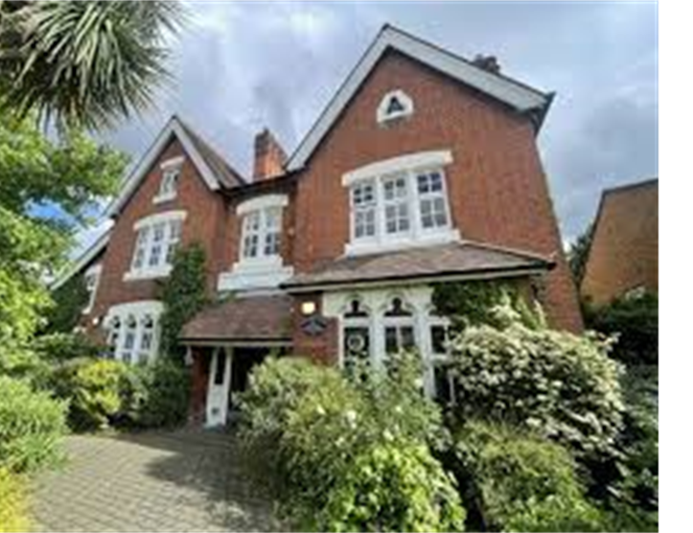

One Public Estate
The Waltham Forest OPE Partnership has been awarded over £2m in OPE funding
LBWF Fellowship/ Estate Rationalisation
Fellowship Square
Families & Home Hub
Juniper House
Grove Road (town hall feeder site)
Masterplanning, Ministry of Justice relocation and acquisition of the Magistrates Court, estates research / spatial planning
Viability and feasibility for the potential co-location with probation and DWP (although not feasible in the end)
Fellowship Square feeders sites : capital receipts fed back into the Fellowship Square programme

Slide 10
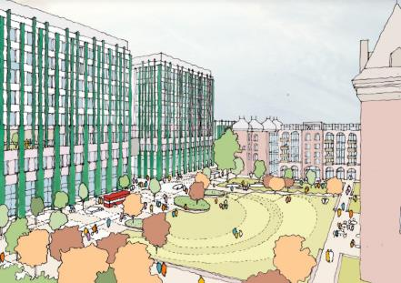
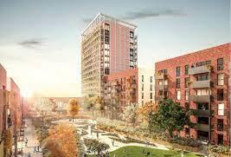
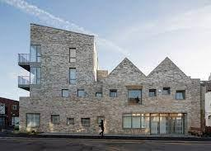
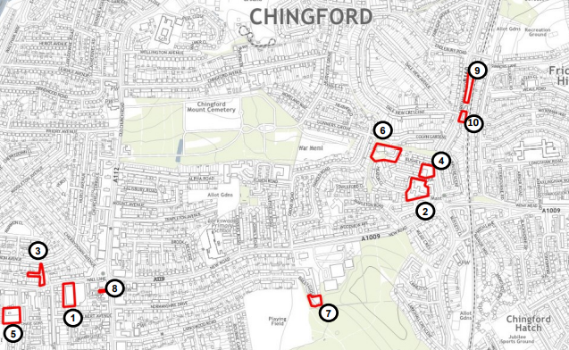
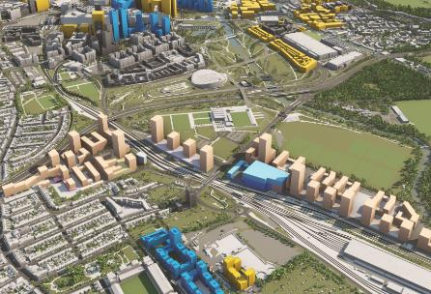
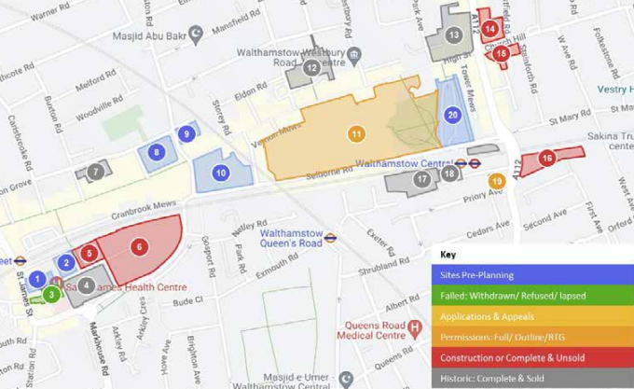
One Public Estate
Health and Care Provision
Whipps Cross Hospital: Masterplanning, space planning, developing integrated model of care, in consultation with stakeholders
Health Hubs: Analytical research and project management to identify community health hubs at St James Quarter, Coronation Square and Sutherland Road
Chingford Health and Care Hub: Feasibility into the rationalisation of health care facilities and creation of health and social hub
Masterplanning
Waste and Land Strategy:
Review waste sites to consider consolidation, intensification or colocation for modern waste to allow the potential release of land for other uses.
Leyton Mills Development Framework: 5,700 new homes and reprovision and uplift of commercial floor space (min 75,000 sqm)
Walthamstow Town Centre Framework: Area-wide strategy and delivery plan for public realm, social value and sustainability and development priorities/ expectations for 8 sites.
Waste and Land Strategy

Slide 11
Brownfield Release Fund
LBWF’s strong OPE track record has enabled the award of Brownfield Land Release Funding.
Almost £5m has been awarded over three rounds
Provides up front capital to address viability issues arising from abnormal costs of proposed development
Aim to release council-owned land for housing and to encourage the use of public assets to drive innovative delivery
Funding can be used for site levelling/ groundworks/remediation, demolition, small-scale infrastructure, highways works/ access, environmental constraints, external works/ substructure/ piling, asbestos removal and sewer diversions
LRF – 2020/21
BLRF – 2021/22
BLRF2 – 2022/23
Families and Homes Hub
Nine Housing Sites
Erskine Road Car Park
Lea Bridge Station Sites
Osbourne Grove
Rowan House
Chingford Hub
Cedarwood House
Russell Road
The Ferguson Centre
Priory Court
190-192 Vicarage Road

