Slide 1
Section Break
The Housing Commission – Planning Obligations and Infrastructure Delivery

Slide 2
Community Infrastructure Levy
tool for Councils to invest in local areas by funding infrastructure to support growth
Developers pay set rate per square metre, based on type of development (in accordance with CIL charging schedule)
Non-negotiable - although relief applies to affordable housing, charities and self builders
rates must have regard to the actual and expected cost of infrastructure and the viability of development

Slide 3
Section 106 agreements
site-specific legally-binding agreements with a landowner as part of the granting of planning permission.
a way of delivering or addressing matters that are necessary to make a development acceptable in planning term
can be used to support the provision of services and infrastructure, such as highways, recreational facilities, education, health and affordable housing.
Can be monetary or non financial (for example affordable housing)

Slide 4
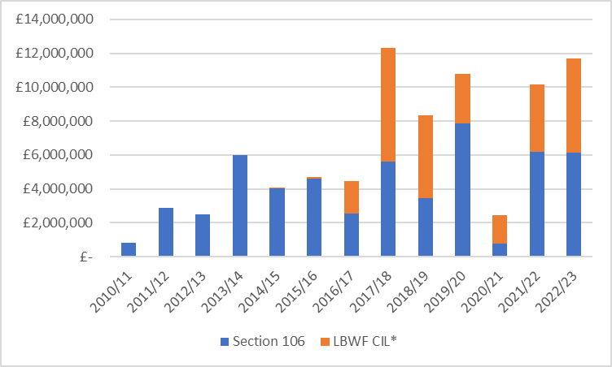
Financial Contributions received since 2010/11
Your Sub head goes here
in 42pt text. Keep to a maximum
of three lines where possible
* CIL was introduced in March 2014
CIL can be spent on any type of infrastructure while Section 106 payments are collected for a specific purpose/project. CIL can not be spent on affordable housing.
Since the introduction of CIL in 2014, it replaced tariff based Section 106 contributions addressing cumulative impact of development across the borough.

Slide 5
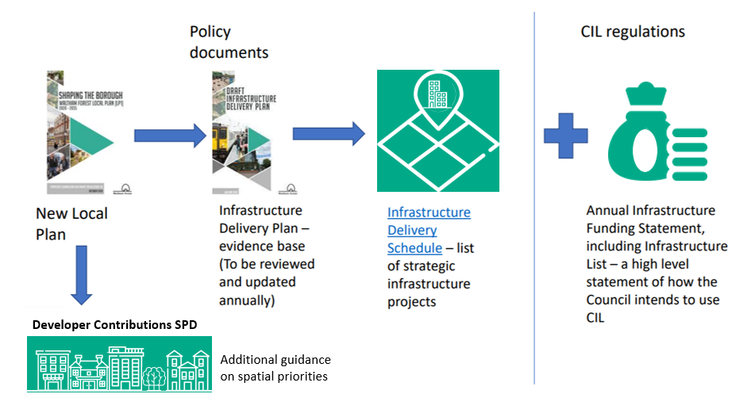
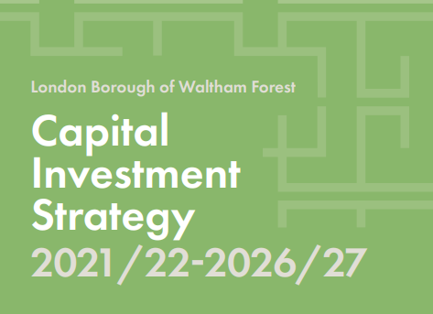
Setting spending priorities
The LBWF Infrastructure Delivery Plan sets out details of the infrastructure required to support planned growth set out in the new Local Plan, including when and where it should be delivered. The Infrastructure Delivery Schedule lists individual projects to be delivered.
The Infrastructure Delivery Plan is reviewed regularly, with the next review planned for this year.
As required, the Infrastructure Funding Statement identifies direct spending priorities on an annual basis.
All planning contributions spending is expected to align with the Capital Investment Strategy.
A new Developer Contributions Supplementary Planning Document will identify investment priorities in local growth areas.
Your Sub head goes here
in 42pt text. Keep to a maximum
of three lines where possible

Slide 6
Governance - Developer Contributions Board
Chaired by the Strategic Director of Place
Held at least quarterly
Provides strategic oversight on the combined use of developer contributions
Identifies priorities for funding
Makes recommendations and delegated decisions on use of Strategic CIL and flexible Section 106 financial contributions
Reviews annual reports, including Infrastructure Funding Statement (IFS)
Portfolio Lead Member and Cabinet make and review final decisions

Slide 7
Funding Infrastructure - CIL
CIL funds various types of physical and social infrastructure, including (but not limited to) major capacity improvements to public transport, green spaces, healthcare, culture, digital infrastructure and play spaces
List of biggest CIL allocations* since the introduction of CIL charging schedule in March 2014:
List of biggest CIL spends since the introduction of CIL charging schedule in March 2014:
* Allocations refer to formal decision having been made to fund a project through CIL, but the funding may not yet have been spent

Slide 8

Funding Infrastructure – Section 106
S106 financial contributions fund scheme-specific matters that are necessary to make a development acceptable in planning terms. They can be used to support the provision of services and infrastructure, such as highways, recreational facilities, education, health and affordable housing. S106 agreements also secure non financial planning obligations – including the delivery of on site affordable housing.

Slide 9
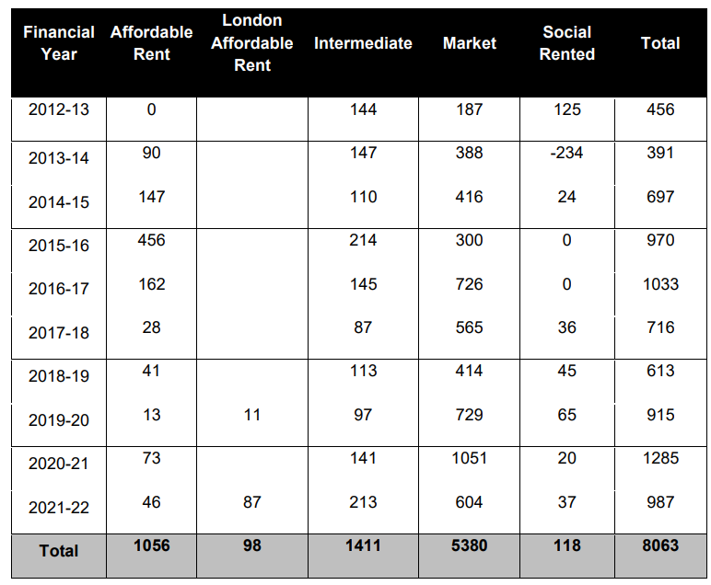
Affordable Housing
Net Self-Contained Housing Delivery 2012-2022
Our preferred policy approach to affordable housing is on site delivery and Section 106 agreements are used to secure the appropriate tenure mix.
In exceptional situations where on site delivery is not viable, we may accept an off site affordable housing financial contribution instead
Each Section 106 agreement involves site specific negotiations and may be subject to a site-specific viability assessment .

Slide 10

Funding Off Site Affordable Housing
Financial contributions secured towards the provision of affordable housing within the borough (as of Feb 2023):

Slide 11
Late stage viability reviews
Where the initial financial viability appraisal (FVA) produced at the planning application stage shows that a scheme would not be viable if fully policy compliant, the Council may seek a viability reappraisal at a later stage.
A viability reappraisal can result in:
(a)additional affordable units being offered.
(b) additional payment (in lieu of affordable housing known as PIL);
(c) no further action - the scheme being demonstrated as not viable to contribute anything beyond what it has already contributed as part of the initial FVA.
Reappraisals analysis based on 51 permissions subject to late stage viability appraisal granted between 2011 and 2020:
12 schemes have fulfilled their obligations by increasing the number of affordable homes on site, totalling 461 additional homes.
8 schemes have made (or agreed to make) a payment in lieu of affordable housing offsite, totalling £5,993,400.68.
6 schemes are currently in negotiations with the council.
17 other schemes have not yet submitted their reappraisal as the trigger has not yet been reached.

Slide 12
Developers’ contributions also support the provision of affordable housing
The vast majority of the RP delivery comes from developer led s106 schemes.
There are currently 3 main developer-led schemes with an RP in place (South Grove, Blackhorse Road Station Car park, Former Homebase - Fulbourne Road). Once complete, these will deliver 556 new affordable homes.
RPs will also pick up the affordable housing on S106 schemes being led on by the Council’s Capital Delivery Team. These are:
The Town Hall Campus where lead developer is Countryside and One Housing Group is the RP. There are 195 affordable homes proposed across this development.
Coronation Square where the lead developer is Taylor Wimpey and Sage Housing Association are the RP. There are 358 affordable homes proposed across this scheme.
Lea Bridge Station Sites where the lead developer is London Square Ltd. An RP has not yet been secured yet but the scheme achieved planning approval just last month. There will be 160 affordable homes on this scheme.
Notes:
The vast majority of the RP delivery comes from developer led s106 schemes. All affordable homes built by developers will at some stage have to be disposed to an RP. Onawale Kuforiji (Information & Monitoring Officer) in Sarah Parson’s team should be able to provide information on all schemes currently on site, not all will have an RP initially.
We currently know of 3 developer led schemes with an RP in place, once complete these will deliver 556 new affordable homes.
RP’s will also pick up the affordable housing on s106 schemes being led on by the Council’s Capital Delivery Team. These are:
The Town Hall Campus where lead developer is Countryside and One Housing Group is the RP. There are 195 affordable homes proposed across this development.
Coronation Square where the lead developer is Taylor Wimpy and Sage Housing Association are the RP. There are 358 affordable homes proposed across this scheme.
Lea Bridge Station Sites where the lead developer is London Square Ltd. An RP has not yet been secured yet but the scheme achieved planning approval just last month. There will be 160 affordable homes on this scheme.

Slide 13
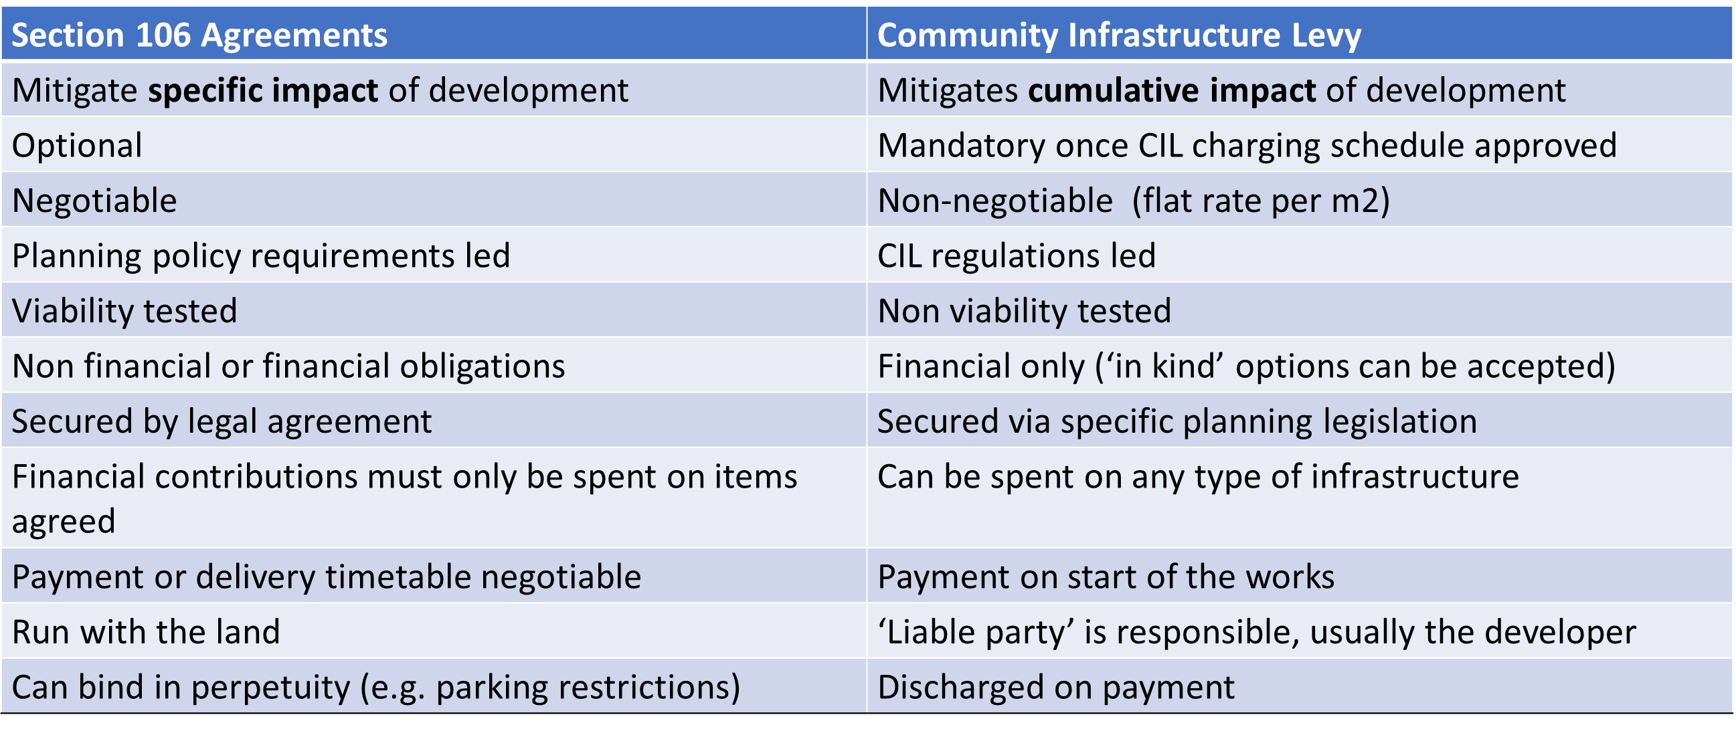
Appendix 1 - Section 106 vs CIL
Your Sub head goes here
in 42pt text. Keep to a maximum
of three lines where possible

