Slide 1
Framing the recommendations
Waltham forest housing commission – session 4

Slide 2
1. RECAP OF THE EVIDENCE
WALTHAM FOREST HAS A STRONG DELIVERY RECORD WHICH HAS secured new homes for over 1,500 residents on the housing waiting list
Despite this, factors beyond the borough’s control mean that challenges are becoming more acute

Slide 3
A strong record of meeting top-down housing targets…
1. Evidence recap
Waltham Forest performance against target relative to London, 2011-22
93% of average housing target delivered since 2011 vs 89% in London as a whole
6,834 additional residents (+25%) in high growth neighbourhoods between 2011 and 2022
Also enabled by significant intensification of the existing stock

Slide 4
…While securing the most diverse tenure delivery in London
Proportion of affordable (low cost rent and intermediate) housing delivered, 2011/12 – 2021/22 (%)
Proportion of housing delivered 2011/12 – 2021/22 by type, Waltham Forest
1. EVIDENCE RECAP
9,164 homes
Over a third (35.17%) of homes delivered since 2011 have been social rent or intermediate.
This is the highest proportion in London, and is significantly higher than the London average.
New development has secured homes for 1.5k people who were on the housing waiting list. Most of these residents had been on the housing waiting list for 3 years or more.
Proportion of housing delivered 2011/12 – 2021/22 by type, London

Slide 5
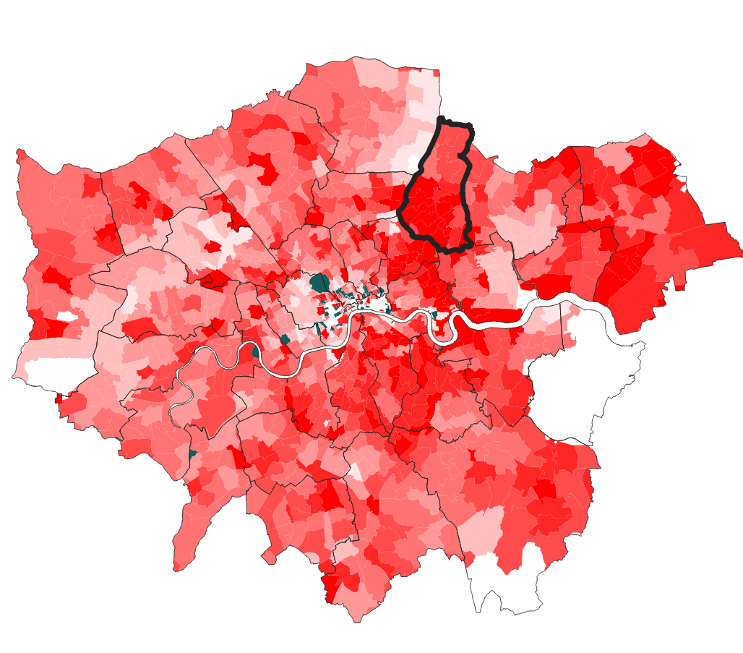
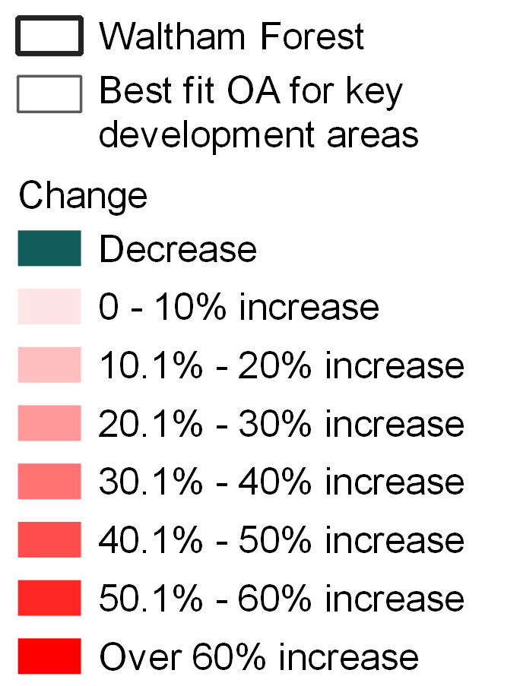
However, this has coincided with rapid shifts across London and the UK housing market
1. Evidence recap
Mean house price change in Outer London, 2011-2021
London’s housing market has undergone rapid change over the last ten years, most notably in Waltham Forest.
Whilst Waltham Forest started and remains cheaper than other areas, the borough has experienced the fastest house price growth in the capital (growing by 118% since 2011 vs 65% in London).
This has been sustained by a decade of historically low interest rates.
Change in value of residential mortgage loans outstanding, Q4 2013 – Q4 2021

Slide 6
Now, much new-build market housing is unaffordable to the average resident
1. Evidence recap
Using essential expenditure modelling, market rent in new-builds in high-growth areas is unaffordable for the average LBWF resident based on median earnings.
The unaffordability of market rate housing increases the importance of tenure diversity in catering for needs across the income distribution.
Market housing completed between 2011 and 2021
Blackhorse Road
Equipment Works
Studio from £1,695/month
– one person would require an income of £47,000
£1,925 for a one bed
– two people would require an income of £50,000
Blackhorse Mills
1-bedroom property from £1,650/month
One person would require an income of £50,000
3-bedroom property available from £2,700/month
Two parents with two children not receiving childcare would require an income of £74,000
£40,003 was the median gross annual salary in the London Borough of Waltham Forest in 2022
St James Street
Ralley Building
Studio from £1,050/month
One person would require an income of £35,000
Essex Brewery
2 bed from £1,625/month
Two parents with a child under 2 in full time childcare would require an income of £67,000
Source:

Slide 7
Despite broadly meeting targets, rising demand for statutory services
1. Evidence recap
Households assessed as homeless per (000s), 2019 v 2022
Proportion of households overcrowded, 2021
Homelessness rates in Waltham Forest have increased by 55% since 2012
Overcrowding is also a major challenge – especially in the south of the borough
The most common reasons for residents being owed a duty by the local authority are:
No longer being able to live with family/friends
Private tenancy ending

Slide 8
Being worsened by the cost of living crisis which could see multi-earner professional households fall into poverty
1. Evidence recap
Analysis of essential cost pressures show that a rounded view of affordability is required.
This is particularly important when assessing the affordability of intermediate tenures such as Shared Ownership.
Teacher and Doctor
Annual earnings: £35,074 & £40,257
Children aged 2 and 4, paying for full time childcare
Private renting a 2-bedroom house
35,700 households within Waltham Forest have dependent children
30.9% of households in Waltham Forest live within homes which are two bed
3,900 children are aged 2 in Waltham Forest, 3,619 aged 4
Income remaining after…
Additional essential expenditure required to live in London as defined by Minimum Income Standards research 2021. It includes expenditure on things like social and cultural participation, personal goods and services and clothing.

Slide 9
These changes are being felt keenly by residents
1. Evidence recap
Close match between perception and reality in Waltham Forest.
Much of the feedback is a reflection of the housing crisis challenge and the current difficult economic context.
There was a lack of understanding about the council’s strategy and the constraints facing the borough.
“
“
“
“
When I moved in it was cheaper you got a lot for your money, that’s changed now.
People who have health issues and / or additional needs Focus Group
”
“I understand you need the first class passengers to make the flight viable. The problem is you’re only delivering for the first class passengers here.”
Social Housing Focus Group
Be transparent show us what you’re doing and why you’re doing it.
Lea Bridge Focus Group
”
”
“
“
”
Teachers can’t afford to live locally. Who is living in these luxury flats? They’re not locals.
Walthamstow Central Focus Group Participant
Calling it affordable housing is a slap in the face to people living here.
Social Housing Focus Group Participant
”
”
It’s another block, after another block. There are more flats but no extra GPs, schools, supermarkets etc.
Lea Bridge Focus Group Participant

Slide 10
2. Framing the recommendations
the delivery context has shifted and business as usual may no longer be possible (or desirable).
Acknowledging these constraints can help to frame the commission’s recommendations and aid prioritisation

Slide 11
Constraints on the impact of the Commission’s recommendations
2: FRAMING THE Recommendations
Planet: Climate emergency
People: Widening inequality
Funding: Local authority budgets
Failure to acknowledge the wider systemic challenges risks setting Waltham Forest up to fail.
From the evidence, we believe there are three constraints that will affect housing (and wider) priorities in Waltham Forest.
We believe that these factors need to be considered alongside deliverability and viability when ranking recommendations.
Action restricted by:
Available local policy levers
National policy
Regional policy
Certainty/stability of funding
Wider economic/financial context

Slide 12
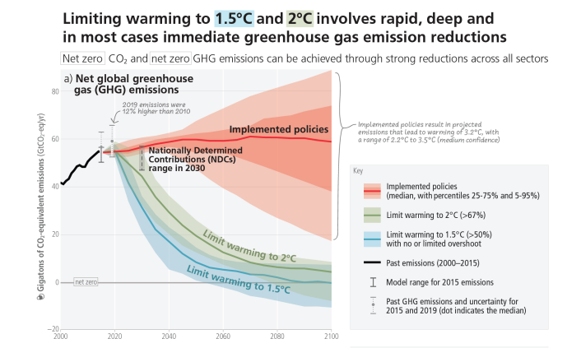
1. Climate emergency
2: FRAMING THE Recommendations
Waltham Forest have declared a climate emergency and have ambitious targets for decarbonisation.
The latest IPPC report shows the scale of the pace of decarbonisation required to meet temperature increase commitments e.g. the Paris Agreement and the inadequacy of current policies.
Currently around half of all emissions are from domestic use.
24% of the borough’s affordable housing would require retrofitting to achieve EPC Band C
£30m estimated cost of retrofitting existing affordable housing properties to achieve a band C EPC rating
£245m estimated cost to reach net zero in existing affordable housing stock by 2050

Slide 13
2. Widening inequality
2: FRAMING THE Recommendations
IMD, 2019
Ratio of household income at the 90th percentile to 10th percentile (after housing costs)
In addition to climate emergency, growing inequality is likely to be the defining challenge of the next decade and beyond.
Income inequality in London has been growing since 2015. The gap between the richest 10% and poorest 10% has been consistently double the rest of the country.
The evidence suggest that negative housing outcomes are disproportionately impacting ethnic minority communities in the borough.
This is also tenure-specific with typically worse outcomes for those in PRS and social rented accommodation.

Slide 14
3. Public finances
2: FRAMING THE Recommendations
Change in London Borough funding, spending power and expenditure, 2010-2019
Funding and delivery of additional affordable housing in England, 2015/16-2020/21
£4bn cut from core funding for local services in London between 2010 and 2020.
At the same time, London’s population has grown by around 900,000 people (11.2%) since 2010.
Social care is accounting for a higher proportion of spend leaving less money in real terms for other important statutory services.
As Session 2 demonstrated, affordable housing delivery has relied on a buoyant housing market to make schemes viable and maximise developer contributions.
Opportunities with institutional investors/patient capital who also need to demonstrate how funds are also helping to address people/planet challenges.
47%
by RPs
41%
by S106

Slide 15
Provocations for Recommendations
2: FRAMING THE Recommendations
How do we capitalise upon the positive evolution and rapid delivery of the last decade? Does this provide a mandate to innovate and work differently?
What is the 'business as usual' scenario?
Can we rely on the market to deliver what we need? If we can, how to we make this happen more quickly?
What are the specific outcomes upon which we need to focus to deliver change? Can these be measured? What is realistic in the current context?
How do we create recommendations which more explicitly respond to the twin challenge of rising inequality and climate emergency?
How do we use housing to deliver improved quality of life and experience within the borough?
What is the impact of national legislation? What needs to change?
What is our single biggest priority?

