Slide 1
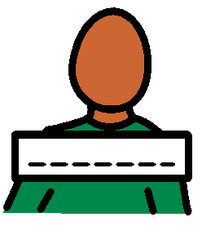
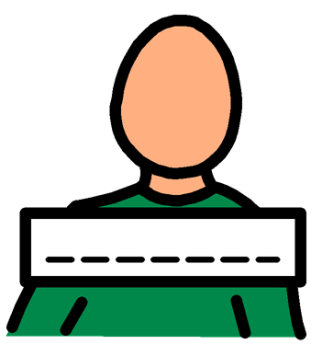
My name is …………………

Slide 2
I am going to see a Specialist Children’s Doctor. They are called Paediatricians.

Slide 3
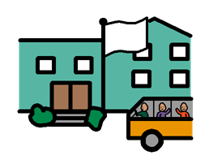
I am going to see a specialist doctor so that my family, my school and I understand more about how to help me with things I find tricky.

Slide 4
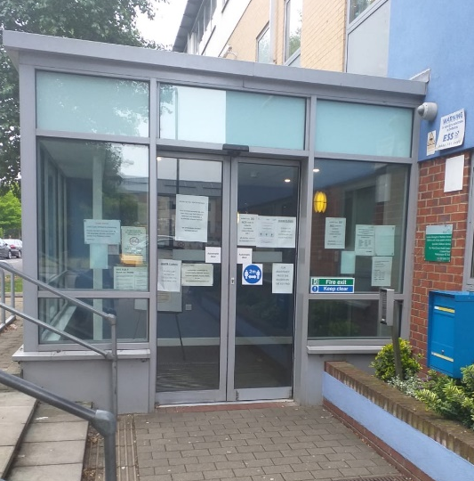
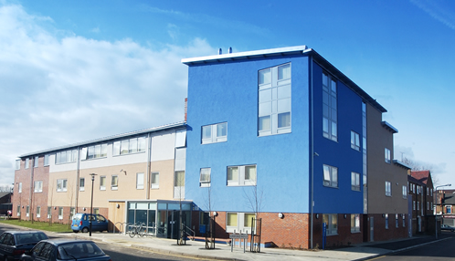
I will go to Wood Street Health Centre. The building looks like this:

Slide 5
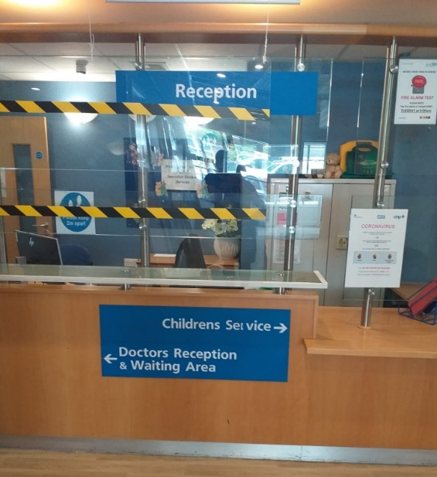
I will go to the reception area and let them know I am here to see the doctor.

Slide 6
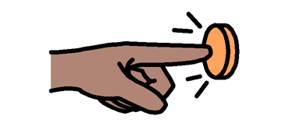
When I get to the door I need to press the green button.

Slide 7
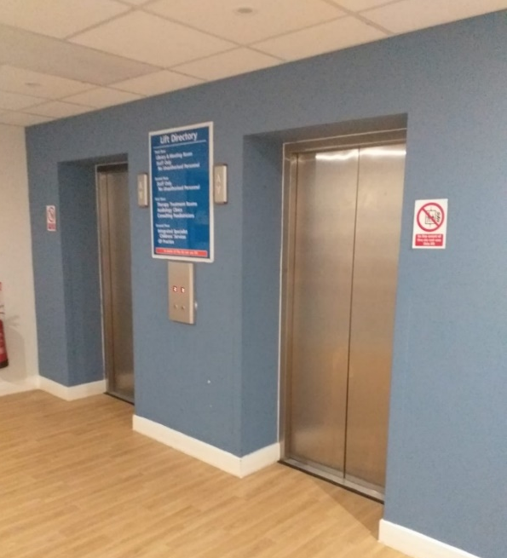
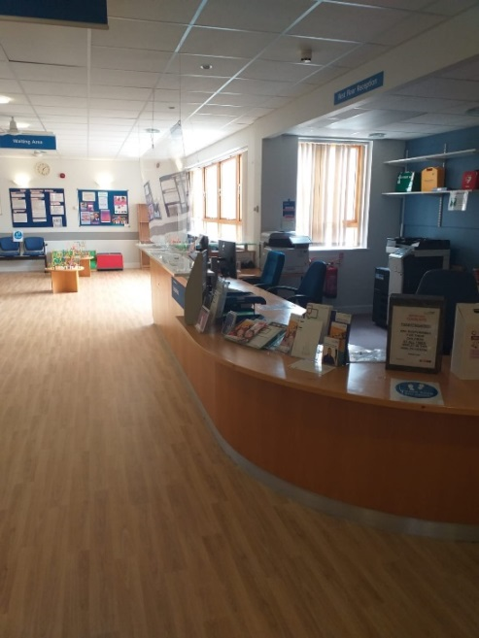
I can use the lift to go upstairs to the waiting area.

Slide 8
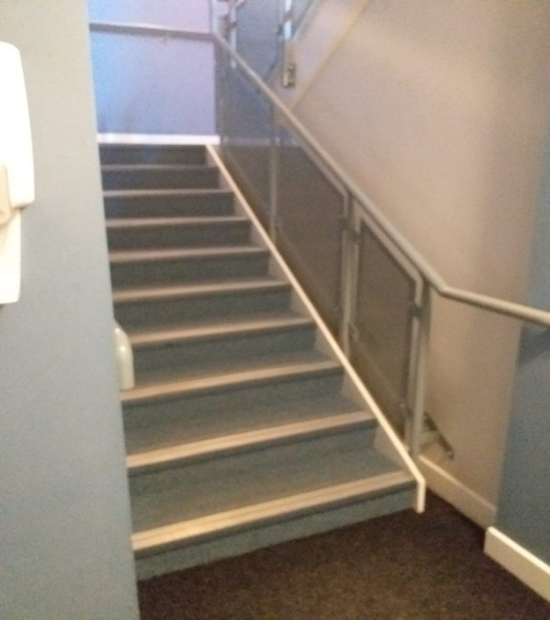
I can use the stairs too:

Slide 9
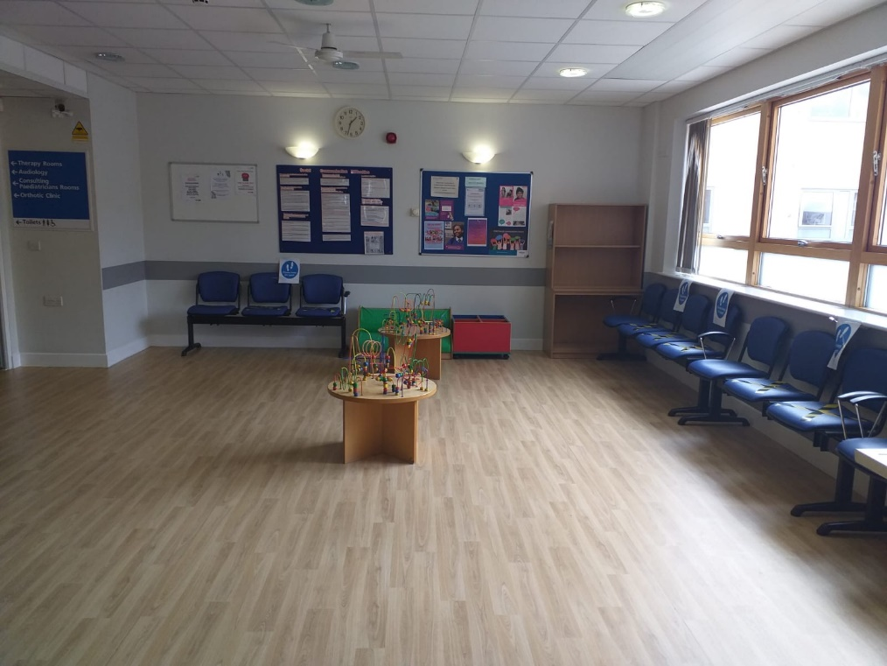
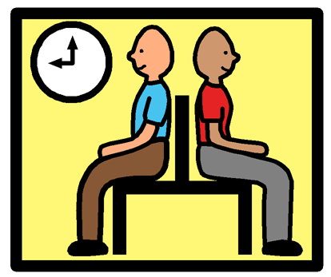
I will wait in the waiting room for my appointment. The waiting room looks like this:

Slide 10
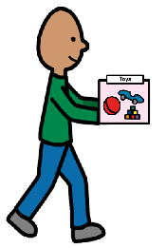
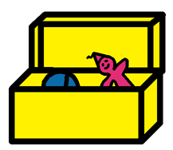
There are no toys in the waiting room as it has to be kept really clean and toys can get dirty, so I am going to bring something to do.

Slide 11
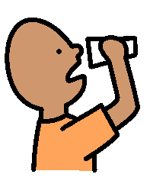
There is a water fountain where I can get water to drink. I have to be careful with the water. If it goes on the floor, the floor will become slippery!

Slide 12
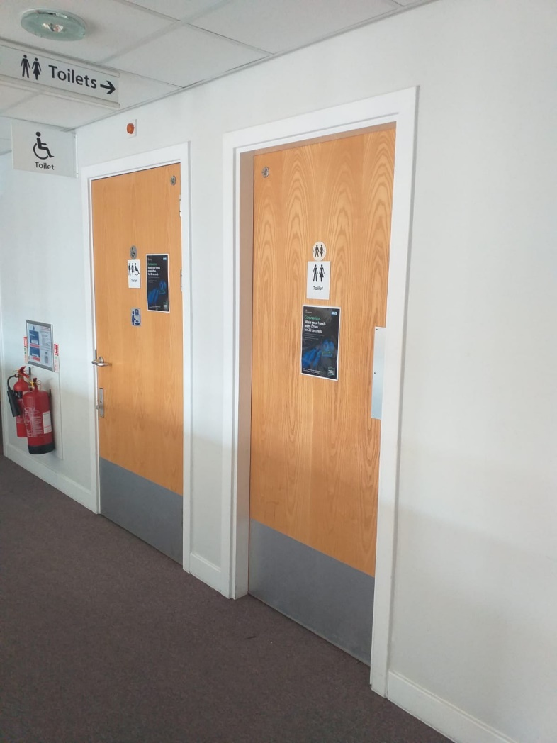
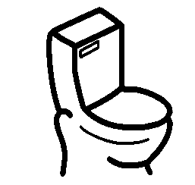
There are some toilets in the waiting room.

Slide 13
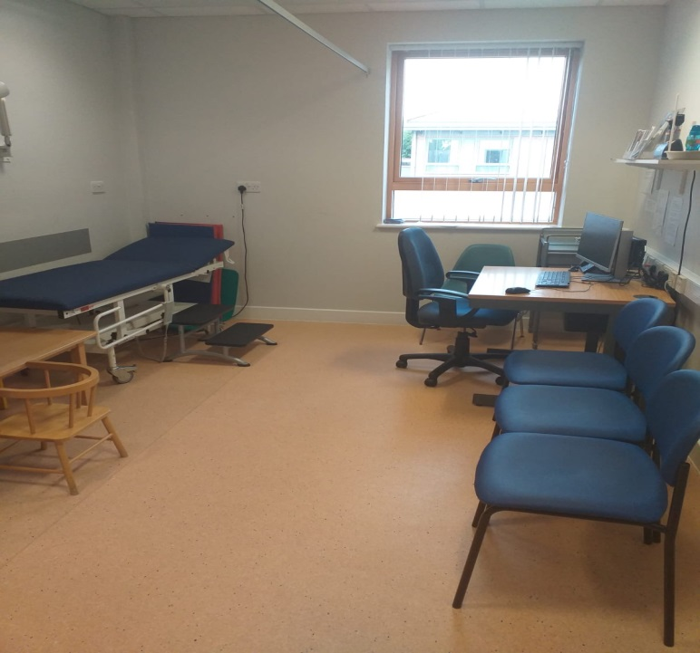
I will go with my grown up to see the doctor in a room that might look like this:

Slide 14
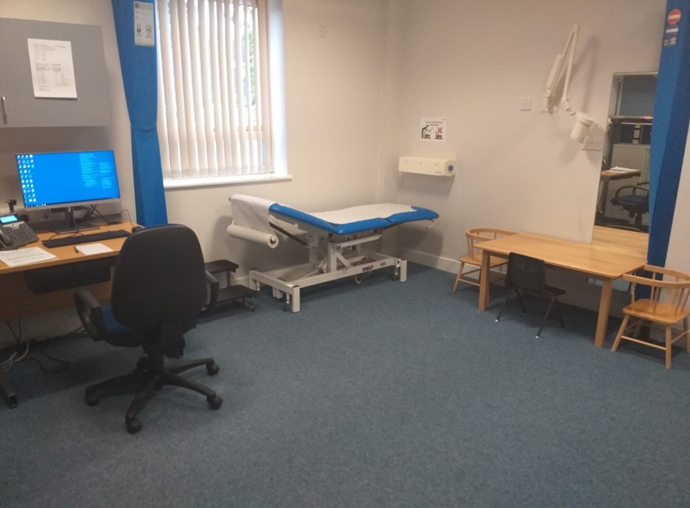
If I stay downstairs the room might look like this:

Slide 15
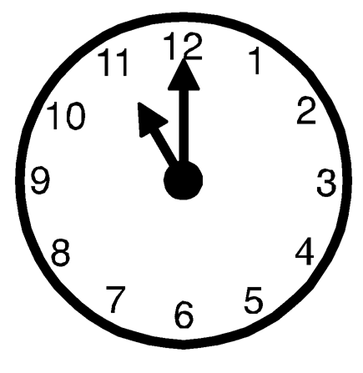
The appointment will last about an hour.
hour

Slide 16
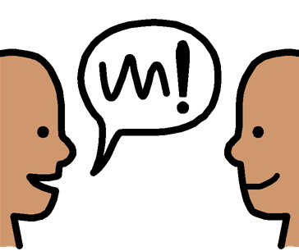
First the doctor will speak to the grown up. They will remember me from when I was growing up and will talk about when I sat up, walked and said my first words. Sometime they will talk about other things like what I like to eat, my sleeping, making friends or sometimes about going to the toilet!.

Slide 17
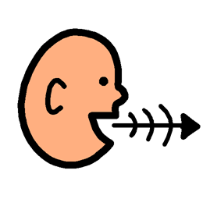
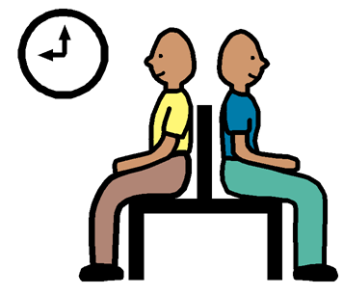
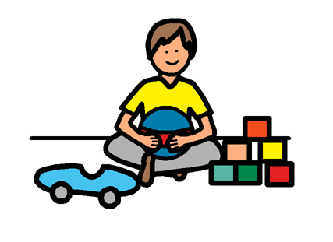
I can join in, but if I don’t want to talk about these things I can wait outside and carry on playing.

Slide 18
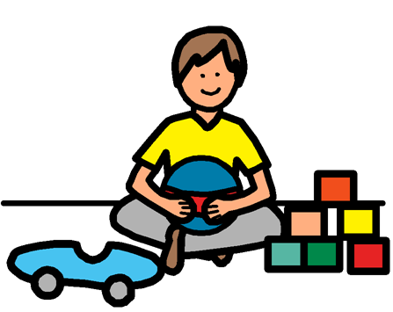
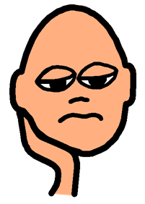
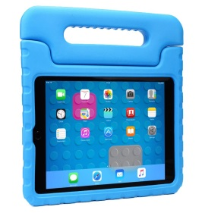
I might get bored when they are talking, so it is really important that I bring things to do…

Slide 19
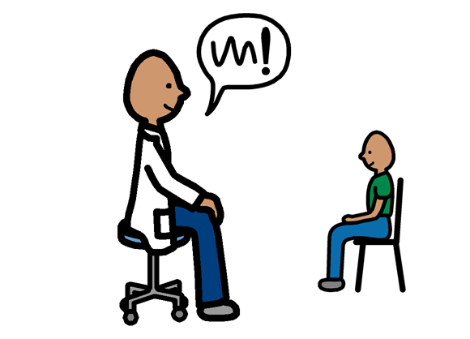
The doctor might want to talk to me too and ask about what I like to do and what is easy or hard for me.

Slide 20
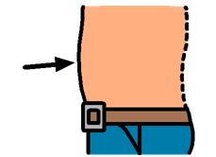
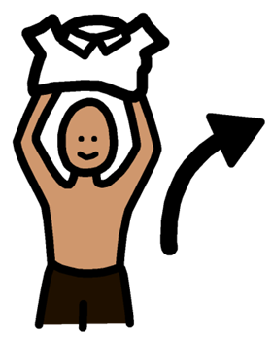
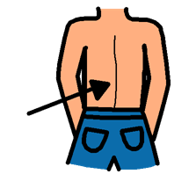
The doctor might want to examine me. This means that they might ask me to take off my top so they can see my back. They might press my stomach but it won’t hurt.

Slide 21
Sometimes the doctor will look at my knees - to do this I need to sit with my legs crossed like this:

Slide 22
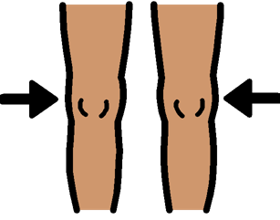
They will press my knee to see how bouncy it is! This won’t hurt either.

Slide 23
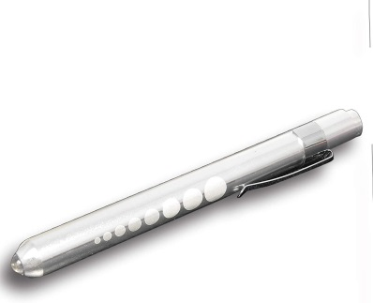
They might want to look in my eyes, ears or mouth. This means they get close to me and shine a light into my mouth.

Slide 24
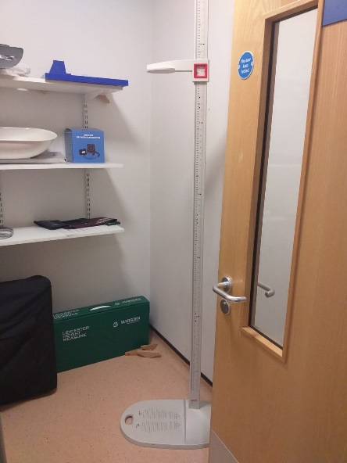
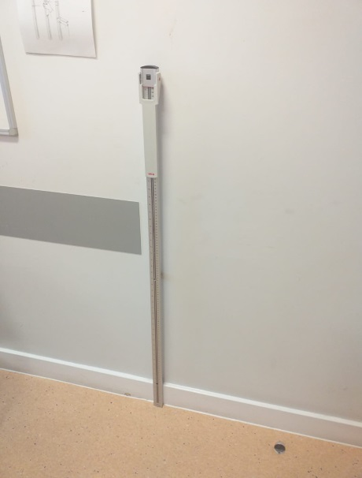
Sometimes the doctor will use a tape measure and measure my head or they might measure my height. This means that I need to stand against the measuring stands like these:

Slide 25
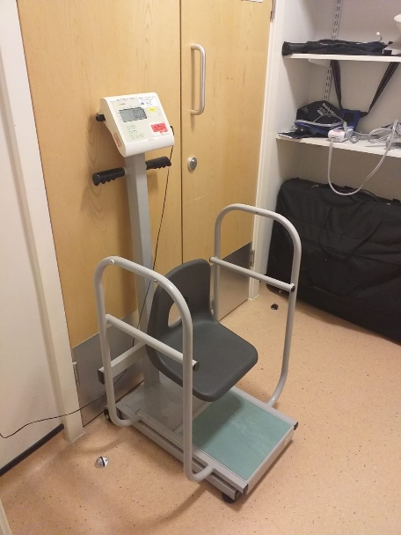
I might have to be weighed, this means I need to sit or stand on scales like this one:

Slide 26
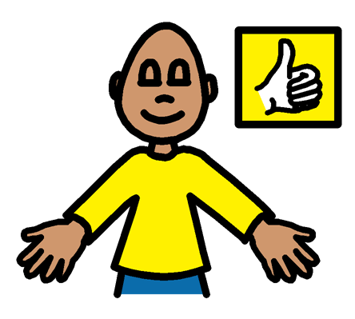
None of this will hurt me. But it helps my grown up understand what is hard for me.

Slide 27
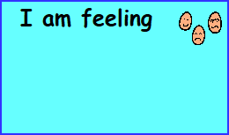
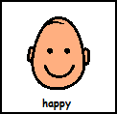
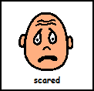
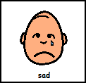
I might feel a bit scared about my appointment. It is okay to feel this way. We all get scared sometimes. My grown up will be with me the whole time.

Slide 28
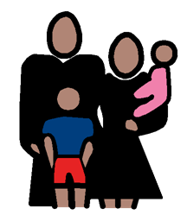
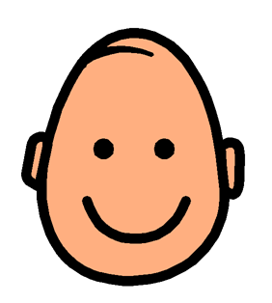
My grown up will be there to make sure that I am safe and well looked after.

Slide 29
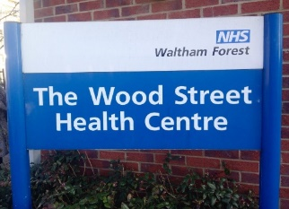
It will be okay to go to see the doctor at Wood Street Health Centre.

