Slide 1
INTRODUCTION
Barbara Jean –Low
Early Help Coordinator
Early Help Support

Slide 2
WHAT IS EARLY HELP
Early Help is made up of teams, services and partners in the Borough who work together to support children, young people and their families .
Age range for support - 0 to 19 and up to 25 with a disability.
The Early Help service works with professionals, parents and carers to intervene early in a child’s life and with families that need extra help.

Slide 3
AIM OF EARLY HELP
To intervene at the earliest opportunity in order to prevent issues escalating to the detriment of the family or child.
Early Help may be needed at any point in a child or young person’s life.
To support children or young people who may have emerging needs (needs not met by Universal Services).

Slide 4
Right Conversation, Right Action, Right Time
LO2: Describe the revised approach to levels of need
Good outcomes What are Emerging needs? Multiple needs
Good progress and achievement
Low engagement
in learning
Poor parental engagement or support for learning
Good attendance
Poor concentration and
low motivation
Parents do not support punctuality and attendance
Positive behaviour
Poor behaviour
Behaviour that parents find hard to manage
No barriers to learning
Child’s development
Families with multiple needs
Additional learning needs
Parenting capacity
Breakdown in family relationships
Family engaged in progress & achievement
Poor pro-social relationships
Family & environmental factors
No access to support for learning at home
Good physical health
Coming to the notice
of Police
Lack of exercise and poor diet
Good mental health and emotional wellbeing
Low self esteem or withdrawn
Being bullied in or out of school or setting
Age appropriate knowledge about risk
Lack of daily routines and structure at home
Notes:
Wall activity i.e emotional abuse, neglect etc.. And 15 break

Slide 5
Right Conversation, Right Action, Right Time
LO3: Outline the Think Family principles that inform work with families
Children and families whose needs can be supported by a single agency
Think Family
Principles
Level 1:
Emerging needs
Universal Plus
Children and families who require a multi-agency response
Level 2:
Multiple needs
Whole Family
Intervention
Think Family Principles inform our response at every level of need
Children and families who require a statutory or specialist response
Good
Outcomes
Level 3:
Complex needs
Statutory
Universal services and the community are involved at every level of need
Level 4:
Acute needs
Statutory / Specialist
If you think a child is at risk of harm, contact MASH
If you think the risk is immediate, call 999

Slide 6
TARGETED SUPPORT
Whole family Intervention
Early Help Family Practitioner
Behaviour, Attendance, Children Missing Education (BACME)
Functional Family Therapy (FFT)
Youth Offending Service (YOS)
Intensive Adolescent Support Team
Family Nurse Partnership

Slide 7
ASSESSMENT
Our Family Journey (OFJ) involves listening to you and your child to find out what your child's needs are and what is working well in your child's life.
The family practitioner will agree an action plan with you and your child, to make sure your child gets the right sort of help.

Slide 8
CONSENT
All support undertaken with Early Help is consent based.

Slide 9
SAFEGUARDING
Early Help is included within Safeguarding requirements.
We ensure problems do not escalate to become more acute to the detriment of children and families, by investing in effective community services and multi-agency coordination.

Slide 10
REFERRALS
Any professional can refer
Parents can self-refer
020 8496 5114 Or send an email to our
secure e-mail address: EarlyHelp EarlyHelp@walthamforest.gov.uk
All requests for Help & Support or Protection should be sent to MASHrequests@walthamforest.gov.uk
MASH: 0208 4962310

Slide 11
QUESTIONS
?

Slide 12
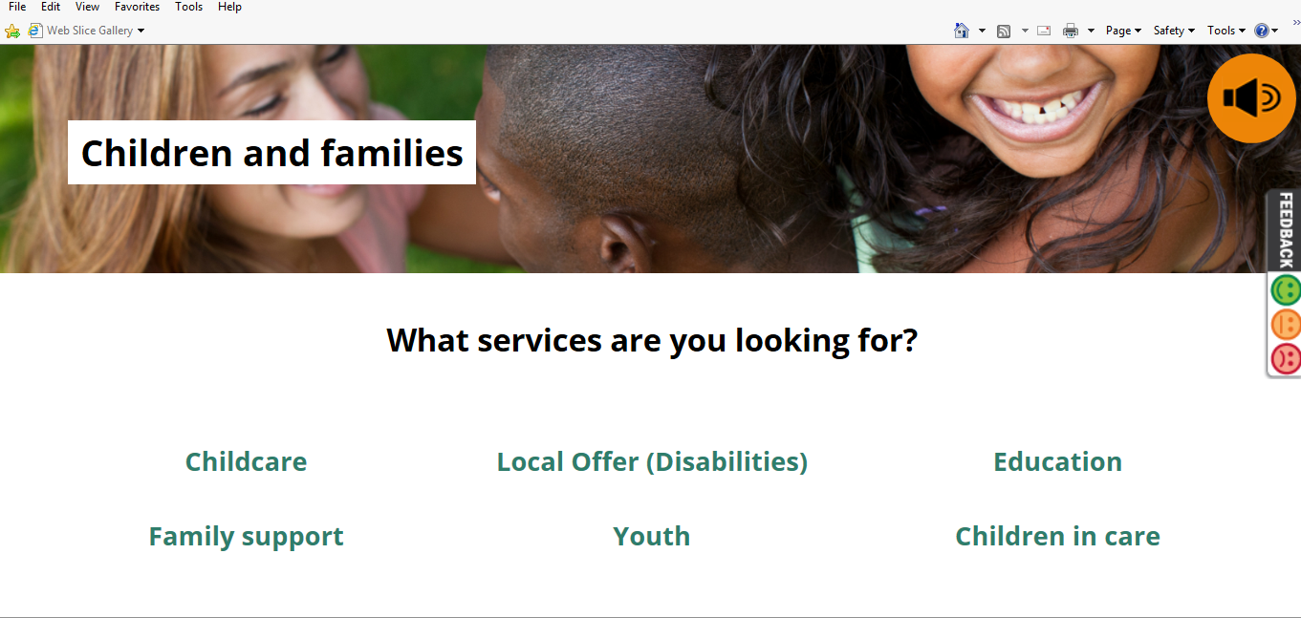
Right Conversation, Right Action, Right Time
LO9: support families to access information about services in the local area

