Slide 1
Home Energy Efficiency Training
Our Mission Is To
“Work with the community to make the homes of local people safe and healthy with affordable fuel bills and low carbon emissions”

Slide 2
Landlord’s Obligations around Energy Efficiency and Why it Matters
OBLIGATIONS
Tenant’s right to request improvements
Minimum Energy Efficiency Standards
Housing Health & Safety Rating System
WHY IT MATTERS
Climate Change
Health
Affordability

Slide 3
Climate Change
40% of carbon emissions in Waltham Forest come from homes - Most emissions relate to heat loss. - Need to insulate
Climate Commission - All homes in the borough have an EPC of C or above by 2030

Slide 4
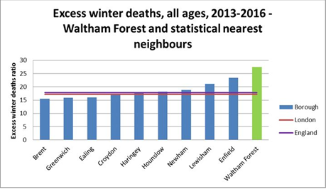
Health
“Cold Homes are a bigger killer in UK than road accidents, alcohol or drug abuse” – NEA
There are approximately 120 premature deaths each year in Waltham Forest that can be attributed to cold homes

Slide 5
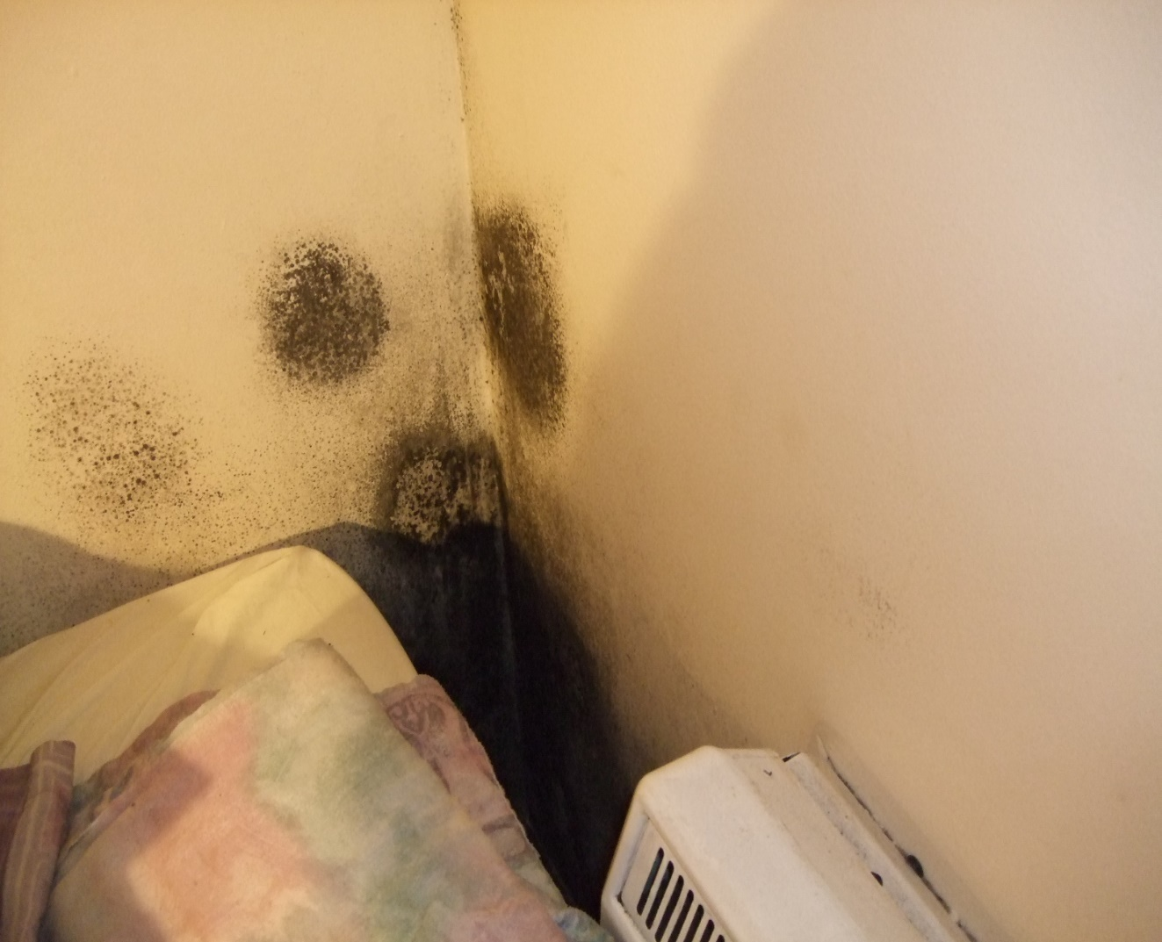
Respiratory Health Condensation and Mould
3% of English homes (604,000 homes)have a severe condensation problem.
8% of households living in relative poverty have a severe condensation problem. - 15% in private rented - 9% in social rented

Slide 6
Affordability
If you are low-income and live in a home that is energy inefficient you are likely to be spending 10 – 15% of your income on fuel.
They will struggle to pay for other essentials such as food
More likely to fall behind with rent.

Slide 7
Warm Homes Fund
Who is it for?
Waltham Forest residents living in homes without central heating (electric fires, storage heaters or gas fires).
Tenant must be low-income or have a long-term health condition
What is on offer?
Free gas connection if there isn’t one.
Installation of new central heating system

Slide 8
Green Homes Grant
Who is it for?
Any tenant living in an E, F or G rated property.
Any tenant that has a household income below £30,000/year
What is on offer?
Grant of up to £5,000 but landlord has to contribute 1/3rd towards cost of works.
Insulation measures – loft, wall, flat roof or underfloor insulation.
Heat pump or solar thermal
Please contact ServiceStore:
0208 496 5525
servicestore@wf-services.co.uk

Slide 9
Energy Company Obligation (ECO)
Who is it for?
Tenants that are in receipt of benefits or have a long-term health condition.
What is on offer?
Eco funding is available for a wide number of insulation and heating measures but funds available are not always for high.
Useful for loft insulation, cavity wall insulation and boiler replacements.

Slide 10
HEET
Who is it for?
Waltham Forest residents that are low-income, vulnerable or have a long-term health problem
What is on offer?
Small measures – draught proofing, radiator panels, LED lights.
Tariffs – support to lower fuel bills through switching and discounts.
Fuel debt – support with debt
Advice – on energy saving behaviours and tackling condensation.
Match funding – where there is a shortfall in fuds from ECO.

Slide 11
Contact
Tom Ruxton – Co-Ordinator
tom@theheetproject.org.uk
020 8520 1900
www.theheetproject.org.uk
c/o Trinity URC, 58 Orford Road, London E17 9QL

