Slide 1
Private Sector Housing & Licensing- Landlord forum
Public Service | Standing together in Waltham Forest

Slide 2
Housekeeping
Please put yourself on mute when not speaking. This will avoid background noise and feedback.
The meeting is being recorded. The recording may be made available online.
If you wish to ask a question in person please use the ‘raise hand’ function. (This is on the right of the tool bar in the centre of your screen). The Chair will then call on you to unmute, switch on your camera and ask your question in person.
If you wish to ask a question without using your microphone please use the ‘chat’ function. (This is on the far right of the tool bar in the centre of your screen). You can type your question there, please note all participants will be able to see the question.
Public Service | Standing together in Waltham Forest

Slide 3
Future Updates.
All Presentations given tonight will be available on the website within the next few days.
The website will be updated regularly over the next few months – it is advisable to check the website for any updates.
Newsletters will be sent out with any significant updates.
Public Service | Standing together in Waltham Forest

Slide 4
Agenda.
Licensing update
Presentation from Safer Renting – evictions during the pandemic
Trading Standards – Tenant Fees Act and MEES.
Presentation from HEET – Green Homes Grant
There will be time for a brief Q & A after each presentation.
Public Service | Standing together in Waltham Forest

Slide 5
Purpose of Licensing briefing.
Licensing update.
Inspections.
Licensing Conditions.
Joint Licence Holders.
Information for Landlords.
Recent court cases.
Public Service | Standing together in Waltham Forest

Slide 6
Licensing Update-applications received.
Additional HMO applications received – 788
Selective Licence applications received – 15292
Draft Licences issued (all types) – 5215
Final Licences issued (all types) – 4013
All HMO’s are inspected before any licence is issued.
Public Service | Standing together in Waltham Forest

Slide 7
Inspections.
Due to the lockdown inspections have been suspended. We continue to visit in emergencies.
This has led to a delay in processing HMO applications which need to be inspected before the licence has been issued.
A decision on when standard inspections can start again will be made when the roadmap out of the lockdown is announced in the 22nd February.
We have still continued to support tenants/landlords by completing virtual inspections where possible and viewing photographs, some visits still going ahead.
Officers wear PPE during the visit and will ask standard set of questions at the door with regards to symptoms or is self isolating/shielding.
Over 1000 inspections since April 2020 despite the three lockdowns.
Public Service | Standing together in Waltham Forest

Slide 8
Licence Conditions.
There are a number of conditions that any licence holder is bound by.
The conditions are different depending on the licence type.
Licence holders should read the conditions attached to the licence.
They can be viewed on the website https://www.walthamforest.gov.uk/content/property-licensing
I would like to draw your attention to the condition regarding management and conditions.-
Public Service | Standing together in Waltham Forest

Slide 9
Licence Conditions.
Managers’ responsibility for compliance with licence conditions
If the Licence Holder appoints a person to manage the house during the period of the licence, he or she must:
before or upon the manager’s appointment, obtain from the manager a written declaration identifying the licence conditions, above and below, if any, by which he or she agrees to be bound;
Ensure that the declaration includes:
A recital that the manager has read and understood the licence conditions;
A notice informing the manager that a failure to comply with the conditions may result in criminal and/or civil liability, including an unlimited fine or a financial penalty of up to £30,000 for each breach;
A notice that, if the manager requires advice about the conditions or any failure to comply with them, he or she should consult a Citizens Advice Bureau or a housing solicitor, before signing the declaration;
A recital that the manager understands the consequences of failing to comply with the licence conditions;
A recital that either (a) the manager agrees to be bound by all of the licence conditions, above and below, (b) the manager agrees to be bound by such of the conditions as the declaration specifies or (c) a recital that the manager does not agree to be bound by any of the licence conditions, above or below; and
In the case of (b) or (c) above, a statement that the person to whom the licence was granted alone is bound by the licence conditions;
Ensure that the aforementioned declaration is signed and dated by the appointed manager; and
Within 21 days of the manager’s appointment, ensure that the Authority is provided with a copy of the above declaration.
Public Service | Standing together in Waltham Forest

Slide 10
Joint Licence holders.
Joint licence holders is an option but not the norm.
Not always beneficial – any breach of conditions would result in both parties being prosecuted/fined
Housing Act states that the licence holder must be the most appropriate person. Does not state that this cannot be joint.
We would need to consider who the most appropriate person is.
Any requests for a joint licence holder needs to be made via email.
Wording will be clearer on the website and we are speaking to the developers with regards to the form and other boroughs requirements.
Public Service | Standing together in Waltham Forest

Slide 11
Information for landlords/tenants.
Reminder that a landlord guide is available on the website and is a really useful document. There is also one for tenants.
Fire fact sheet will be posted on the website within the next week, to assist with fire requirements depending on property type.
Public Service | Standing together in Waltham Forest

Slide 12
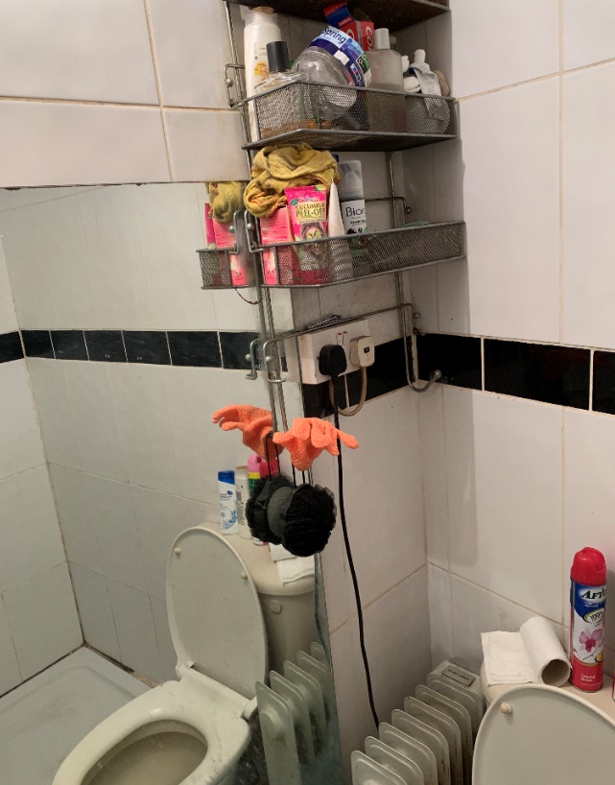
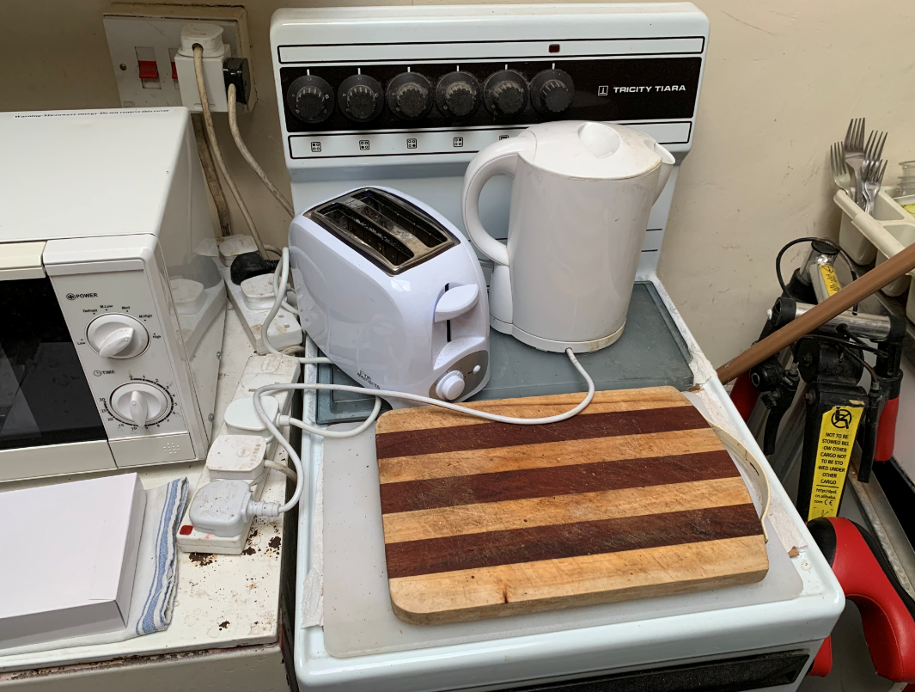
Recent Court Cases
Mr Bhatti – Leyton High Road, pleaded guilty to 12 charges. Including non- licensing, management regs breaches and failure to provide documents.
£82,139.51 total financial penalty
Mr Bhatti was given 6 months to pay in full. Collection order made.
Properties were extremely poor, with concerns over fire regs, worked in partnership with LFB.
Public Service | Standing together in Waltham Forest

Slide 13
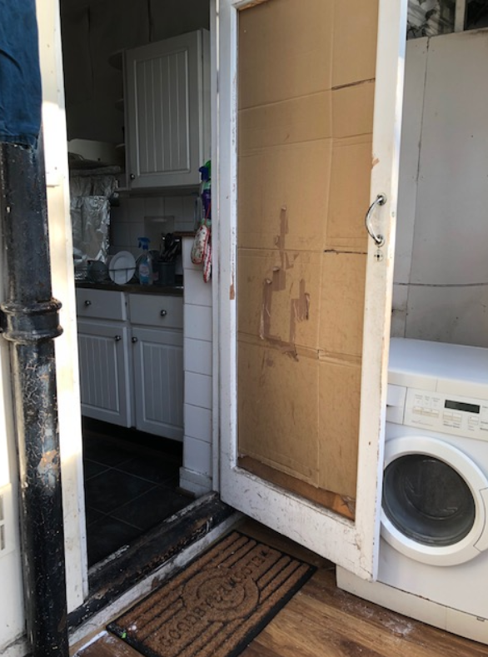
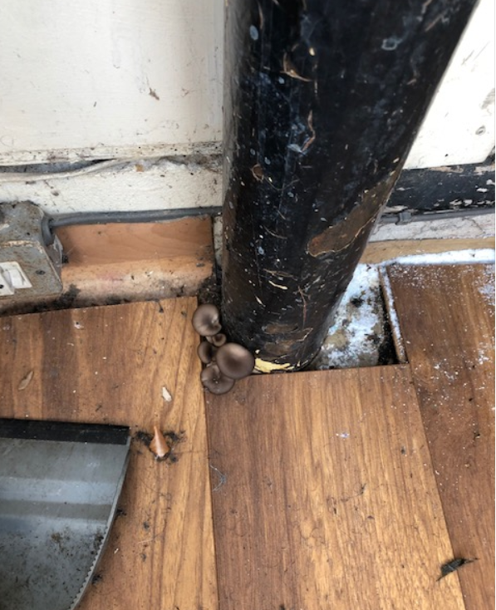
Recent Court Cases
Mr Seegolam pleaded guilty to all charges. Including failure to licence HMO properties. Properties were in severe disrepair as well as being unlicensed.
£63,556 total financial penalty
Mr Seegolam was given 3 months to pay in full.
Public Service | Standing together in Waltham Forest

Slide 14
Communication
We will continue to communicate with landlords in a variety of ways including the following:
Regular Landlord forums
E-newsletter
Website – regular updates.
Landlords must ensure that they keep up to date of legislation changes via the website/NRLA independent legal advice.
Public Service | Standing together in Waltham Forest

Slide 15
Contact us.
https://www.walthamforest.gov.uk/content/property-licensing
Propertylicensing@walthamforest.gov.uk
020 8496 4949
Public Service | Standing together in Waltham Forest

