Slide 1
Planning & HMOs 11 February 2020

Slide 2
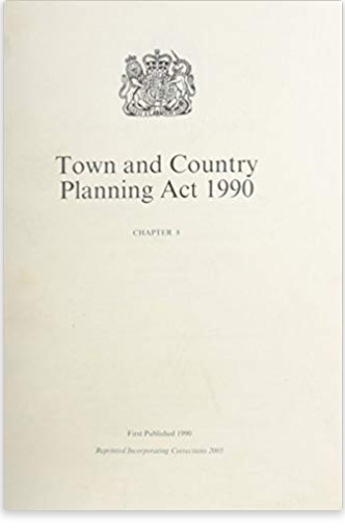
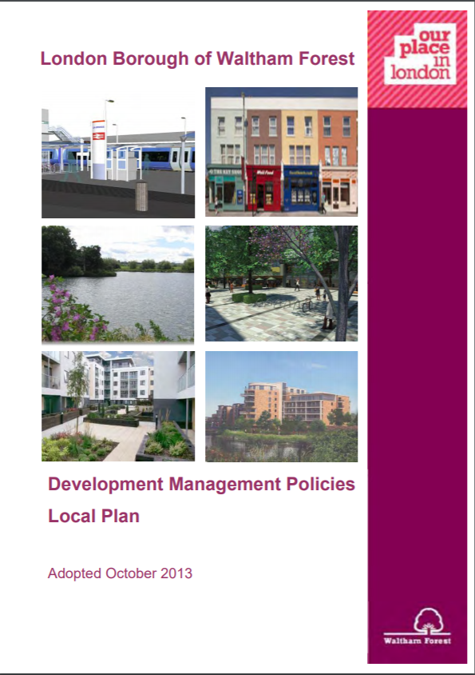
Planning & HMOs
The Use Classes Order
Waltham Forest Article 4 Direction
Planning applications for HMOs
Lawful Use Certificates for existing HMOs

Slide 3
Use Classes Order
C3 Dwellinghouse
C3(a) – use by a single person or family (as defined in Housing Act)
C3 (b) – Up to 6 people living together as single household and receiving care
C3 (c) up to 6 people living together as single household that don’t fall into C4 (e.g. small religious community, home owner + lodger)
C4 Small HMO – shared house occupied by 3 – 6 unrelated individuals sharing basic amenities
Large HMO (more than 6 unrelated people living together) = sui generis i.e. a class of its own

Slide 4
Waltham Forest Article 4 Direction
C4 Use Class introduced by Government in 2010 to address proliferation of HMOs, particularly in university towns
Change of use from C3 to C4 was ‘permitted development’
But Government gave opportunity to remove this where justified
Waltham Forest introduced an Article 4 Direction removing PD rights across whole borough, came into force 16th September 2014
Planning permission always required for change of use from C3 to C4 in Waltham Forest

Slide 5
Assessing planning applications for change of use to HMO
Policy DM6 of Council’s Development Management Development Plan Document
Council will not permit conversion to HMO where:
Gross original internal floor space < 124sqm
Within restricted conversion ward (wards south of Nth Circ)
Results in over concentration in one street
Appropriate parking cannot be provided off-street
We want to maintain the stock of small family houses
We are concerned about impacts of over concentration of HMOs

Slide 6
Assessing planning applications for change of use to HMO
If > 124sqm and in north of the Borough, will only be permitted where:
Meet minimum space standards for bedrooms and communal rooms
Is close to public transport, shops and services
Provides good refuse and storage facilities
Provides safe and secure cycle and car parking
Includes outdoor amenity space
We are currently consulting on new draft local plan
Removes restricted conversion wards
Sets minimum standards for HMOs
Due for adoption mid 2021

Slide 7
Existing HMO without planning permission?
Apply for a Lawful Development Certificate (£462)
Need to describe precisely what is being applied for
Operations are lawful if:
Does not involve development/require planning permission (e.g. is permitted development)
The time for enforcement has expired (i.e. in continuous use for 10 years) and there is no enforcement notice in force
Large HMOs will require evidence of continuous use for 10 years prior to date of application
Small HMOs will require evidence of continuous for four years prior to the date of application
Need to prove on balance of probability continuous use as HMO for specified number of people

Slide 8
Evidence required
Needs to be sufficiently precise and unambiguous
Onus is on applicant to provide this
Council can seek its own evidence – but must share this
Will depend on individual circumstances but examples include:
Signed and dated tenancy agreements
Electoral register, Council tax records, utility bills, meter installation, landlord insurance, gas safety checks, tax returns, bank statements showing rental payments, receipts for building works and building control certificates in association with the conversion, receipts for fixtures & fittings for kitchens, bathrooms, managing agents’ agreements, land registration
Sworn statements to corroborate the above
Likely to require a combination of evidence
Can appeal against refusal

