Slide 1
Welcome
Waltham Forest Adult Learning Service Apprenticeships

Slide 2
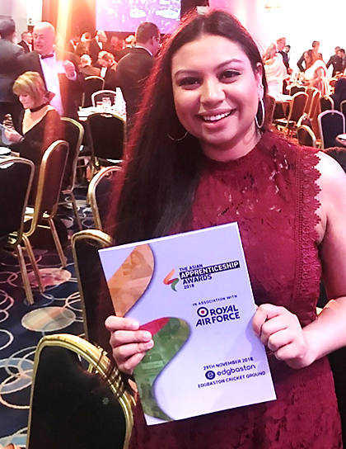
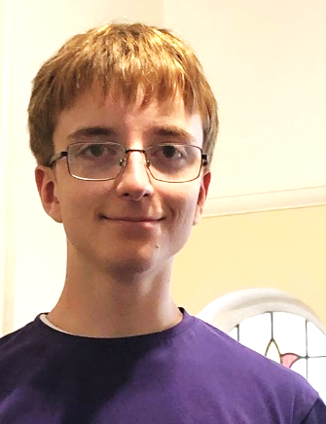
Why join our apprenticeship programme?
‘’I have been given incredible opportunities as part of my apprenticeship which have enhanced my professional and my personal development’’.
Rima Patel
‘’When I first started working as an Apprentice I was quite nervous and a bit introverted and didn’t have a lot of experience. I have found my experience working as a part of the council engaging and rewarding. I feel a great deal of joy from being able to provide customers with a high-quality customer service experience’’.
Jack Tew

Slide 3

Why join our apprenticeship programme?
‘I have learnt so much while undertaking the programme and I have been able to apply my knowledge to my everyday working role in Customer Service and Business Support
Patricia Rhyde
‘’My apprenticeship has been one of the best decisions I have made – it has been a great way to get my foot in the door and has given me the chance earn while studying.
William Giffin

Slide 4

What is an Apprenticeship?
Full time employment
Training to achieve apprenticeship certification and qualifications
Takes 14 – 24 months to complete (depends on level and type of apprenticeship)
Level 2 (GCSE) to level 7 (masters degree)
You get 20% of paid working hours dedicated for training
New apprentices starting salary £11, 000 up to £17,000
Training is free - employers fund training so no costly university fees

Slide 5
New Apprenticeship Standards
Skills, knowledge and behaviours
Designed by employers for each job role or industry
Include optional or mandatory qualifications
All apprenticeships require achievement of English and maths qualifications at level 1 or 2

Slide 6

How is an apprenticeship achieved?
All apprenticeships have different requirements depending on the type and level of the programme
Achievement of the programme will involve completion of some or all of the following:
A portfolio of evidence
Work based project
Assignments
Professional discussion and interview
Knowledge test
Timed assignments

Slide 7
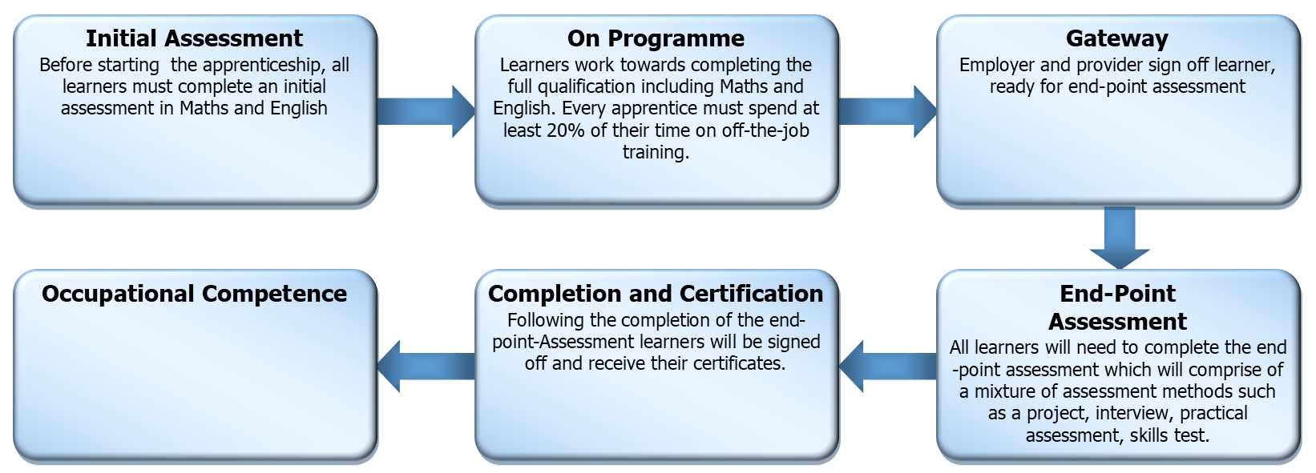
The Apprenticeship Standard Journey

Slide 8





Who do we work with?
Large employers within the public and private sector
Reputable, high quality employers
Employers who have been vetted – transparent, anti-discriminatory practices, proactive and committed to equality of opportunity for all
Employers who have the highest standards and are committed to the success of apprentices
Supportive employers who value apprentices

Slide 9

Covid Safe Recruitment & Training
Safe and supportive online recruitment
Weekly online recruitment sessions
Employer interviews online
All our training is delivered via TEAMs or ZOOM during Covid 19
Online coaching and check ins online with your Coach Assessor

Slide 10

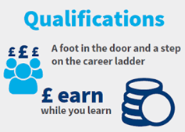
Benefits of Apprenticeships
You will learn relevant knowledge, skills and professional behaviours needed to succeed in your chosen career and or progress to higher education
Apprenticeships combine hands-on work with classroom learning (delivered virtually during Covid 19)
Apprenticeships are highly valued by employers giving you the edge in a competitive job market
Increase your salary potential

Slide 11

Who should apply for an apprenticeship?
We welcome applications from anyone aged
16 yrs (school leaver) and upwards - there is no upper age limit
Residents from all boroughs
Unemployed people ready for full time work
People looking for their first job who want training
Employed people looking for a career change or promotion

Slide 12
Quick Check Eligibility for Apprenticeship
To apply for apprenticeship you will need to be able to prove you meet the following criteria:
Proof of 3 yrs residency in EU
Must have a National Insurance Number
Level 2 maths and English for level 3, 4 or 5 apprenticeships Equivalent qualifications are: Functional skills level 2, CSE grade 1 , O’Level A-C, GCSE A-D or GCSE grade 4
Notes:
Keep this slide

Slide 13

We offer the following Level 2 – 5 Apprenticeships
Operational and Departmental Management
School Business Professional
Leadership and Management
Accountancy
Business Administration
Public Sector Service Delivery Officer
Higher Level Teaching Assistant
Teaching Assistant
Childcare and early years
Learning Mentor

Slide 14



Get in touch to find out more
Call or text ‘apprenticeship’ to 07740046122 or 07816132855
Email:
apprenticeships.als@walthamforest.gov.uk
Check website for apprenticeship jobs and other online courses
www.lbwfadultlearning.co.uk/

Slide 15
FAQ
Q1. Do I need my maths and English before I join the programme?
As part of the recruitment process, you will be required to provide evidence of your maths and English certificates.
Q2. Can an apprenticeship be done part -time?
An apprenticeship is a full time programme, the minimum number of hours you can do is 30, the maximum is 40 hours

Slide 16
FAQ continued…
Q3. What will the apprenticeship involve?
You will have fortnightly or monthly taught sessions, you will be assigned a coach assessor who will support you throughout the apprenticeship.
Q4 what are the benefits of doing apprenticeship?
Debt free alternative to university, Accelerated career progression, Increased salary potential, Networking with professional people, Excellent way to progress your career , Over 90% gain permanent employment.

Slide 17
Q5. What happens when I come to the end of my apprenticeship?
We will work with you to progress into employment, higher level apprenticeships or to apply to universities.
Q6. What support will I get?
We agree a programme plan with you, monitor your progress, support your achievement, provide mentoring and coaching for the duration of the programme.

