Slide 1
Top Ten Challenges Facing London Landlords October 2020
Richard Blanco – NRLA Representative

Slide 2
1. Avoid The Courts
Courts Re-opened on 21 September 2020
Must use the court to evict legally
Reactivation Notice
Prioritisation of cases
6 month notice period
Special Christmas Arrangements
BUT…. Expect 12 month process for court action
Restricted use of some venues because of social distancing
Backlog of old cases and increase in new cases
So instead of going to court, work with your tenant if you possibly can….

Slide 3
Pre-action Plan for rent disputes
Developed by the NRLA and agreed with MHCLG. Voluntary, but landlords are encouraged to follow: https://www.nrla.org.uk/resources/ending-your-tenancy/pre-action-plan-avoiding-possession-claims
Includes nine ‘golden rules’:
Communicate with the tenant
Establish whether the tenant is vulnerable
Signpost to organisations who can support and advise the tenant
Agree an affordable repayment plan
Be clear by providing quarterly rent statements showing any temporary changes
Consent from the tenant for direct payment of housing element of benefits
Guarantors should be involved in discussions
Mediate if you can not agree
Record all contact with the tenant
Notes:
The Pre-Action Plan relates to best practices pre-action and managing rent arrears disputes to avoid needing to take possession action if possible. This list was agreed with MHCLG – it contains some suggestions members may not like (communicating and working with tenants who aren’t paying rent, links to Citizens advice/Shelter).
This is just guidance and so they don’t have to follow it, and indeed even where they try to some tenant’s might be completely unworkable. They should still definitely refer to the reactivation notice page to ensure that when they do take possession action against the tenant they do it in the correct legal way.

Slide 4
2. Hone Your People Management Skills
Stay in touch with your tenant
Know when to phone or meet up with them
Ask Open Questions
Listening Skills
Manage arrears clearly & firmly
10 days arrears is serious
Agree clear objectives
Assist with benefits

Slide 5
3. Covid Safe Procedures
Viewings & Maintenance Visits
Masks, gloves & 2m Social Distancing
Virtual viewings or one household
Tenants wait outside or in one room
Clean or avoid door handles/surfaces
Be sensitive to vulnerability
Self-isolating – stay in one room (or visit after isolation period)
Keep records if gas or electrical safety visits not possible
Flexibility around start or move in dates

Slide 6
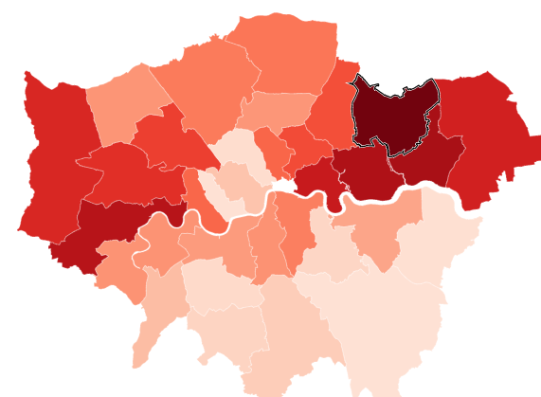
4. Covid Rising
Covid cases in London have doubled in last week
Waltham Forest has 86 per 100,000
100 is seen as threshold for possible increased restrictions
Impact on tenants – especially if in affected sectors
Job Support Scheme – Up to 77% of pay from 1 November 2020
Self Employed Help – 20% until 30 April 2020
But UC back down by £1k from April 2021
Spread tax and VAT over 12 months
BBLs extended to 10 years

Slide 7
5. The Looming Recession
Sectors that are benefitting: tech, supermarkets
Sectors suffering: hospitality, leisure, arts, travel
Cliff Edges
31 October: End of Furlough Scheme
31 December: End Of EU Transition Period
31 March: Stamp Duty Holiday
4.1% unemployment expected to rise
Best scenario peak at 9.2%, back down to pre Covid levels in 2022
Worst scenario peak at 13.7% back down to 6.3% in 2024 (OBR)
GDP fall of 20% in Q2
Shape of the recovery – V, U, L or Nike Swoosh

Slide 8
6. When To Buy, When To Sell?
End of housing cycle next year – it will be 13 years since 2008 crash
Up 7.3% nationally (Halifax), Up 3.4% to June/4.2% in London (ONS)
Rents up 1.3% to Aug 2020 in London
Sales up 27% in London according to Zoopla
125% jump in sales within a week compared to last year (Rightmove)
Mortgage applications at 12 year high
Has been a great time to sell
Are buyers getting cold feet?

Slide 9
7. Mortgage Market & Remortgaging
Restrictions
Lenders increasing rates to curb demand
Range of products paired right back
90% LTV products withdrawn
Remortgaging
Backlog and delays
Expect cautious valuation
Good rates for low LTVs, 2 & 5 year fixes
For capital raising – likely to require 5 year fix or specialist lender
An experienced broker can help

Slide 10
8. Manage Your Cashflow
Challenges
Possible Tenant Arrears
Unexpected Repairs – e.g electrical safety (deadline 1 April 2021)
Plan Ahead
Have separate pots of money
Spread Tax & VAT payments (12 months next year)
Bounce Back Loans
25% of turnover up to max £50,000
Interest free for 1 year, then 2.5% up to 10 years in total
Deadline extended to 30 November 2020

Slide 11
9. The Complexity Of Licensing
Understand Licensing Landscape
Selective, Additional & Mandatory Schemes (23 London boroughs)
Article 4 Directions may require planning permission (11 boroughs)
LACORs fire safety regulations
Your team of contractors
Processing can take up to 2 years
2004 Housing Act – 5 year blocks
London Property Licensing website

Slide 12
10. Possession Reform
Renters Reform Bill
Will abolish no fault eviction (section 21) – lifelong tenancies
Timescale as yet unknown (2022?)
Will not affect existing tenancy agreements
Keys issues will be
Redrafting of grounds in section 8 (sell, move in, refurbish, accelerated)
Modernisation of courts system
Main challenges for landlords
Choose new tenants very carefully
Record keeping especially around repairs and compliance

Slide 13
Podcast, Webinars & NRLA Membership
Listen to NLA Podcast & Watch Webinars
Google ‘NLA Podcast Apple’ (or soundcloud)
Google ‘Inside Property’ for legacy editions
Webinar recordings at www.nrla.org.uk
Join The NRLA
Google ‘Join the NRLA’
£75 per year by direct debit
Discount code – R59 (becomes £65)

Slide 14
NRLA Advice Line 0300 131 6400 Your NRLA London Reps
Richard Blanco NRLA London Representative (East & North East)
Yvonne Baisden NRLA London Representative (West & North West)
Karen Gregory NRLA London Representative (South London)

