Slide 1
Private Sector Housing & Licensing Landlord Forum
Julia Morris
Date: 5th October 2021

Slide 2
Housekeeping
Please put yourself on mute when not speaking. This will avoid background noise and feedback.
All cameras should be off unless presenting.
The meeting is being recorded. The recording may be made available online.
If you wish to ask a question in person please use the ‘raise hand’ function. (This is on the right of the tool bar in the centre of your screen). The Chair will then call on you to unmute, switch on your camera and ask your question in person.
If you wish to ask a question without using your microphone please use the ‘chat’ function. (This is on the far right of the tool bar in the centre of your screen). You can type your question there, please note all participants will be able to see the question.

Slide 3
Agenda
Licensing update
Ben Reeve - Lewis, Safer Renting - Presentation on Rent to Rent
Richard Blanco, NRLA – Regulatory Update
James McHugh, LBWF – Eco Show Home – Green Homes
There will be time for a Q & A after each presentation. Please wait until the end of the presentation before raising your hand. Any questions should be general and not specific to your individual application/property

Slide 4
Update on licensing
Applications Received to date
Selective Applications – 18483
Additional HMO – 972
Mandatory HMO - 489
Whilst we have applications outstanding we are working hard to determine licences.
All HMO’s are required to be inspected prior to the licence being issued.
We are striving to find new ways of working to improve our standards.
You can help us by ensuring all applications are complete with correct information and the gas certificate is provided.

Slide 5
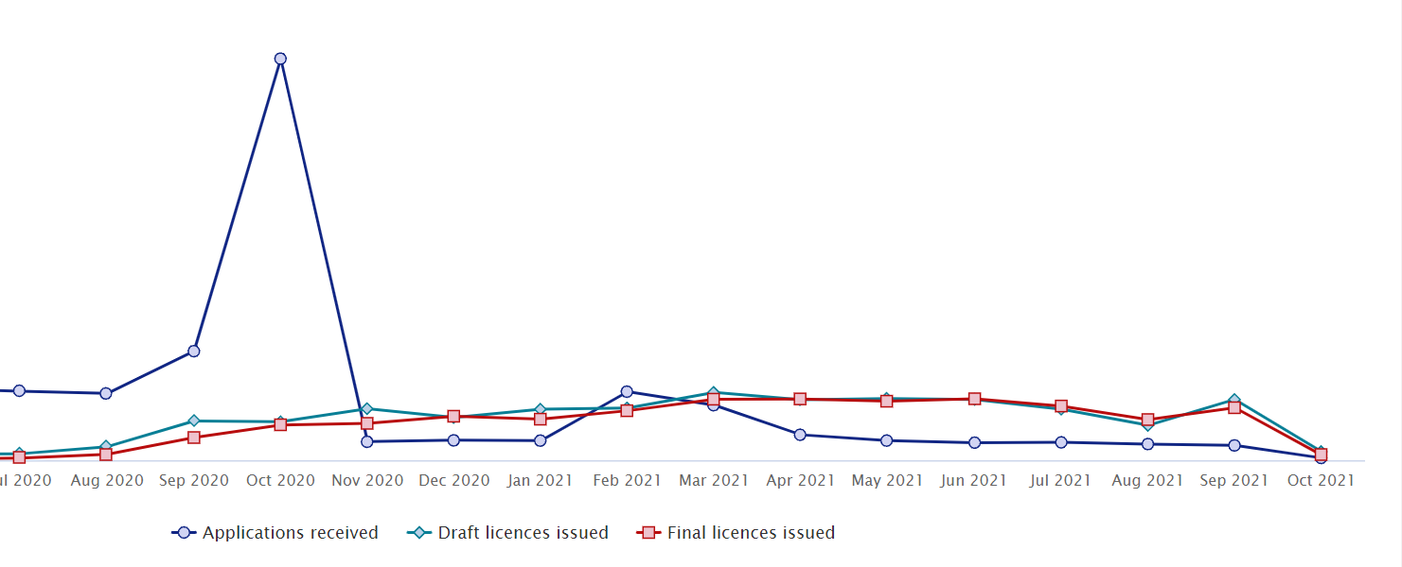
Update on licensing

Slide 6
Update on licensing
The previous slide demonstrates the level of applications being made and the number of licences issued month by month.
In real terms we need to determine more licences per month than applications that we receive, to be able to clear all outstanding applications.
The figures for the last 6 months suggest that we are well on the way of achieving this.
Total applications received -2042
Total Licences issued - 6031

Slide 7
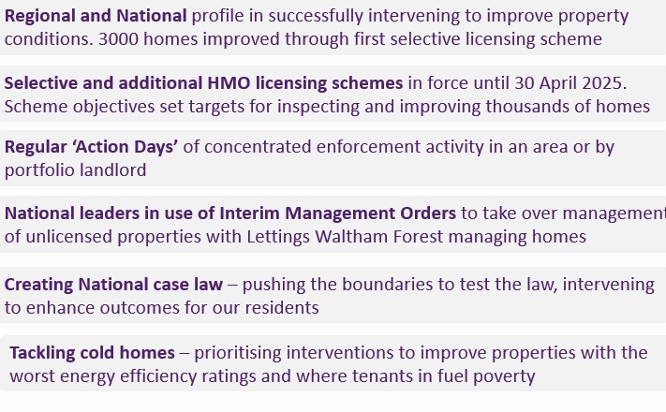
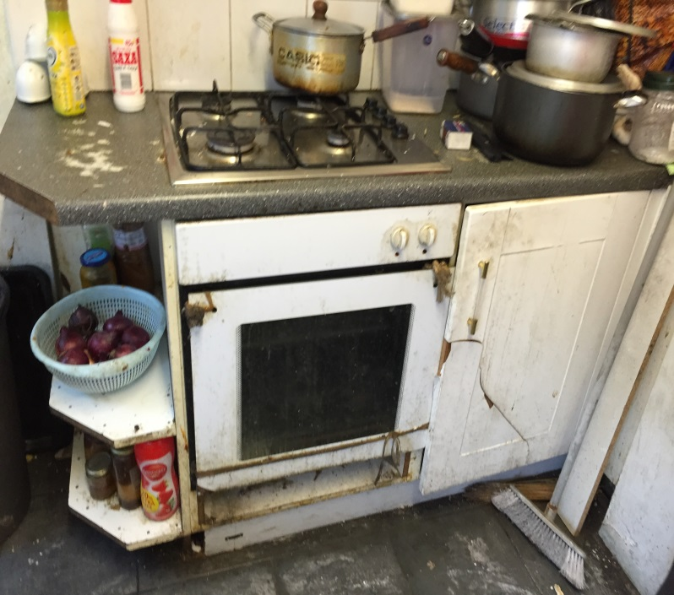
Key achievements and targets
Private Sector Housing & Licensing – Regulation of property condition and management standards in privately rented homes through enforcement and operation of flagship property licensing schemes. Empty properties brought back into use. Enforcement role in RP-owned properties if required.

Slide 8
Enforcement
Whilst we always strive to work with landlords to improve
property standards and reduce ASB, sometimes Enforcement
action is required.
The following options are available to us
Prosecution
Financial Penalty
Notices
Interim Management Orders
Financial Management Orders

Slide 9
Enforcement – landmark hearing
After a five-year case, last week a landlord was hit with a
fine of nearly £190k for a “rent to rent” scam in a landmark
ruling.
The pair of landlords who ran rent-to-rent scams across
Waltham Forest were sentenced at Wimbledon Magistrates
Court after a five-year legal battle including two judicial
Reviews.
The fines – among the largest in the country – were imposed
Following a four-day trial in April. The defendants were found
Guilty of eight counts of failing to licence six HMO’s.
The defendants claimed that the properties were let out to
Single family households, in fact each was let as a HMO with
Between 8 and 16 individuals via a network of letting agents.

Slide 10
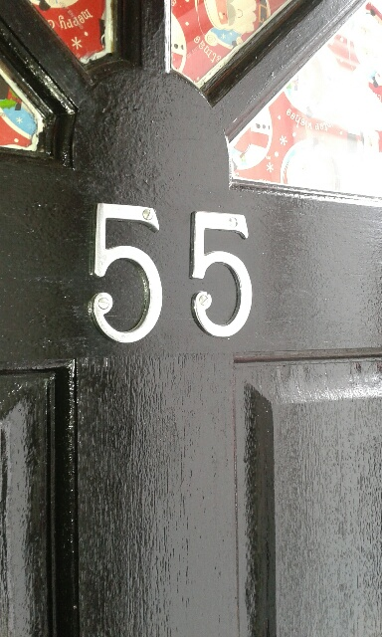
Enforcement – landmark hearing
The case demonstrates the Council’s commitment and determination to pursue serious
Breaches of the law, we will do whatever it takes to protect the heath, safety and welfare of our residents, many of which live in the private rented sector.
This was a really difficult case to pull together and one that was helped by our large scale property licensing scheme, which highlighted the wrong-doing and without it we may never have got the successful conclusion that has been reached.
The Government introduced the mandatory licensing of HMOs as it recognised the increased risks to tenants. By not applying to licence the property as an HMO, the landlords avoided the scrutiny and safeguards provided by the licensing regime.

Slide 11
Future updates
All Presentations given tonight will be available on the website within the next few days.
The website will be updated regularly over the next few months – it is advisable to check the website for any updates.
Newsletters will be sent out with any significant updates.
We want your ideas for next Landlord Forums – topics to be discussed.

Slide 12
Contact us
https://www.walthamforest.gov.uk/content/property-licensing
Propertylicensing@walthamforest.gov.uk
020 8496 4949

