Slide 1
Regulatory Briefing
Richard Blanco – NRLA London Representative

Slide 2
Impact Of Evictions Moratorium
Enforcement ban on evictions ended on 1 June 2021
Notice periods 4 months, tapering to pre-Covid by 30 Sep
Notice Periods in England Back To Pre-Covid 1 Oct 2021
Still 6 months in Wales, 3 months in Northern Ireland
800,000 in private sector housing built up arrears since March 2020
82% not in rent arrears prior to lockdown
StepChange says 200,000 have serious arrears
NRLA research suggests landlords & tenants negotiating
Courts process is taking 6-7 months
Shortage of judges and bailiffs

Slide 3
Rental Reform White Paper
Despite no specific mention of a Renters’ Reform Bill in this session, Government committed to:
Publishing consultation response on abolishing Section 21
Outlining proposals for a new ‘lifetime’ tenancy deposit
Publishing a White Paper in the autumn, detailing the reform package, including mandatory redress
Bring forward reforms to drive improvements in standards – mention of Register
Notes:
From our conversations with MHCLG there is now no expectation that the Renters’ Reform Bill will be introduced in the next parliamentary session, which is good news as it suggests the government is taking the approach that they need to scrutinise and consider the proposals thoroughly. The government is now expected to begin further consultation in the summer with stakeholders with focuses on specific functions of the bill, which naturally we will engage heavily with.
We await the consultation response and the White Paper to detail the government’s published approach and the firmer specifics of the proposals.
The government have re-affirmed their commitment to landlord membership of redress schemes and stated they will explore mandatory landlord registration.
You can read our response here: https://www.nrla.org.uk/news/government-must-use-time-to-get-rental-reform-right-for-landlords-and-tenants

Slide 4
What Might The Renters Reform Bill Mean For You?
Review your use of section 21 in the past
How do you need to adapt your business going forward
Tenant selection will be key
Certain tenant groups could suffer – e.g. on benefits
Implications for student sector is unknown & of concern
It will be the last straw for some and could mean a smaller PRS

Slide 5
Minimum Energy Efficiency Standards
Energy Efficiency
Consultation ended 30 Dec 2020
Min EPC = C by April 2025 new tenancies
April 2028 existing tenancies
Cost cap of £10k, 10% exemptions expected
67% of PRS properties are D or lower
Review your EPCS & make a plan
Take advantage of grants
May be ‘fabric first’ or targeted at low income households

Slide 6
Building Safety Bill
Developers must join New Homes Ombudsman Scheme
Residents to have more say in management of buildings
Building owners responsible for managing safety risks for lifetime of property
Criminal sanctions
Building Safety Regulator
6 to 15 years to claim compensation for substandard work, applies retrospectively
National Regulator For Construction Products

Slide 7
Other Bills In This Parliament
New DLUHC (replaced MHCLG)
New Secretary of State, Michael Gove
Planning Bill
On hold
Leasehold Reform (Ground Rents) Bill
Universal Credit returning to pre Covid Level
£20 per week lower

Slide 8
Right To Rent
Temporary Adjustments extended again to 5 April 2022
Scan by email and video contact, follow up checks not now required
From 1 July 2021 – Permanent right to rent
EU countries provide residence card or evidence of settled status
Other EEA/Swiss nationals provide residence card
Online portal to prove settled status. Not required for Irish nationals.
Temporary Right To Rent (12 months)
EEA/Swiss nationals provide passport and proof of entry in last 12 months
Government’s Landlord Checking Service

Slide 9
Reasons To Be Cheerful…
Strongest economic recovery in G7
Mortgage interest rates at the lowest ever and availability is good
Rental demand is picking up – 39% report increased demand
Return of international students
No obvious Brexit impact
Migrants from Afghanistan & Hong Kong
House Prices still rising, sales market buoyant
8% (13.2%) across UK, 2.2% (6.3%) in London: 12mths to July 2021
Down 3.7% in last month

Slide 10
Clouds On The Horizon…
Increasing Regulation & Abolition of Section 21
Burdens/Restrictions of Licensing & Articles 4s in East London
Cost of new measures
Professional, compliant landlords
well placed to absorb business from exiting smaller landlords
Renters Reform Bill Uncertainty
Abolition of no fault eviction
Although Register has been hinted at
Planning Reform Uncertainty

Slide 11
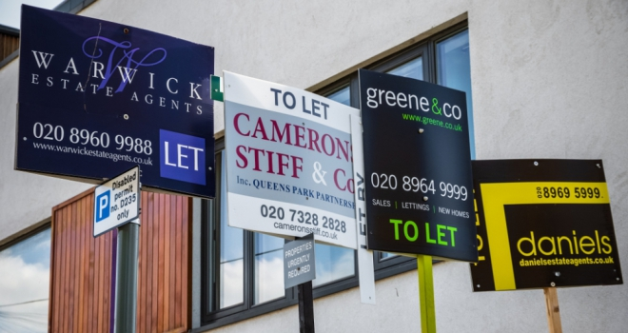
Buy, Sell or Hold
Landlord Optimism in Own Business
Dip from 44 to 41 (was in 50s and 60s)
14% expand, 20% reduce
Reasons To Buy
Low cost of borrowing
Improving rental market
Reasons To Hold
Smaller, more professional community?
Rental yields and capital growth are positive
Reasons To Sell
Is the market peaking?
Regulation, Tax, Possession Reform

Slide 12
Podcast & NRLA Membership
Listen to NRLA Podcast
Listen Up Landlords
Google NLA Podcast Apple (or soundcloud)
Google Inside Property for legacy editions
Join The NRLA
Google Join the NRLA
£75 per year by direct debit
Discount code – R59
Advice Line 0300 141 6400

