Slide 1
Eco Show Home & Support to Retrofit
James McHugh
Landlords Forum
5 October 2021

Slide 2
Overview
Waltham Forest Housing Service has recently improved a Victorian 4-bed end terrace property with an EPC rating of “E” into an "A". The improvements to the property reduced fuel bills by over two thirds, introduced a heating system entirely powered by solar power and an air source heat pump.
The purpose of this scheme is to demonstrate the “menu of works” a homeowner may consider when retrofitting a property. It displays the various works and has information on costs and estimated energy/fuel bill savings.
This is particularly vital as carbon emissions from homes account for over 50% of emissions locally. Waltham Forest Council has committed to achieve net zero carbon emissions by 2030.

Slide 3
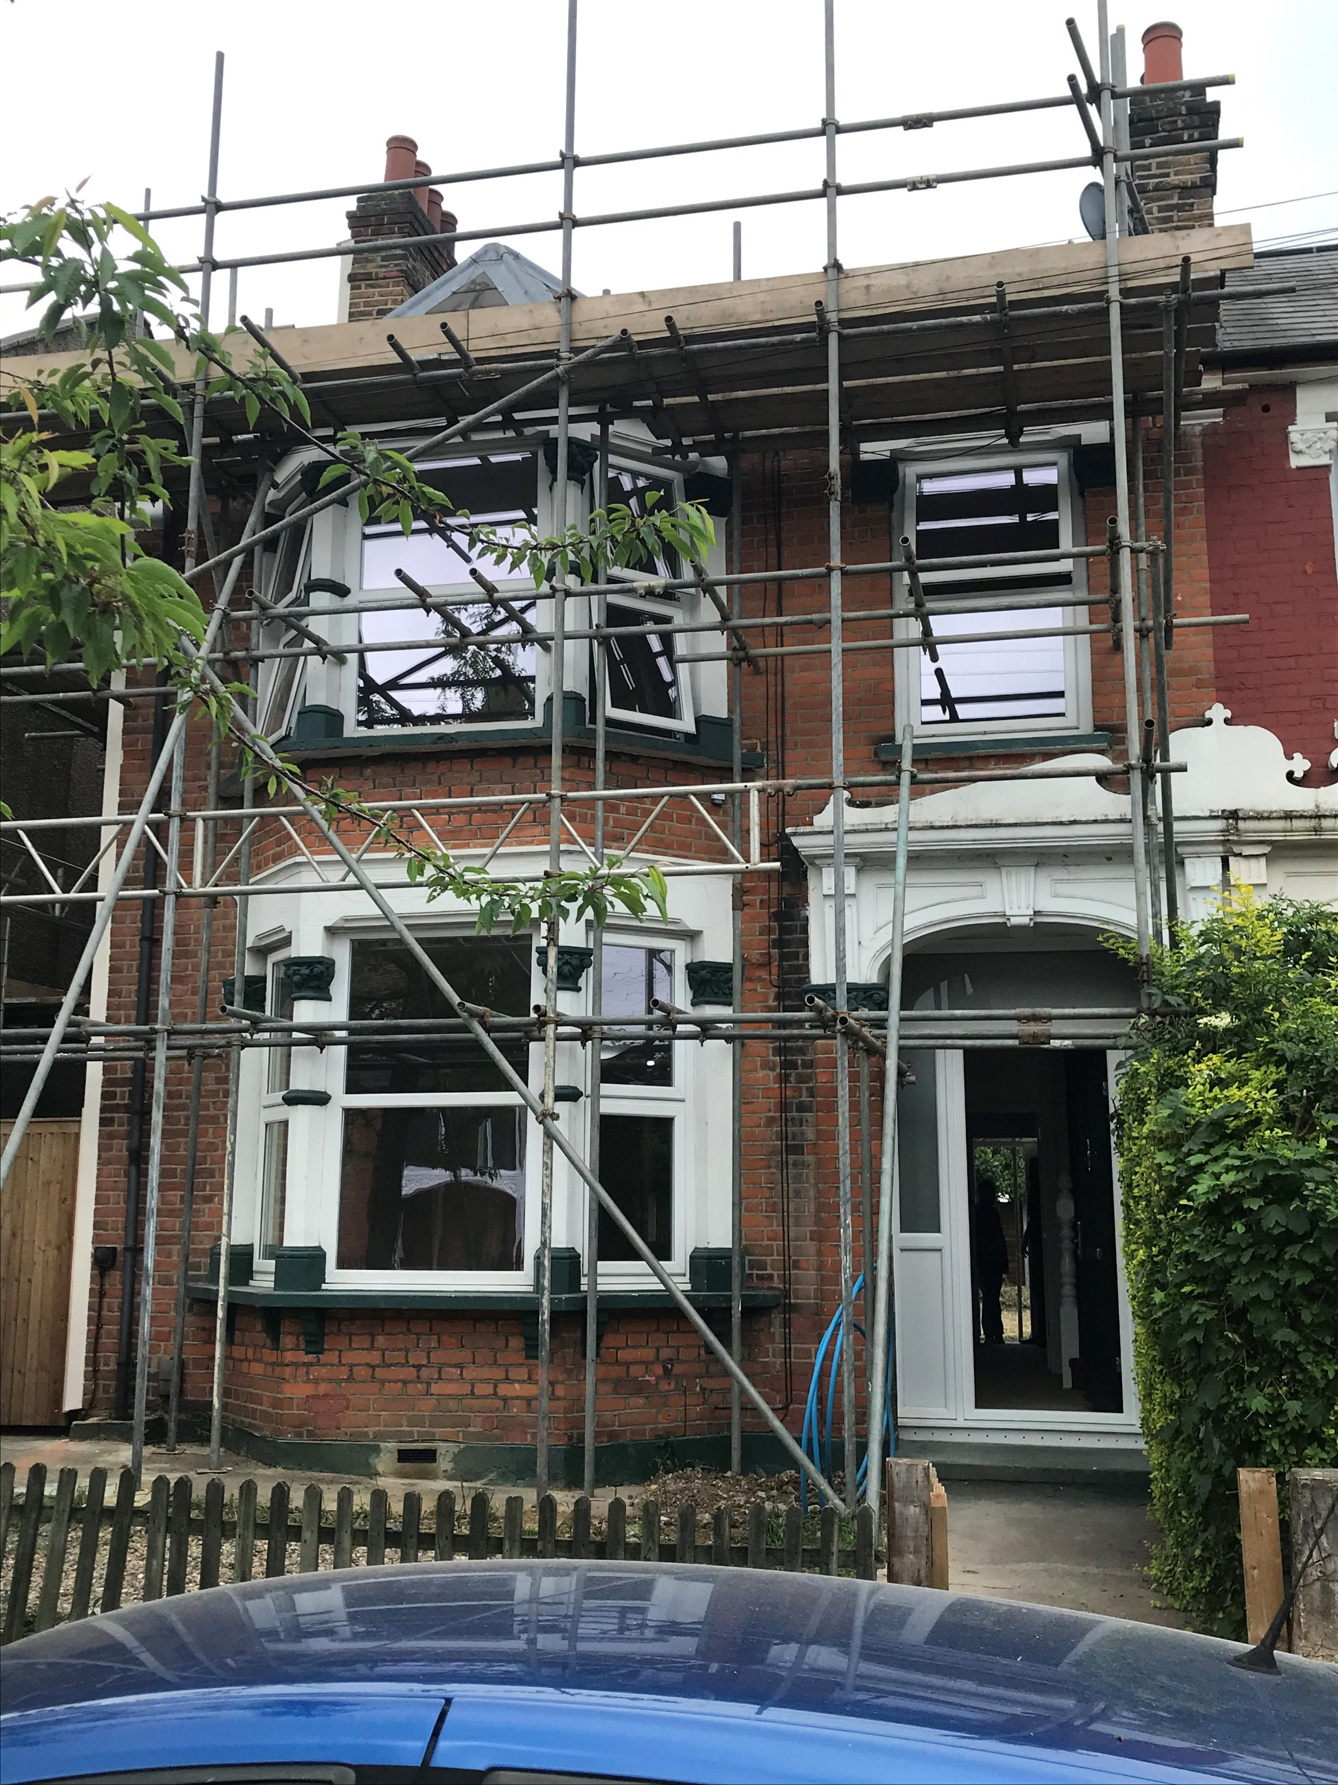
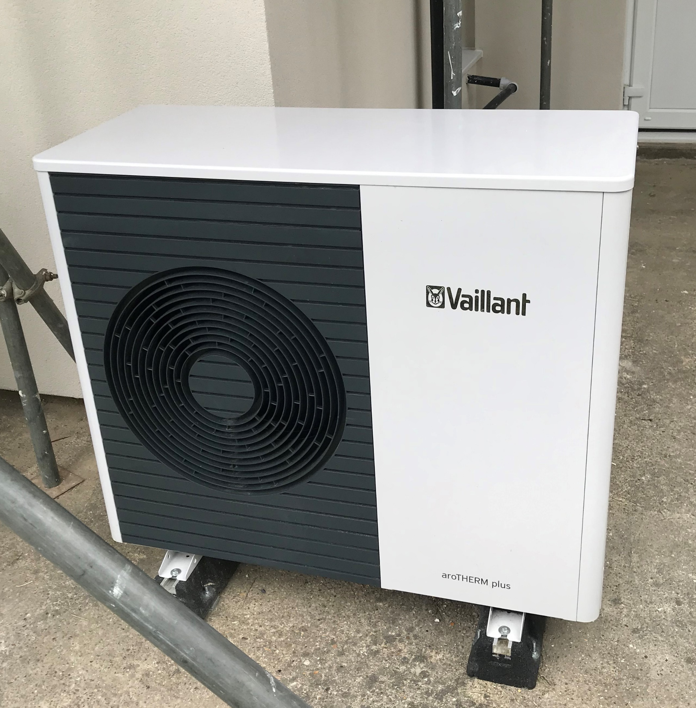
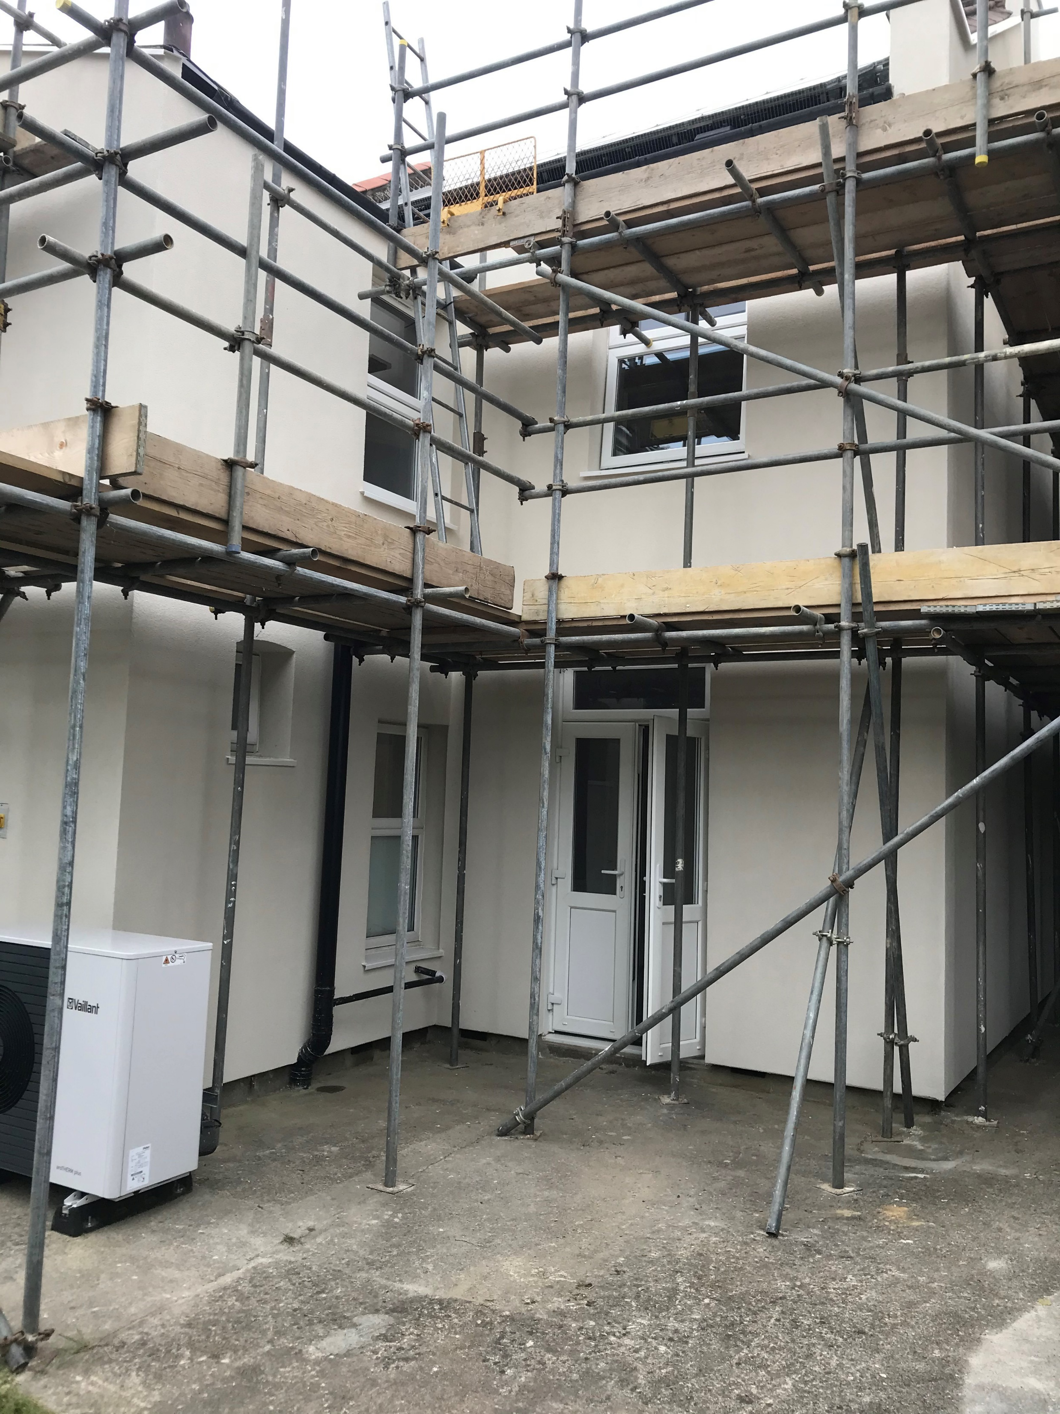
What improvements were made?
1. | Insulating the loft, underfloor cavity, and walls. | This is the first measure to consider. It has the highest impact for the relatively lowest cost. For example, the loft insulation cost £829 to install and saves £120 per year.
2. | Replacing the gas boiler with an air source heat pump. | This is a carbon neutral form of heating that draws heat from the air. It cost £10,200 to install and has an estimated saving of £860 per year.
3. | Installing solar panels and batteries. | This cost £12,294 to install and is estimated to save £609 per year. It powers the heat pump and surplus energy can be reused.
4. | Other works. | Mechanical heat recovery unit. Shower waste heat recovery system. Smart ventilation air bricks. Smart lighting and smart electrical sockets.

Slide 4
Why should I consider this for my properties?
1. | More attractive rental and a higher value asset. | A more energy efficient property is more comfortable and is cheaper for a tenant to heat. This is particularly desirable given the increase in fuel costs following the raising of the energy price cap and the continued issues with fuel supply chains. Improvements would also increase the financial value of the asset.
2. | Futureproofing | The Government has made a legal commitment to meet a target of net zero carbon emissions by 2050. This will require increasingly strict regulation of properties to promote retrofitting. The proposed Future Homes Standard will require all new tenancies granted from 2025 to have an EPC rating of “C” and all existing tenancies to be EPC “C” from 2028. This increase will be accompanied by an increase in the maximum amount landlords will have to spend on energy efficiency improvements before they are exempt from regulatory requirements. The Government will ban installing gas/oil boilers in new builds from 2025.
3. | Include within existing renovation plans. | If you are already considering renovating an older property or have to make some improvements void in-between tenancies, many of the options demonstrated at the property can be delivered quickly and cheaply as part of a renovation programme, and ensure you are compliant with future requirements.

Slide 5
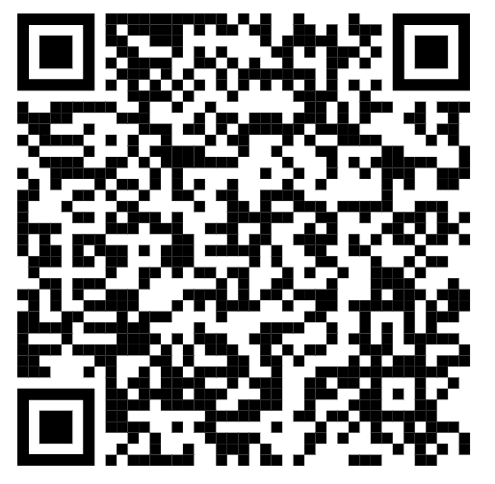
Can I visit the property?
The property (47 Greenleaf Road, E17 6QN) will be kept open for the next 6 months with a series of open days and tours during the week and weekend. These dates will be released on a rolling basis, and you can sign up to attend the property by clicking on the link below or scanning the QR code with your smartphone.
The next open days are on the 3rd of November (10am-4pm) and Saturday the 6th of November (10am-4pm) with tours available every hour.
https://www.eventbrite.co.uk/e/waltham-forest-eco-show-home-open-days-tickets-177906622497

Slide 6
What funding can I get to help retrofit my property?
Green Homes Grant (GHG) If you are a social or private landlord of a home rated D or below with a tenant earning under £40,000, you can obtain a subsidy of up to £5,000 (a contribution of one third will be required from the landlord) For more information click here
Domestic Renewable Heat Incentive (DHI). This is a Government funded scheme where you can receive payments over seven years if you have already or are planning to install biomass boilers, solar water heating and certain heat pumps. For more information click here
The Energy Company Obligation (ECO) is a government energy efficiency scheme which requires medium to large energy suppliers to provide grants to cover all or part of the cost for installation of energy efficiency measures such as wall insulation, boiler replacements, or other heating improvements. However, the eligibility criteria for ECO is quite complex and requires a household to be low income and experiencing some kind of vulnerability or fuel poverty. Your energy provider can tell you if you are eligible or speak to the Simple Energy Advice helpline 0800 444202. For more information click here

Slide 7
Where can I find more information or advice to on retrofitting my property?
Waltham Forest Council have partnered with Parity Projects to help bring a low carbon home renovation service to residents. The service will help assess the energy efficiency of your home, identify works to improve the property, and can get you quotations from local suppliers and provide oversight. To use this service simply click the link below to access the Ecofurb website and use the free “Plan Builder”. The Plan Builder helps you understand which energy efficiency measures would have the most impact for your home, and the likely costs and savings. You can then choose to book home survey for £295 if you would like the in person support of a professional. Click here for further information
For more information on the Eco Show Home, please use the links below to access further information on the project.
Link to Council's webpage on the Eco Show Home
Link to Eco Show Home project report and estimated savings information
A short film showing the Eco Show Home's journey and explaining the key works.
If you have any further questions about retrofitting your property or the Eco Show Home, please contact HousingStrategy@walthamforest.gov.uk

