Slide 1
Private Sector Housing & Licensing Landlord Forum
Julia Morris
Date: 12th January 2022

Slide 2
Housekeeping
Please put yourself on mute when not speaking. This will avoid background noise and feedback.
All cameras should be off unless presenting.
The meeting is being recorded. The recording may be made available online.
If you wish to ask a question in person please use the ‘raise hand’ function. (This is on the right of the tool bar in the centre of your screen). The Chair will then call on you to unmute, switch on your camera and ask your question in person.
If you wish to ask a question without using your microphone please use the ‘chat’ function. (This is on the far right of the tool bar in the centre of your screen). You can type your question there, please note all participants will be able to see the question.

Slide 3
Agenda
Licensing update
Amrick Nota – Lettings Waltham Forest
Tom Ruxton – HEET (energy efficiency)
Jonathan Joseph - Housing – Landlord incentives
There will be time for a Q & A after each presentation. Please wait until the end of the presentation before raising your hand. Any questions should be general and not specific to your individual application/property

Slide 4
Landlord requests
Landlord interested to know the level of upheaval when installing fire doors and interlinked smoke alarms and if this would be bearable.
Request data on licensing fees, how many properties have been vetted/licensed – what is the money used for?
Requested topic regarding various grants available to help improve energy efficiency rating, are there any external organisations who are offering support?

Slide 5
Update on licensing
Applications Received/issued to date
Selective Applications – 19471/15733
Additional HMO – 1004/374
Mandatory HMO – 565/257
Whilst we have applications outstanding we are working hard to determine licences.
All HMO’s are required to be inspected prior to the licence being issued.
You can help us by ensuring all applications are complete with correct information and the gas certificate is provided.

Slide 6
Update on licensing
Since the start of the new schemes, we have…….
Issued 16363 licences
Carried out 3720 inspections
Issued 103 intentions to issue a civil penalty
successful in securing 18 prosecutions
Income from licensing is used for the administration and enforcement of the scheme.
The income is ringfenced and cannot be used for any other purpose within the Council.
In the last five year scheme we broke even, there was a slight deficit that was met by the Council.
Figures will be provided at the end of the scheme to reflect Income and Expenditure during the term.

Slide 7
Information available for landlords
Regular information sharing via newsletter
Regular landlord forum with speakers on a variety of topics
Access to Landlord guide, available on the website
https://www.walthamforest.gov.uk/guidance-landlords-and-tenants/guidance-landlords
Reduced pest control fees
.

Slide 8
Enforcement
Whilst we always strive to work with landlords to improve
property standards and reduce ASB, sometimes Enforcement
action is required.
The following options are available to us
Prosecution
Financial Penalty
Notices
Interim Management Orders
Financial Management Orders

Slide 9
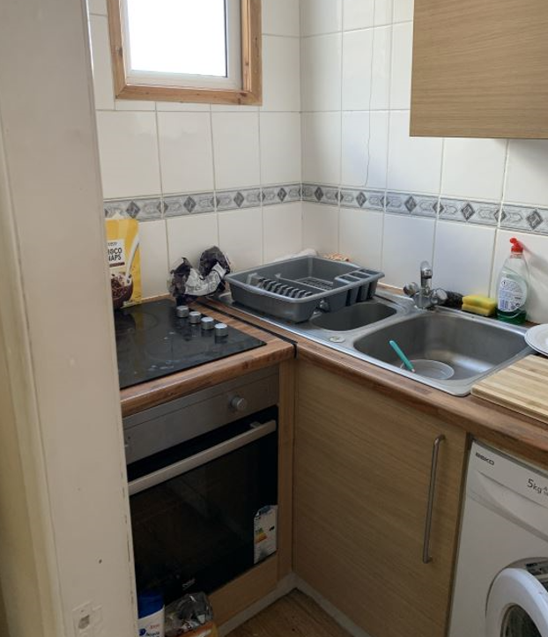
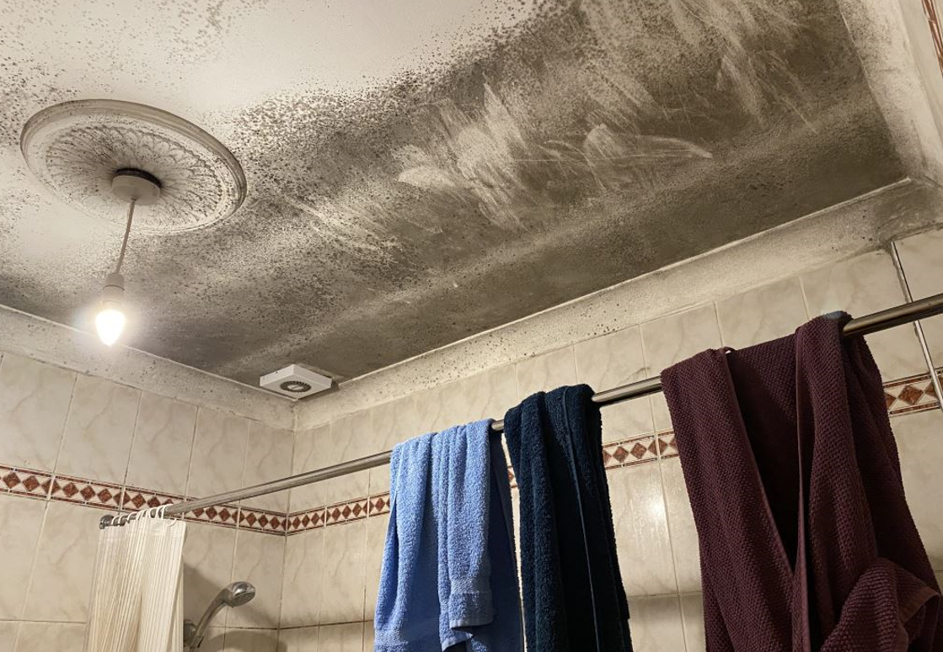
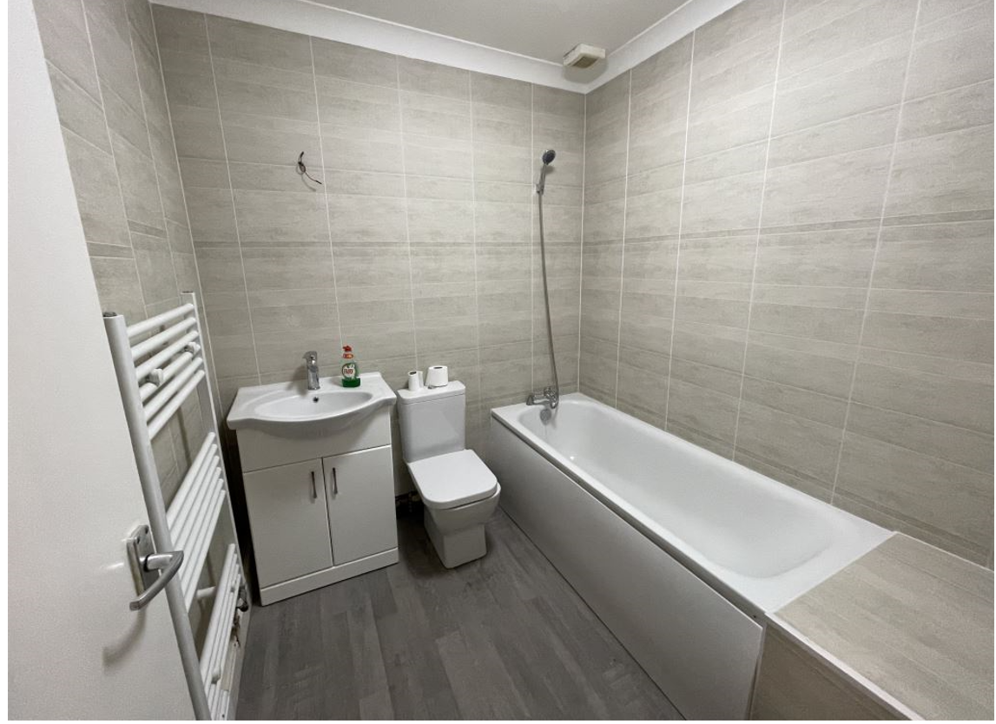
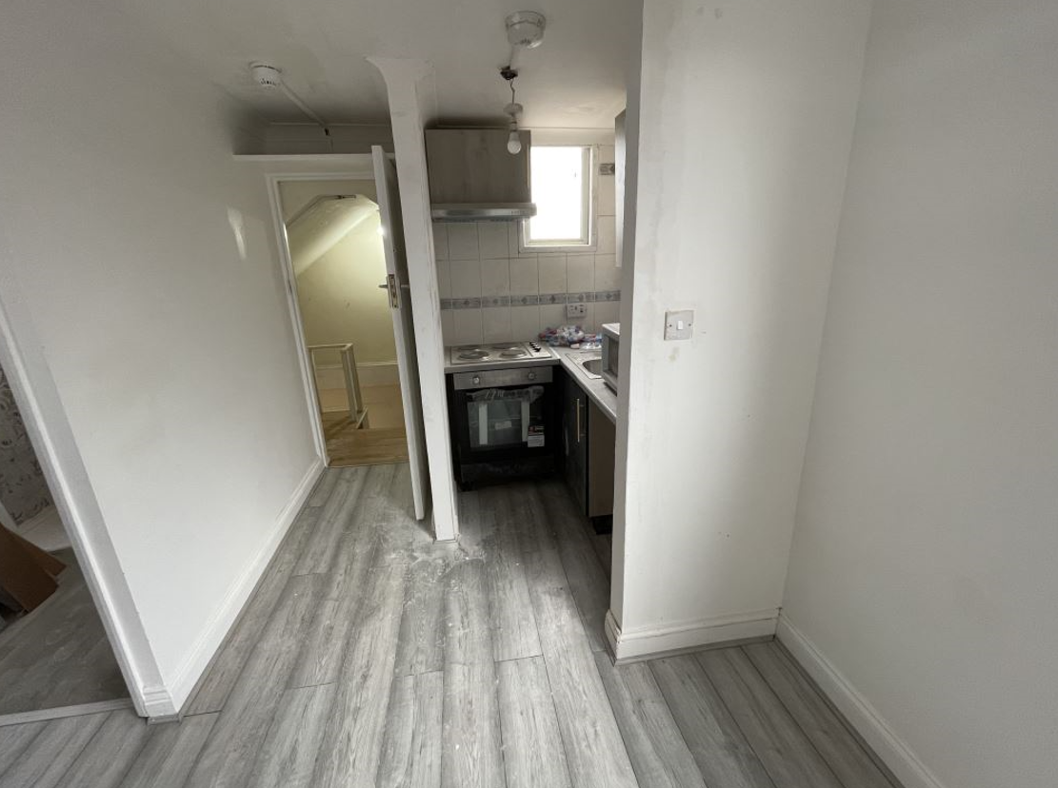
Enforcement

Slide 10
Future updates
All Presentations given tonight will be available on the website within the next few days.
The website will be updated regularly over the next few months – it is advisable to check the website for any updates.
Newsletters will be sent out with any significant updates.
We want your ideas for next Landlord Forums – topics to be discussed.

Slide 11
Contact us
https://www.walthamforest.gov.uk/content/property-licensing
Propertylicensing@walthamforest.gov.uk
020 8496 4949

