Slide 1
Private Sector Housing & Licensing Landlord Forum
Evelyn Williams
Date: 27th April 2022

Slide 2
Empty Property…In Waltham Forest
As with most London Boroughs, we have over 2000 empty properties that are privately owned.
Around 20% of these properties have been empty over 5 years, with 1% over 15-20 years.
We will examine why we have so many empties when property within the M25 corridor is so expensive and in such demand.

Slide 3
Why deal with empty property?
Everyone benefits including the owners, new owners, new occupiers or tenants, neighbours and the wider community
Older buildings can be brought up to modern decent homes, comply with eco-works, green energy compliance and brought up to modern decent homes standards
Increased supply of good quality housing for rent or for sale
Anti-poverty – creating refurbished homes, recovering council tax and bringing other income into the community
Local investment in the local economy
Existing ‘brown’ land used, the street scene improved

Slide 4
Why are properties left empty?
Half of empties are transitional…
Awaiting new tenants
Awaiting probate after someone has died
Awaiting sale
Being repossessed by bank or building society
Awaiting insurance payments following an event such as a fire

Slide 5
The reasons for long term empties…
Property inherited with next of kin in dispute
Owner unable or unwilling to let or sell
Property used as pension / for tax reasons / dowry
Owner in care / nursing home / gone abroad / died
without family or institutions aware of these assets
Sentimental reasons – parents lived there, childhood
memories, does not want to sell for these reasons
Owner knows the value will rise and does not care
Next of kin abroad and unaware of the property

Slide 6
HOW DO WE IDENTIFY EMPTIES?
Empty Property Team
Neighbours
Council Tax records
Council website
Local councillors, MP’s

Slide 7
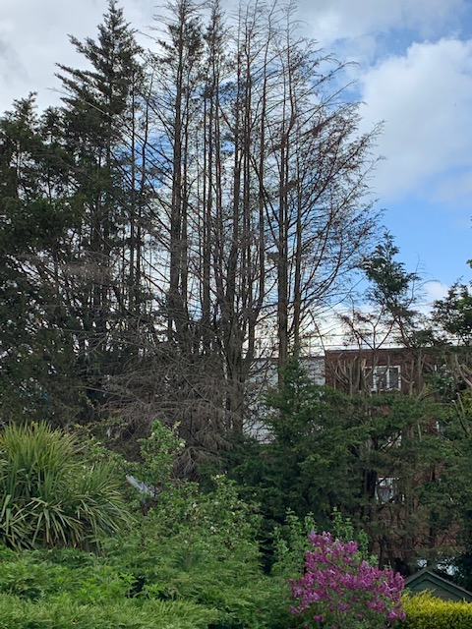
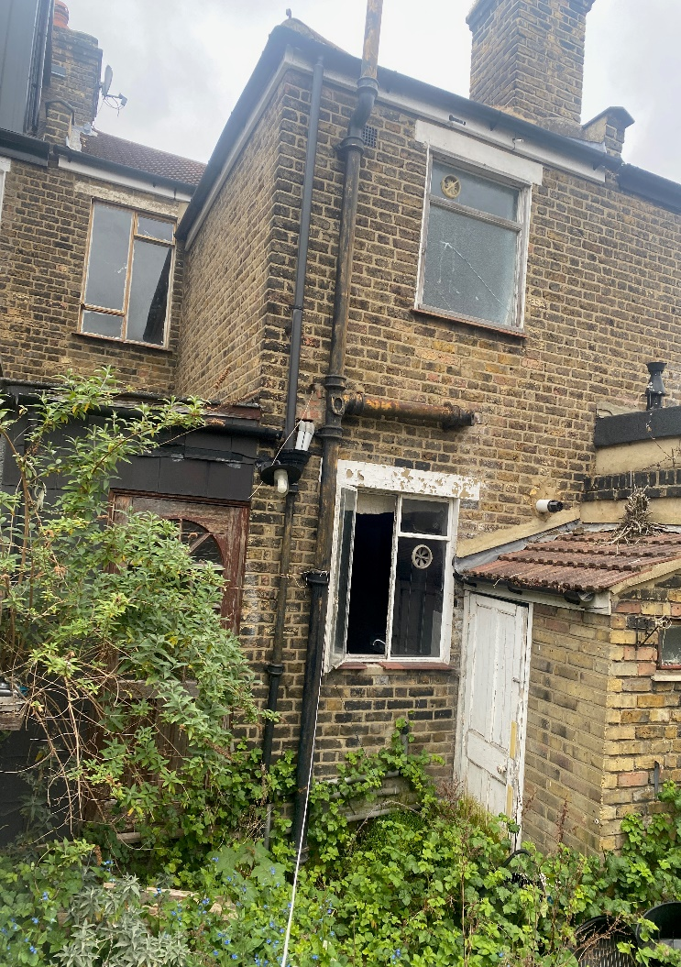
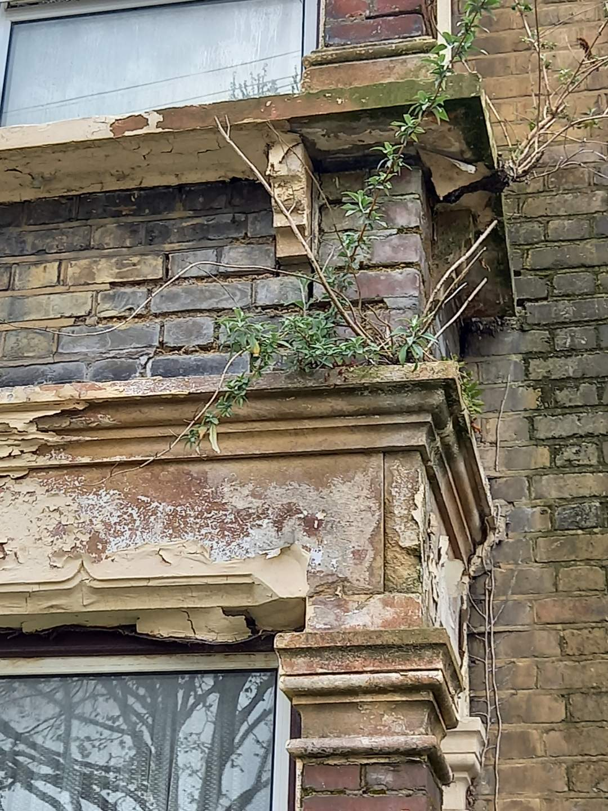
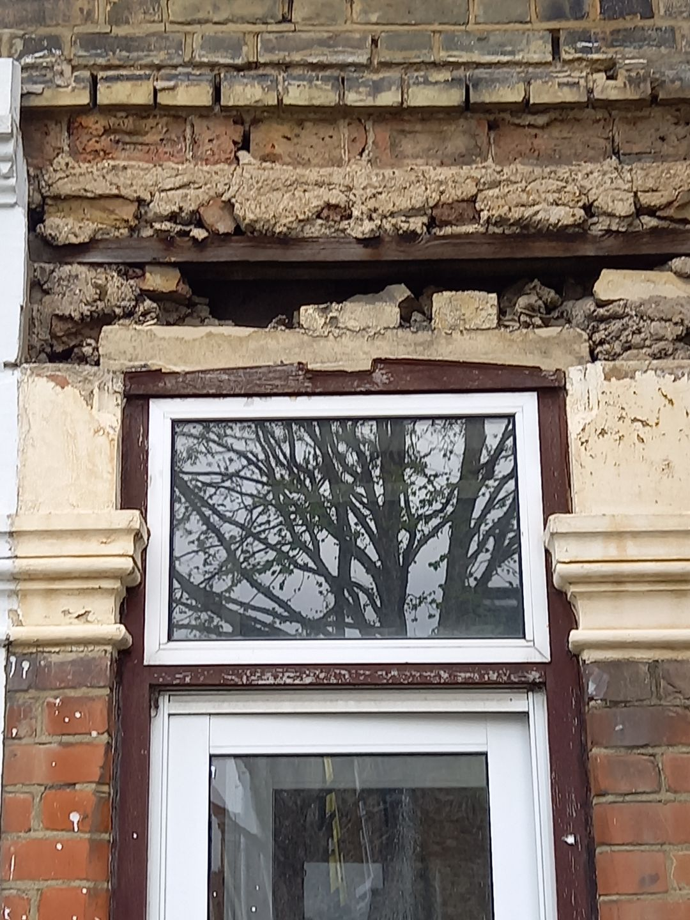
Problems caused by empties

Slide 8
infestations

Slide 9
HOW DO WE DEAL WITH EMPTIES?
Visit the property
Find the owner
Meet with the owner
Discuss options / Give advice
Where we cannot find the owner or they refuse to co-operate - Serve enforcement notices with regard to pests, securing property or works in default
Compulsory Purchase or Enforced Sale as a last resort
REFURBISHED PROPERTY READY FOR SALE OR RENTAL

Slide 10
REDUCED VAT
PROPERTY EMPTY TWO YEARS
VAT reduction on building work for empty properties may be reduced up to 5% for properties empty over two years before building works start and is intended for use solely for relevant residential purpose.
Please see EMPTY HOMES VAT NOTICE 708 (Buildings & Construction) (HM Revenue & Customs)
A letter establishing that the property has been empty two years for the purpose of HMRC can be acquired by contacting me:
Evelyn Williams
Team Manager Empty Homes
Private Sector Housing
Resident Services
3 The Square, High Road, Leyton, E10 5NR
Phone 020 8496 3000 ext 5168 Mobile 07786 530892
Website: www.emptyproperties@walthamforest.gov.uk

Slide 11
Case study – Shernhall Street
The property was reported empty in 2013. There were constant complaints from the neighbours about the holes in the roof and the trees that were growing out of the windows at the back of the property.
As repeated correspondence did not have the desired effect of the property being brought back into habitable use, the council served notices leading to starting compulsory purchase of the property.

Slide 12
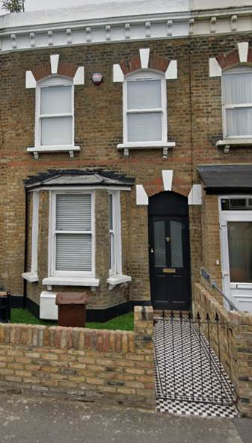
Case study – Shernhall Street
The owner then decided to sell the property before compulsory purchase started.
It was sold to a new owner who have completely refurbished the property and it is now occupied.

Slide 13
Thank you.
Contact us
emptyproperties@ walthamforest.gov.uk
020 8496 5168

