Slide 1
Waltham Forest Landlords Forum NRLA News & Update
Richard Blanco – NRLA Representative

Slide 2
In this presentation, brief updates on…
Renters Reform White Paper
Landlords Selling
Mini Budget
Rising Interest Rates
Cladding Remediation
Building Safety Act
Smoke & Carbon Monoxide Alarms
Right To Rent changes
Energy Bills Support Scheme
Renting Homes (Wales) Act 2016
Afghan Resettlement Scheme
Homes For Ukraine

Slide 3
Renters Reform Bill – Key Points
Timing Unknown
We will get 6 mths notice
Periodic Tenancies
No fixed term
Tenant gives 2 months notice
ASTs will last 12 months ONLY into new system
Changes to Grounds for Possession
Selling & Moving in (2 mths/3 mths)
Students (PBSA exempt)
Arrears changes to 4 weeks notice
Repeated serious arrears
ASB vague
Court modernisation
Ombudsman & mediation
Urgent sifting, serious cases only
Digitisation by 2023
Rent Increases
To first tier tribunal (capped)
Other stuff
End No DSS/Families
Compulsory pets
Passporting deposits
Decent Homes Standard for PRS
Local Authority Enforcement
Portal

Slide 4
Renters Reform Bill - Opportunities
End Anti Landlord Rhetoric
Anti Social Behaviour
Student Market – push back on Article 4
Reform Courts
Could portal replace licensing?
Easing of punitive tax regime
Gilbert & Tobin

Slide 5
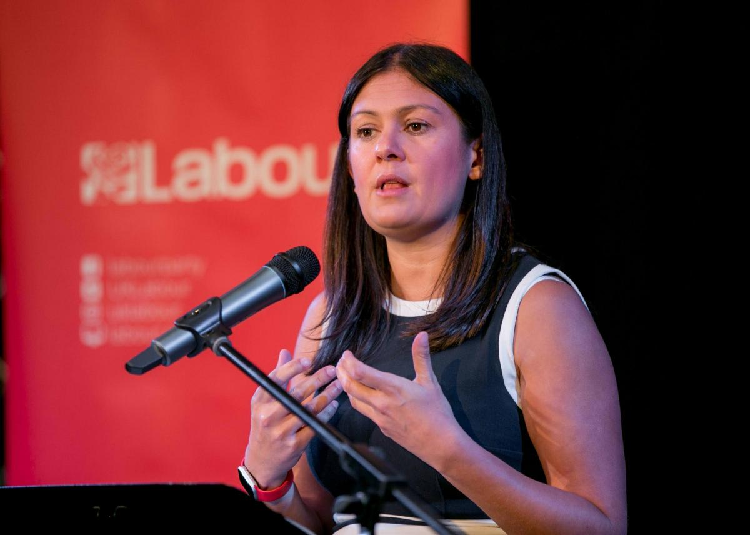
Landlords Selling
Drivers
S24 tax – landlords pay 60% tax
Additional 3% SDLT
PRA changes require bigger deposits especially in London
CGT at 28% instead of 20%
MEES - £10k per property 2025/6 to get to EPC C
Generation Rent into Generation Buy
Political antipathy
Looming Housing Crisis
Capital Economics Figures
225,000 PRS units needed every year
But PRS is shrinking – 260,000 net fewer in last 5yrs
Propertymark & NRLA Research
50% fall in lettings availability
14% buy, 23% sell in next 12 mths
Larger portfolios: 18% buy, 41% sell
Last 3 mths: 8% bought, 12% sold
Failure of successive government policy
Lost 3m council houses 1979-95
Failure to build enough
Planning constraints
LA enforcement varies widely

Slide 6
23 September Mini Budget
Tax Cuts
Top 45% (and top dividend tax) abolished – U Turn
20% reduced to 19%, NI increases abolished
Corporation tax remains at 19%
Investment Zones with tax incentives
SDLT 0% increased to £250k saving £2,500
FTB 0% rates increased to £425k and £625k
Economic impact
Sterling falling
Interest rates rise higher and quicker – to 6% next year
Inflation expected to peak at 10-11% (could be higher now sterling has fallen)
May already be in recession – expected to last 15 months
Some predictions that housing market could fall 15% next year
Much depends on Ukraine conflict

Slide 7
Landlords & Rising Interest Rates
BBR raised 1.75% to 2.25% in September
Next rise expected at MPC meeting 3 November
OBR review on 23 November (or sooner)
If Interest rates rise by 2% - 18% would have to sell property
If Interest rates rise by 4% - 30% would have to sell property
Big gap between BBR and payrates on fixed products
Lenders are being very cautious – switching risk to customer with trackers
Evidence that some are trying to protect existing borrowers with cheaper product switch rates
Landlords face big jump in payments when 2 or 5 year fixes end this year and next – from 1.25% to 5% or more
Could let products go to SVR and wait for rates to falls again

Slide 8
Examples Of Unregulated BTL Rates
Rates are for your information and for your research only
Always seek advice from a FCA regulated mortgage broker, especially if you have inherited a property or intend to let family members live in the BTL property
Lender | 2 Year Fix | 5 Year Fix | 2 Year Discount Variable or Tracker
TMW | 6.04% | 5.74% | 2.39% | £1995 fee
Precise |  | 7.24% |  | 1.5% fee
Coventry | 3.50% existing clients only | 4.50% existing clients only |  | No fee
Hinckley & Rugby Product Switch | 6% | 3.15% lifetime discount | 2.75% (SVR 6.94%) | No fee

Slide 9
Cladding Remediation
11-18m high buildings will now receive cladding remediation
Owner of up to three properties included (more than 3 excluded)
You are included if property is primary residence
Cap for non cladding remediation (over 10 years)
Responsibility of developer, building owner, landlord (not leaseholder)
£15k cap for properties £325k-£1m (within London)
£10k cap for properties £175k-£1m (outside London)
No protection for buildings under 11m high
Building Safety Fund covers buildings over 18m high

Slide 10
Building Safety Act further provisions
Other provisions in the Building Safety Act include:
Require building owners to manage building safety risks, including residents in decision-making
Residents have legal obligation to respond to requests for information from accountable person and to ensure their actions don’t create safety risks
New Building Safety Regulator within the Health and Safety Executive to implement and enforce regulations for residential blocks over 18m high
National regulator for safety of construction products
Extension of limitation period for build and refurbishment defects to 30 years
Notes:
Website article: https://www.nrla.org.uk/news/cladding-building-safety-bill-nrla-secures-funding

Slide 11
Smoke & Carbon Monoxide Regulations
CO detector in every room with combustible fuel appliance (except gas cookers) from 1 Oct 2022
Smoke alarms requirement extended to Social Housing
One on each floor, different requirements for HMOs
Test CO and smoke alarms at start of tenancy
New requirement for landlord to repair alarms if informed by tenant – but tenant responsible for testing during AST
LAs can issue improvement or hazard awareness notice: mains inter-connected smoke alarms under HHSRS
Can also serve remedial notice penalty of £5,000

Slide 12
Right To Rent changes from 1 July 2022
Unlimited Right to Rent
UK & Irish Nationals and anyone with no time limit on their stay
EU nationals - provide residence card or evidence of settled status
Time Limited Right To Rent for new tenancies (12 months)
EEA/Swiss nationals & USA, Canada, Australia, NZ, Singapore, South Korea
Provide passport and proof of entry in last 6 months
Applies to pre settled status and people with time limited visas
From 1 Oct 2022, Covid adjusted checks no longer permitted, instead:
Meet the applicant in person and check original document(s)
Use online checking system with share code and date of birth
Use certified provider to perform a digital check (They use Identity Document Validation Technology)
Government’s Landlord Checking Service

Slide 13
Energy Bills Support Scheme – Cost of Living
Households to start receiving £400 off their energy bills from October, with discount made in 6 instalments
The govt plans to legislate to ensure landlords pass on the Energy Bills Support Scheme discount to tenants paying all-inclusive rents.
The govt has introduced a new price cap that will be in place until October 2024, typical house = £2500/yr.
Notes:
Prices are still set to rise, nearly doubling from last winter. However, this new price cap will be significantly lower than the original one set by Ofgem, which was set to cost an average household £3,500 per year.
The new price cap is set at a maximum of:
34p per kWh for electricity for the unit charge and 46.4p per day for the standing charge.
10.3p per kWh for gas and 28.5p per day for the standing charge.
These are significant reductions on the planned price cap where electricity was set to be capped at 51.89p per kWh and gas was originally set to go up to 14p per kWh.
The UK government has now set out further details of the Energy Bills Support Scheme.
Households to start receiving £400 off their energy bills from October, with the discount made in 6 instalments to help families throughout the winter period.
The government has now announced that it will legislate to ensure that landlords pass the £400 Energy Bills Support Scheme (EBSS) payment on to their tenants, if the tenancy is on a bills-inclusive basis.
Chris Norris, Policy Director has stated that “Given payments under the support scheme have not begun to be made, the government’s plans to legislate are premature and are demonising landlords unnecessarily. "It sends a dangerous and misleading message that landlords cannot be trusted to do the right thing, creating needless fear and anxiety for tenants.“

Slide 14
Renting Homes (Wales) Act 2016
Was due to come into force from 15 July 2022, delayed to 1 Dec 2022
Fundamentally changes renting in Wales. All PRS tenancies replaced by ‘occupation contracts’ with new required terms, and rules around possession – including a replacement for Section 21 which will require six months’ notice and can only be served after the first six months of the occupation contract
Will also bring in new fitness for human habitation requirements (EICR, smoke alarms, CO alarms) and restrict notice where mandatory requirements are not met including issuing specified documents
For full details: nrla.org.uk/resources/pre-tenancy/preparing-for-renting-homes-wales

Slide 15
Afghan Refugee Resettlement Scheme
Local authorities looking for properties
Mostly larger properties – 3 or more beds
Afghan Refugees have right to work
Las have top up funds for rent
Webinar hosted by Afghan Welcome & NRLA
Listen Up Landlords podcast
For schemes and to offer help, google
Afghan Housing Offers Of Support for UK Govt Central Portal
NRLA Afghan Welcome

Slide 16
Homes for Ukraine scheme
Sponsors are asked to provide homes or a spare room rent-free, for as long as they are able, with a minimum stay of six months
Govt is offering a £350 per month ‘optional thank you payment’ to UK households who provide accommodation.
Rent cannot be charged and thank you payment cannot be used to top up rent. Government has published ‘excluded occupier’ and ‘excluded licence’ agreements for use
Tenants need their landlords consent to take part
Properties should be inspected for suitability by the local authority
If a tenant moves out of a property and the sponsored person does not, landlords may find they are responsible for providing accommodation afterwards
Landlords should also consider whether giving consent will mean that the property becomes licensable under additional or mandatory licensing schemes
For more info: nrla.org.uk/news/homes-for-ukraine-whats-the-latest
Notes:
No rent can be charged…
The UK Government is clear that no rent can be charged by sponsors to those they are hosting. This is intended to ensure that an assured shorthold tenancy is not created and that it is clear that those who are hosted are guests. At the same time, they are requiring a minimum commitment of six months’ hosting for any UK households participating in the scheme.
Households hosting refugees will be eligible for an optional £350 per month ‘thank you payment’ from the Government, for a maximum of 12 months. This is provided at a flat rate per property, is not rent, will be tax-free, and will not affect benefit entitlements or any council tax discounts. It will be paid in arrears.
… and no AST should be created
The Government has published model contracts which can be used to set out the expectations for the sponsorship. An Excluded Licence Agreement is advised where guests are sharing accommodation with the host – for example, communal areas, kitchen and bathrooms. Where guests are being hosted in self-contained accommodation – such as a holiday let – you are advised to use an Excluded Tenancy Agreement. It is not a requirement to use these, but it may help clarify the terms of the hosting and be helpful for landlords to evidence the nature of the arrangement.
Because the refugees are hosted as guests, the Government has assured us there is no requirement to evidence the Right to Rent.
Sponsors are asked to give at least two months’ notice if they want to end the sponsorship. If the sponsorship breaks down before six months, they should contact the local council.
You need to check with your insurer and mortgage lender
The Government has been working with lenders and insurers to agree ways to ease the process, but as things currently stand, you are advised to speak to your insurer and your lender before entering into any sponsorship arrangement. You may be breaching the terms of your policy or mortgage agreement if you do not get their permission.
Properties will be inspected before guests are placed
Local authorities are responsible for undertaking property inspections to ensure they are suitable and meet the appropriate standards for health and safety, as well as overcrowding. These are set out in the Government FAQs. These requirements will be familiar to private landlords. In addition, landlords must ensure that their properties meet the regulations for the sector.
Furthermore, councils will undertake Disclosure and Barring Service (DBS) checks on all occupants of the household aged 16 and over, and further checks if children or vulnerable adults are hosted.
HMOs remain a grey area
Guidance for councils sets out that the Government expects that properties where neither sponsors nor guests are paying rent will not be considered as houses in multiple occupation (HMOs).
But there is less clarity where the sponsor is already paying rent on the property, as will be the case if your tenant wants to be a host.
An additional person or persons living in the property could mean that the property becomes licensable, under either mandatory HMO licensing (with five or more people living in the property, comprising two or more households) or if there is an additional licensing scheme – which covers smaller HMOs – in place in the area.
It’s advisable that landlords consider carefully whether giving consent to their tenants to act as hosts would make their properties licensable. NRLA members can use Kamma to check whether their property would require a licence.
Ukrainians entering the UK via the scheme are eligible for benefits
Ukrainians entering the UK as part of the scheme will be eligible for benefits, including the housing element of Universal Credit should they decide they want to rent rather than remain in hosted accommodation. They will also be given a £200 initial payment by local councils to cover subsistence before benefits kick in.
All Ukrainians entering through the scheme will also be eligible to work in the UK.

Slide 17
Podcast, Webinars & NRLA Membership
Listen to NRLA Podcast & Watch Webinars
Google ‘Listen Up Landlords’
Google ‘Inside Property’ for legacy editions
Webinar recordings at www.nrla.org.uk
Join The NRLA
Google ‘Join the NRLA’
£85 per year by direct debit
Discount code – R59

Slide 18
NRLA Meetings in North & East London
Property Investor Show (Face to face)
Excel on 7 & 8 October 2022
London Regional Webinar – Your Money
7-9pm on 20 October 2022
Redbridge Landlords Forum (Webinar)
7-9pm on 3 November 2022
Broxbourne Landlords Forum (Face to face)
6.30-8pm on 9 November 2022 at Council Offices
Barking & Dagenham (Webinar)
7-9pm on 6 December 2022

Slide 19
NRLA Advice Line 0300 131 6400 Your NRLA London Reps
Richard Blanco NRLA London Representative (East & North East)
Yvonne Baisden NRLA London Representative (West & North West)
Karen Gregory NRLA London Representative (South London)

