Slide 1
Section Break
Private Sector Housing & Licensing
Landlord Forum
23rd February 2023

Slide 2
Agenda
Licensing update – Licence conditions/Damp & Mould.
Riccardo Solesin – Lettings Waltham Forest Offer
Alice Bradley (GLA) – Improving the PRS for the fuel poor
There will be time for a Q & A after each presentation. Please wait until the end of the presentation before raising your hand. Any questions should be general and not specific to your individual application/property

Slide 3
Housekeeping
Please ensure Microphones and Cameras are off, until asking a question.
You can ask a question by typing it in the comments and a colleague will respond.
At the end of each presentation there will be a chance to ask questions if you could raise your hand.

Slide 4
Section Break
Licensing update

Slide 5
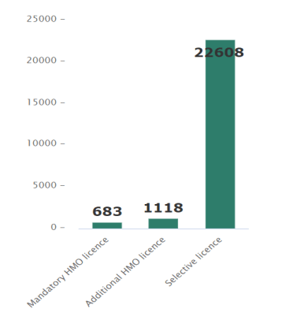
Licensing
Total applications received 24,160

Slide 6
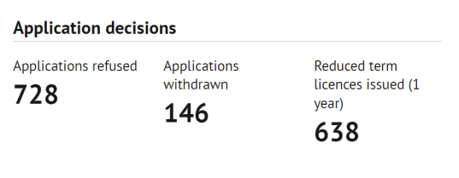
Licences Issued
Total licences issued 21,123
Selective 20,351
Mandatory HMO 286
Additional HMO 486

Slide 7
Section Break
Licence Conditions

Slide 8
Conditions
Any issued licence is accompanied by a set of licence conditions
The licence holder is bound by these conditions and can be subject to a fine of up to £30,000 for non compliance
Please ensure you read through your conditions to ensure you are compliant.
Licence holders abroad will need to ensure that they have a manager in the UK who agrees to be bound by some of the conditions, such as regular inspections of the property.

Slide 9
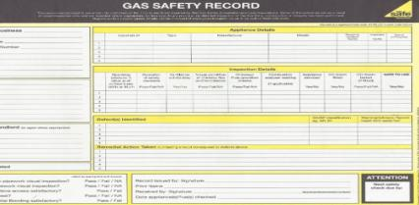
Conditions
The Licence Holder must obtain, keep and, upon each anniversary of the date on which this licence comes into force, produce to the Authority a current valid gas safety certificate obtained within the last 12 months by a Gas Safe registered Engineer or, if the boiler was installed less than 12 months ago, a Gas Safe Installation Certificate. Copies of this certificate must also be provided to all occupiers at the start of their occupation.

Slide 10
Conditions
The Licence Holder must ensure that:
  A smoke alarm is installed on each storey of the house on which there is a room used wholly or partly as living accommodation; and that,
  Each such alarm is kept in proper working order; and that,
  On demand, the Authority is supplied with a declaration by him or her as to the condition and positioning of any such alarms.
  The installed smoke alarms should be appropriate to the house
bathrooms and lavatories are treated as rooms used as living accommodation.
Battery operated smoke detectors to BS EN 14604:2005 may be provided to houses and purpose-built flats that are not above commercial premises (although mains-linked smoke alarms remain the preferred option in all cases). For other houses, such as flats within converted buildings and HMOs, hard wired mains operated smoke alarms with battery back-up to BS 5446 should be provided.

Slide 11
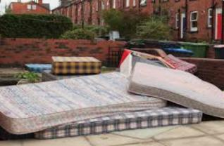
Conditions
If the Licence Holder becomes aware that the occupiers of the house or their visitors are not using the waste disposal facilities provided and/or leaving waste outside the house or in its vicinity (for example old furniture, mattresses), they must ensure that a warning letter is sent to the occupiers within 7 days advising them to remove the items immediately. A copy must be kept and must be provided to the Authority within 21 days on demand.

Slide 12
Conditions
The Licence Holder must inform the Authority within 21 working days of any material changes in their own circumstances and, within 21 days of becoming aware of them, of any known and material change in the circumstances of any person managing or involved in the management of the house, such as:
Details of any unspent convictions – for either the licence holder or manager
Details of any finding by a court or tribunal against the Licence Holder and/or the property manager that he or she has practised unlawful discrimination.
Details of any contravention on the part of the Licence Holder or property manager relating to housing, public health, environmental health, or landlord and tenant law, which has led to civil or criminal proceedings and a judgment or finding being made against him or her.
Any change of the property manager.
Any change of address of the licence holder or property manager
The undertaking of any substantial works to the house including conversions and modernisations that would affect the licence or the licence conditions

Slide 13
Conditions
The Licence Holder shall ensure that inspections of the house are carried out at least every six (6) months to identify any problems relating to the condition and management of the house. The Authority may increase the frequency of such inspections if it has good reason to be concerned about the condition or management of the house. The records of such inspections shall be kept for the duration of this licence. As a minimum requirement the records must contain a log of who carried out the inspection, date and time of inspection and issues found, and action(s) taken. Copies of these must be provided to the Authority within 21 days on demand.
The above is for Selective – the same condition is in place for HMOs but the requirement is every 3 months.

Slide 14
Section Break
Damp & Mould

Slide 15
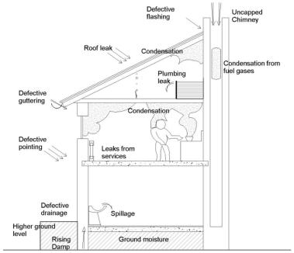
1. Damp & Mould Explainer
Damp & Mould is caused by excess moisture, which may be the result of many and varied factors, such as:
  Leaks, condensation, rising damp and other sources of moisture
  A lack of (or ineffective) insulation, ventilation and heating
  Structural issues or defects relating to the age, design or maintenance of a home
Tracing the exact cause of damp and mould can be complicated and typically relies upon the expertise of a qualified Building Surveyor
It can be exacerbated by other factors relating to occupancy, including:
  Overcrowding
  Moisture created by bathing, cooking, drying clothes
  Other regular day-to-day household activities
Mould produces allergens, irritants and, sometimes, toxic substances,
It is proven to be a causal and/or aggravating factor of health conditions, such as respiratory infections, allergies and asthma
Your Sub head goes here
in 42pt text. Keep to a maximum
of three lines where possible

Slide 16
2. How This Emerged as an Issue
26 October 2021
Housing Ombudsman report urges “zero tolerance approach” to damp and mould. The report, based on a rising number of complaints and high rates of maladministration, is strongly critical of social landlords for inferring too much blame on lifestyle factors. It makes 26 recommendations for landlords to implement on tackling damp and mould.
15 November 2022
Coroner rules 2-year-old Awaab Ishak died due to a severe respiratory condition caused by “prolonged exposure to mould” in his home managed by Rochdale Boroughwide Housing, which was first reported in 2017. The advice given by the landlord was not clear or effective, with too much emphasis placed on the parent’s lifestyle, and a failure to address the underlying cause, which was the lack of adequate ventilation in the property.
19 November 2022
Secretary of State writes to all LAs and RPs regarding their responsibility to treat damp and mould seriously. LAs are asked to “do everything in your power to prioritise the improvement of housing conditions” and to provide further info on their approach to inspection/enforcement. RPs are asked to reflect on the Coroner’s report and to undertake “rapid remedial works” on homes with damp and mould or falling short of the Decent Homes Standard.
23 November 2022
The Regulator for Social Housing writes to all social landlords requesting data on their approach to assessing damp and mould, the extent of such issues in their homes, and the action being taken to remedy issues relating to damp and mould, and non-decent homes.
Your Sub head goes here
in 42pt text. Keep to a maximum
of three lines where possible

Slide 17
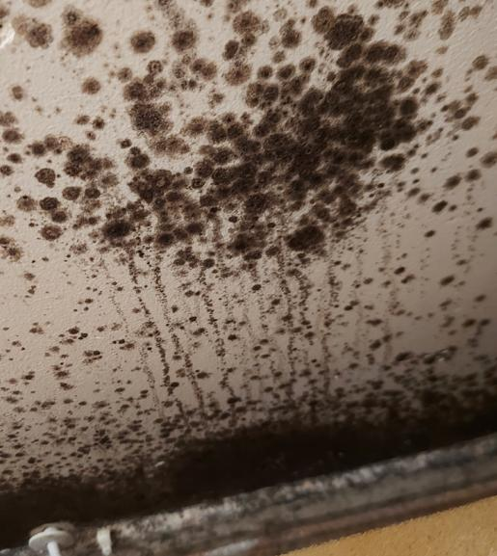
Private Rented Sector – DLUHC asks
Comprehensive response provided 30 November 2022 regarding D & M in the PRS.
Further extensive information provided on the 25 January, additional asks around
  Property Licensing/resources
  Views on HHSRS

Slide 18
Health Concerns
There is strong research evidence to suggest the following health conditions can be exacerbated by damp and mould in housing:
Asthma symptoms.
Hypersensitivity pneumonitis (reaction to allergens).
Upper respiratory tract symptoms.
Wheeze.
Coughs.
There is more limited evidence for an association with:
Lower respiratory illness in otherwise healthy children.
Dyspnoea (shortness of breath).
Development of asthma.

Slide 19
Health Concerns
Individuals who may be most vulnerable are:
People with pre-existing respiratory conditions (including asthma and COPD).
People with cardiovascular disease.
People with allergies.
Pregnant women and their unborn babies.
Children under 5 years of age.
People over 65 years of age.
People with skin conditions (e.g. eczema).
People living in poor quality housing and/or poverty.
People exposed to tobacco smoke in their homes.

Slide 20




3. Inspection & Enforcement of Rented Homes
  Private Sector Housing Enforcement Policy agreed by Cabinet:
    Council will not normally take formal action if identified defects equate only to minor or moderate HHSRS Category 2 hazards
    Where formal action to is required to address a Category 1 hazard, there are several potential options
    These include serving an Improvement Notice requiring works to be carried out and making a Prohibition Order to prohibit the use of a property until the hazards have been removed.
    Failure to comply with either is a criminal offence and the Council has the power to prosecute in the Magistrates Court or issue a fine as an alternative.
  Selective Property Licensing Scheme:
    Using powers under the Housing Act 2004, most areas within Waltham Forest have been designated part of large-scale selective licensing schemes
    Schemes to improve property conditions and management standards in single family dwellings and HMOs
    Includes measurable KPIs, e.g. reducing housing hazards by 25% in single family dwellings and by 50% in HMOs over the 5-year life of the scheme.
    Licenses granted subject to ongoing compliance with limited conditions relating to the proper letting/management of rented homes
  Inspection & Enforcement
    The Private Sector Housing & Licensing Service carries out 100s of inspections as part of the administration and enforcement of its licensing schemes
    Triage system to resolve some issues without the need for an officer visit
    Inspections triggered by a complaint, proactive visits based on data, multi-agency operations, referrals from other services/agencies (e.g. HEET, health visitors), Neighbourhood Action Days, and referrals from the GLA’s Rogue Landlord and Agent checker
    The service provides information to landlords and tenants, including landlord forums, electronic newsletters to >17k landlord/agent subscribers, Council webpages, a weekly drop-in session for tenants, and publication of successful enforcement actions

Slide 21
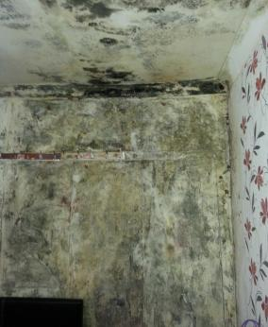
4. Summary of Issues in Rented Homes
Private Rented Sector: Housing Stock Condition and Stressors Report, December 2018
  Stock-modelling approach provided insights about the prevalence and distribution of a range of housing issues
  Estimated that 8,622 PRS properties had at least one serious HHSRS hazard (Category 1), representing 22% of the PRS stock
  Additional information indicated that 1,336 properties contained a Category 1 HHSRS Damp & Mould hazard.
  Reasonable to assume that all homes estimated to have a significant Category 1 HHSRS Excess Cold hazard, would at least have a moderate Category 2 Damp & Mould hazard
Report supported the evidence base for the consultation on the proposed Large-Scale Licensing Schemes in early 2021
Your Sub head goes here
in 42pt text. Keep to a maximum
of three lines where possible
PRS property in Hoe Street suffering from significant damp & mould, now improved

Slide 22
Private Rented Homes – key actions & outcomes
Inspections
Properties Improved
Properties where damp/mould found
5762
1371
446
Properties improved where damp/mould found
Improvement Notices & Prohibition Orders
Prosecutions & Financial Penalties in cases involving damp/mould
Your Sub head goes here
in 42pt text. Keep to a maximum
of three lines where possible
268
55
21
Notes:
Also 5 Emergency Remedial Actions under Part 1 Housing Act

Slide 23
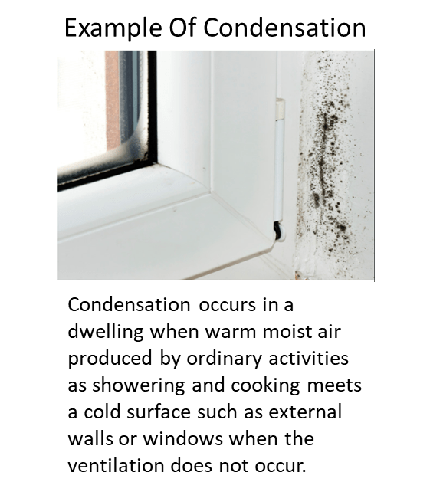
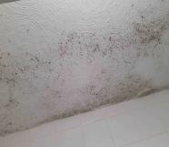
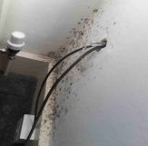
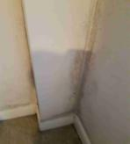
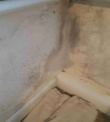

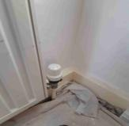
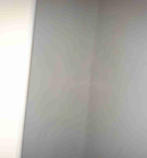
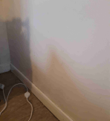
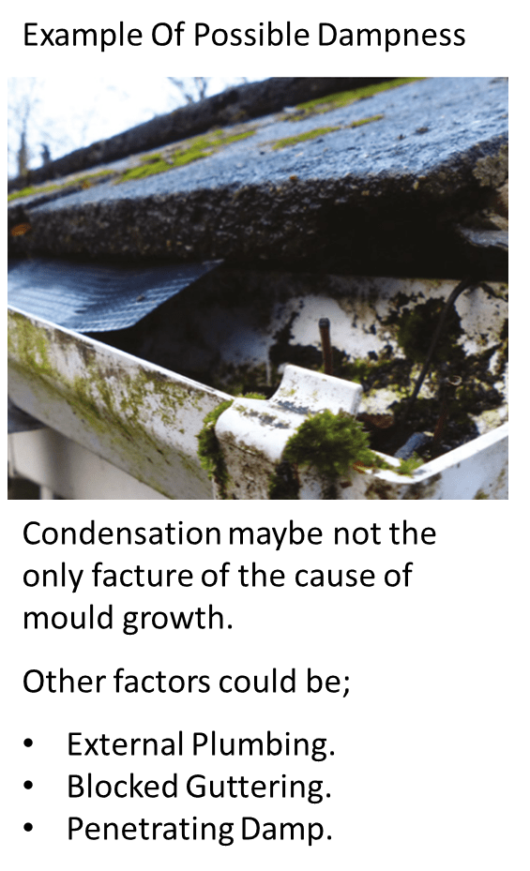

Property 1 Moderate risk
Slight Risk Example
Severe Risk Example
Bathroom ceiling
Bedroom Area
Property 1 After
After treatment
After treatment
Decorated with mould wash and mould resistant paint
Bedroom Area

Slide 24
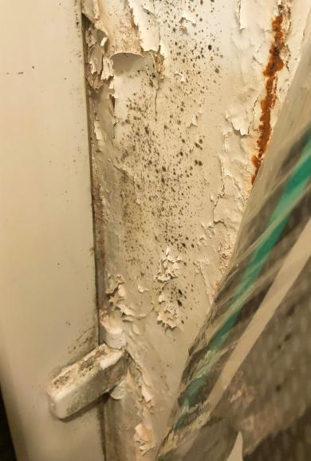
Private Rented Sector
110 new service requests relating to damp & mould since 15 November
> 300% increase on previous periods
Almost exclusively related to PRS, small number RP owned
Damp & Mould cases prioritised; addresses allocated for review and immediate inspection when needed.
Improvements made via informal & formal actions. Some limits to address damp/mould through property licensing but use HHSRS powers to enforce.

Slide 25
Identify hazards & rectify
Is there condensation on windows or surfaces in the home?
Are there visible patches of damp or water damage on walls or ceilings?
Is there any visible mould growth on windows or surfaces?
Are there leaks inside the property or faulty pipes or guttering outside the property?
Are there working extractor fans fitted in all bathrooms and the kitchen?
Is the property able to be sufficiently ventilated (e.g. can windows be opened?)
Is the property able to be sufficiently heated regularly (between 18-21⁰C)?

Slide 26
Information available
Information is available on our website with regards to Damp & Mould both relating to the PRS https://www.walthamforest.gov.uk/guidance-landlords-and-tenants/damp-and-mould
Also available is information on the Council Housing web pages here https://www.walthamforest.gov.uk/housing/council-tenants/damp-and-mould
A Task force has been set up to deal with Damp & Mould across all tenure types.
Information is also available on the cost-of-living crises and support that is out there for your tenants and you as a landlord https://www.walthamforest.gov.uk/guidance-landlords-and-tenants/support-energy-costs

Slide 27
Future updates
All Presentations given tonight will be available on the website within the next few days.
The website will be updated regularly over the next few months – it is advisable to check the website for any updates.
Newsletters will be sent out with any significant updates.
We want your ideas for next Landlord Forums – topics to be discussed.

Slide 28
Information available
Regular information sharing via newsletter
Regular landlord forum with speakers on a variety of topics
Access to Landlord guide, available on the website
https://www.walthamforest.gov.uk/guidance-landlords-and-tenants/guidance-landlords

Slide 29
Contact us
https://www.walthamforest.gov.uk/content/property-licensing
Propertylicensing@walthamforest.gov.uk
020 8496 4949

