Slide 1
Waltham Forest Landlords Forum Regulatory Briefing & Market Update
Richard Blanco – NRLA Representative

Slide 2
In this presentation, brief updates on…
Raising Rents Fairly & Legally
Govt consultation on short term lets
Renters Reform Bill
Updated How To Rent Booklet
Minimum Energy Efficiency Standards
Making Tax Digital
New Fire Safety Measures
Smoke & Carbon Monoxide Alarms
Housing Market update

Slide 3
Raising Rents Fairly & Legally
UK Rents up by 10.4% (new lets), 4.8% (all lets)
Available properties fallen by third in last 18months
Why are rents rising?
Short supply, high demand – up more than 50%
11% of homes for sale on Zoopla were previously rented
33% of landlords told NRLA they are thinking of selling
Increased mortgage costs – BBR 5%, may peak at 6%
64% of landlords don’t put up their rents whilst tenants in situ

Slide 4
Raising Rents – The Law
AST Assured Shorthold tenancies (fixed period)
Minimum of six months
Cannot raise the rent during fixed term
Longer ASTs could have a rent review clause
Better to end the tenancy and re-negotiate
SPT Statutory Periodic Tenancies (when AST rolls on)
S13 one month’s notice
Tenant accepts or go to tribunal (or ends tenancy)
Tribunal could decide rent should be higher or lower than landlord proposal
Contractual Periodic Tenancies (no fixed period)
If they have a rent review clause, use s13 notice as laid down in the clause.
When the rent increase takes effect, the contract will become an SPT

Slide 5
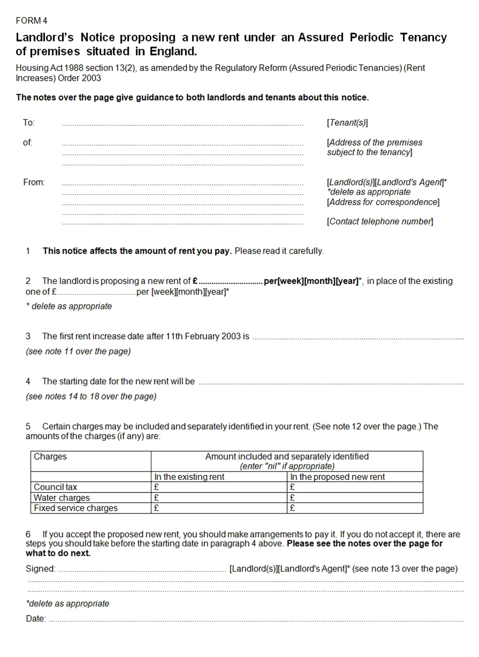
About section 13 notices
Prescribed form available on government website
Provides details on notice periods etc
Normally one month’s notice – but length of rental period
Can be served on rent due date….
At end of fixed period
Minimum of 12 months into contractual periodic tenancy
12 months after last s13 was served
Rent rise goes ahead unless tenant disputes it
Tenant can dispute rent by applying to tribunal using form 6
Tribunal will make a judgment based on market rents
Call NRLA advice line for help on 0300 131 6400

Slide 6
Raising Rents – Best Practice
Use a 12 month Assured Shorthold Tenancy
3 months before end of the tenancy, discuss tenants plan
Explain your plans regarding the rent
Do You Have A Rent Policy?
For example - review rents every two years, use market comparables
Give tenants 6 or 12 months notice of proposed increases
Rents Falling Below Market Rent
Consider cost of void and possible redecoration etc
Weigh this up against keeping the same tenant at below market rent
Increase rent by a reasonable amount and explain
Best time to reset to market rent is when tenant moves out

Slide 7
Govt Consultation On Short Term Lets
Ran from 12 April to 7 June 2023
Proposed definition
Register person or property and who with
Level of fees
Inspections and minimum standards
Scotland has a licensing scheme and Wales is considering one
Wales local authorities can charge 300% council tax
200% in England Apr 2024
Proposed Use Class of C5
Permitted development rights – but could be removed with Article 4
Could be granted with conditions eg max 90 days

Slide 8
Renters Reform Bill – Key Points
Assured Shorthold Tenancies (ASTs) replaced by Periodic Tenancies
Ended by tenant giving 2 months notice
Landlord can end tenancy using Section 8 – Section 21 abolished
New grounds for selling up & moving in – 2 months notice
Existing ASTs will last max 12 months into new system
Max one rent increase per annum – can be challenged at tribunal (but market rent)
Compulsory redress scheme membership & Ombudsman
Pets cannot be unreasonably refused
Property Portal – upload compliance documents, provide advice
Support Local Authority enforcement
Govt committed to Court Modernisation
Not In The Bill
No longer advertise ‘no families’ and ‘no DSS’
Decent Homes Standards for Private Rented Sector

Slide 9
Renters Reform Bill - Reactions
DLUHC Committee Report
Exempt Student tenancies
Amend sale or move in grounds – 6 months and 1 year
Specialist housing court
Review tax changes
Increase house building
What The NRLA is calling for
End anti-landlord rhetoric and back quality landlords
Address issues in the student market re indefinite tenancies
Establish firm principles on tackling anti-social tenants quickly and effectively
Reform the courts BEFORE Section 21 powers are removed
Abolish local licensing once the property portal is introduced

Slide 10
Renters Reform Bill – Timescale
Timescale
Bill published 17 May 2023
Earliest it could become law is Spring 2024
Come into force Autumn 2024
ASTs valid until Autumn 2025
Anti Social Behaviour provisions – working group set up
Concern In Student Sector (Purpose built exempt)
Ministers had said they would look at this

Slide 11
Updated: How To Rent Guide
March 2023 version must be served at the start of any new tenancy or on renewal, for tenancies in England.
What’s been added?
The requirement for carbon monoxide alarms to be fitted in every room with a fixed fuel-burning appliance.
The requirement for Electrical Installation Conditions Reports to be provided to the tenants.
Information on fitting smart meters and requests for reasonable adjustments for tenants with accessibility needs.

Slide 12
Minimum Energy Efficiency Standards
Consultation ended in January 2021
Graham Stuart minister says they will respond “by the end of this year”
Don’t be confused by Minimum Energy Performance of Buildings Bill – it is a private members bill that will not be enacted
Proposed EPC C by 2025 (2028 existing tenancies)
Max contribution of £10,000 by landlord, option of exemption register
Average cost is £8,300 per property
NRLA is asking government for
Clear timetable for response
Extend deadline to 2028 for all properties
Tax allowance for works & Building Renovation Passports
Tapering cost cap depending on rent
Delay is causing uncertainty & “planning blight”

Slide 13
Some stats on MEES
A third of properties in PRS are pre-1919 (10% H/O and 5% social)
13 points between D and C – challenging for older properties to get to C
44.5% of PRS properties have EPC of C or higher
Was 18% ten years ago
27% of landlords say they would sell rather than carry out works
But 1 in 6 said they would carry out works with grants or their own savings
Motivated to reduce tenants bills and make home more comfortable
60% said would only buy property which is C or above
50% are thinking of selling properties that are D or below

Slide 14
Making Tax Digital
Quarterly digitised tax returns to HMRC
Plan was for landlords with gross rental income over £10,000 to start in 2024 – NRLA requested change to timing and limits
Changed to 2026 for landlords with gross rental income over £50,000
2027 for landlords with gross rental income over £30,000
Consultation on Council Tax Disaggregation ended 31 March 2023 – await response

Slide 15
Changes to Fire Safety Regulations
From 23 January 2023 and affects:
Freeholders of blocks of flats
Mixed use dwellings such as shops with a flat above
HMO landlords who let properties by the room (not shared house HMOs)
Applies to common parts, exterior doors and walls and those that separate flats (or HMO bedsit rooms) from common parts
Requirements
Fire safety instructions displayed in conspicuous part of building
Evacuation strategy, how to report a fire (address), any other instruction
Provide information on fire doors to occupants (keep shut, no tamper with self closers)
Given to new tenants as soon as practicable and re-issued every 12 months

Slide 16
Changes to Fire Safety Regulations
Extra requirements for higher buildings
Discount the basement when calculating height
Buildings over 11 metres, responsible person must….
Check fire doors every 3 months
Check flat entrance doors every 12 months
Buildings over 18 metres (high rise), responsible person also provides
Wayfinding signage for firefighters
A secure information box containing relevant info for fire fighters
Lifts and essential fire fighting equipment for fire fighting crew
Floor plans and building plans
Information on external wall construction

Slide 17
Smoke & Carbon Monoxide Regulations
CO detector in every room with combustible fuel appliance (except gas cookers) from 1 Oct 2022
Smoke alarms requirement extended to Social Housing
One on each floor, different requirements for HMOs
Test CO and smoke alarms at start of tenancy
New requirement for landlord to repair alarms if informed by tenant – but tenant responsible for testing during AST
LAs can issue improvement or hazard awareness notice: mains inter-connected smoke alarms under HHSRS
Can also serve remedial notice penalty of £5,000

Slide 18
Non-Qualifying Leaseholders
To qualify for funds towards remedial work under Building Safety Act
Own a property in a relevant building higher than 11m (or 5 storeys) with at least 2 dwellings
Your lease existed before 14 Feb 2022
Your property was your primary residence or you owned no more than 3 properties in the UK
Non Qualifying Leaseholders
Estimated 1.3m in blocks 11m or lower
400,000 in taller blocks (many own more than 3 properties)
Includes share of freehold
Bought or extended the lease after 14 Feb 2022

Slide 19
Renting Homes (Wales) Act 2016
Came into force on 1 Dec 2022
Fundamentally changes renting in Wales. All PRS tenancies replaced by ‘occupation contracts’ with new required terms, and rules around possession – including a replacement for Section 21 which will require six months’ notice and can only be served after the first six months of the occupation contract
Will also bring in new fitness for human habitation requirements (EICR, smoke alarms, CO alarms) and restrict notice where mandatory requirements are not met including issuing specified documents
For full details: nrla.org.uk/resources/pre-tenancy/preparing-for-renting-homes-wales

Slide 20
Is Now A Good Time To Invest In Property?
Current challenges
Construction costs and shortage of Labour
Increased finance costs due to rising Bank Base Rate
Lender caution & high stress tests
Falling house prices
Unfavourable taxation: section 24, additional SDLT, worsening CGT, rising Corporation tax
Costs, restraints & bureaucracy of licensing & HMO Article 4 Directions
Impending regulation: Renters Reform Bill and MEES
33% of landlords plan to sell in next 12 months
10% plan to buy….

Slide 21
The Economy: Inflation Projection

Slide 22
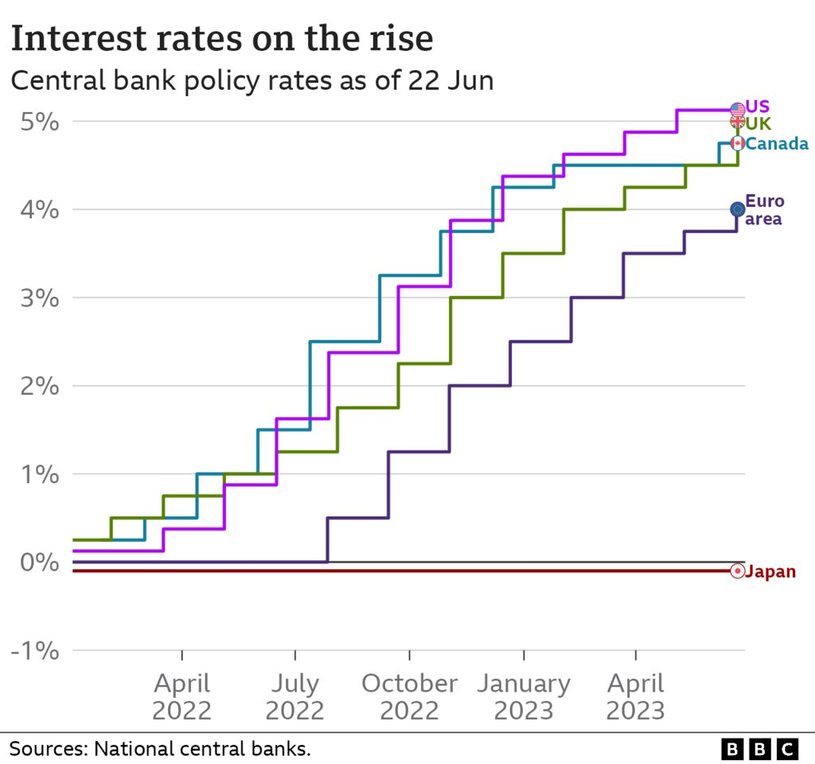
Bank

Slide 23
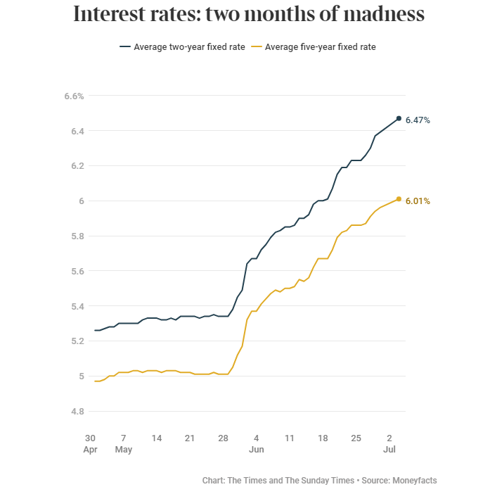
Swap Rates now
2yr 5.87%
5yr 5.05%
On 6 May 2023
2yr 4.40%
5yr 3.93%

Slide 24
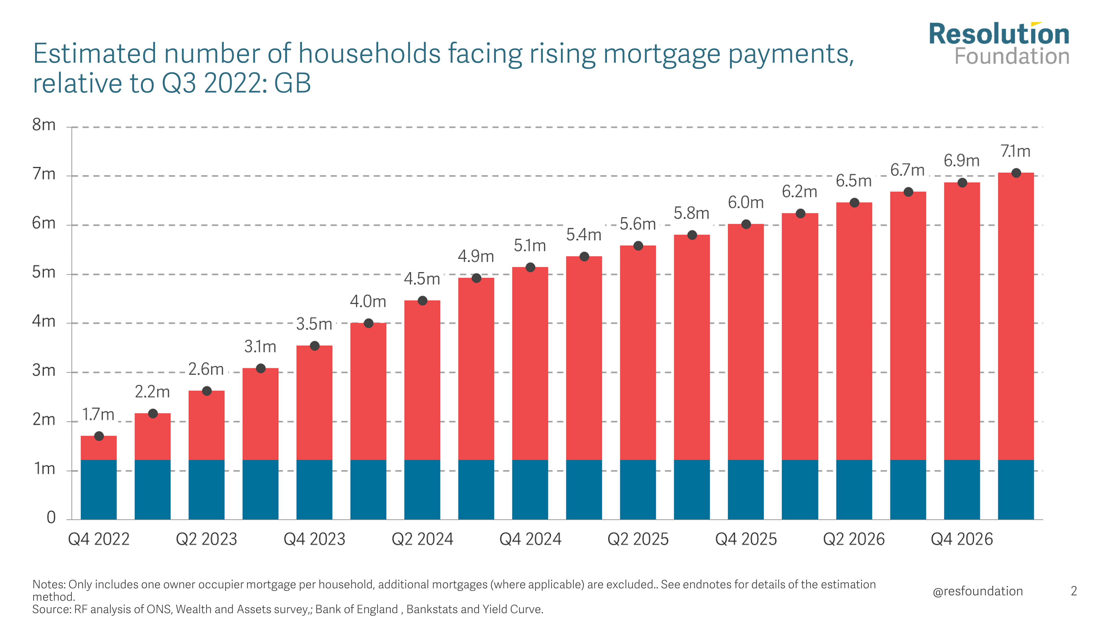
House prices
Inflation
Interest rates

Slide 25
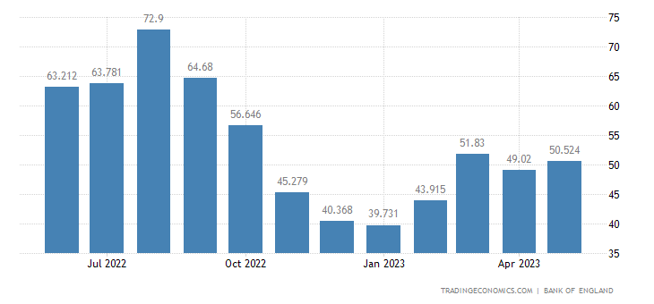
UK Mortgage Approvals

Slide 26
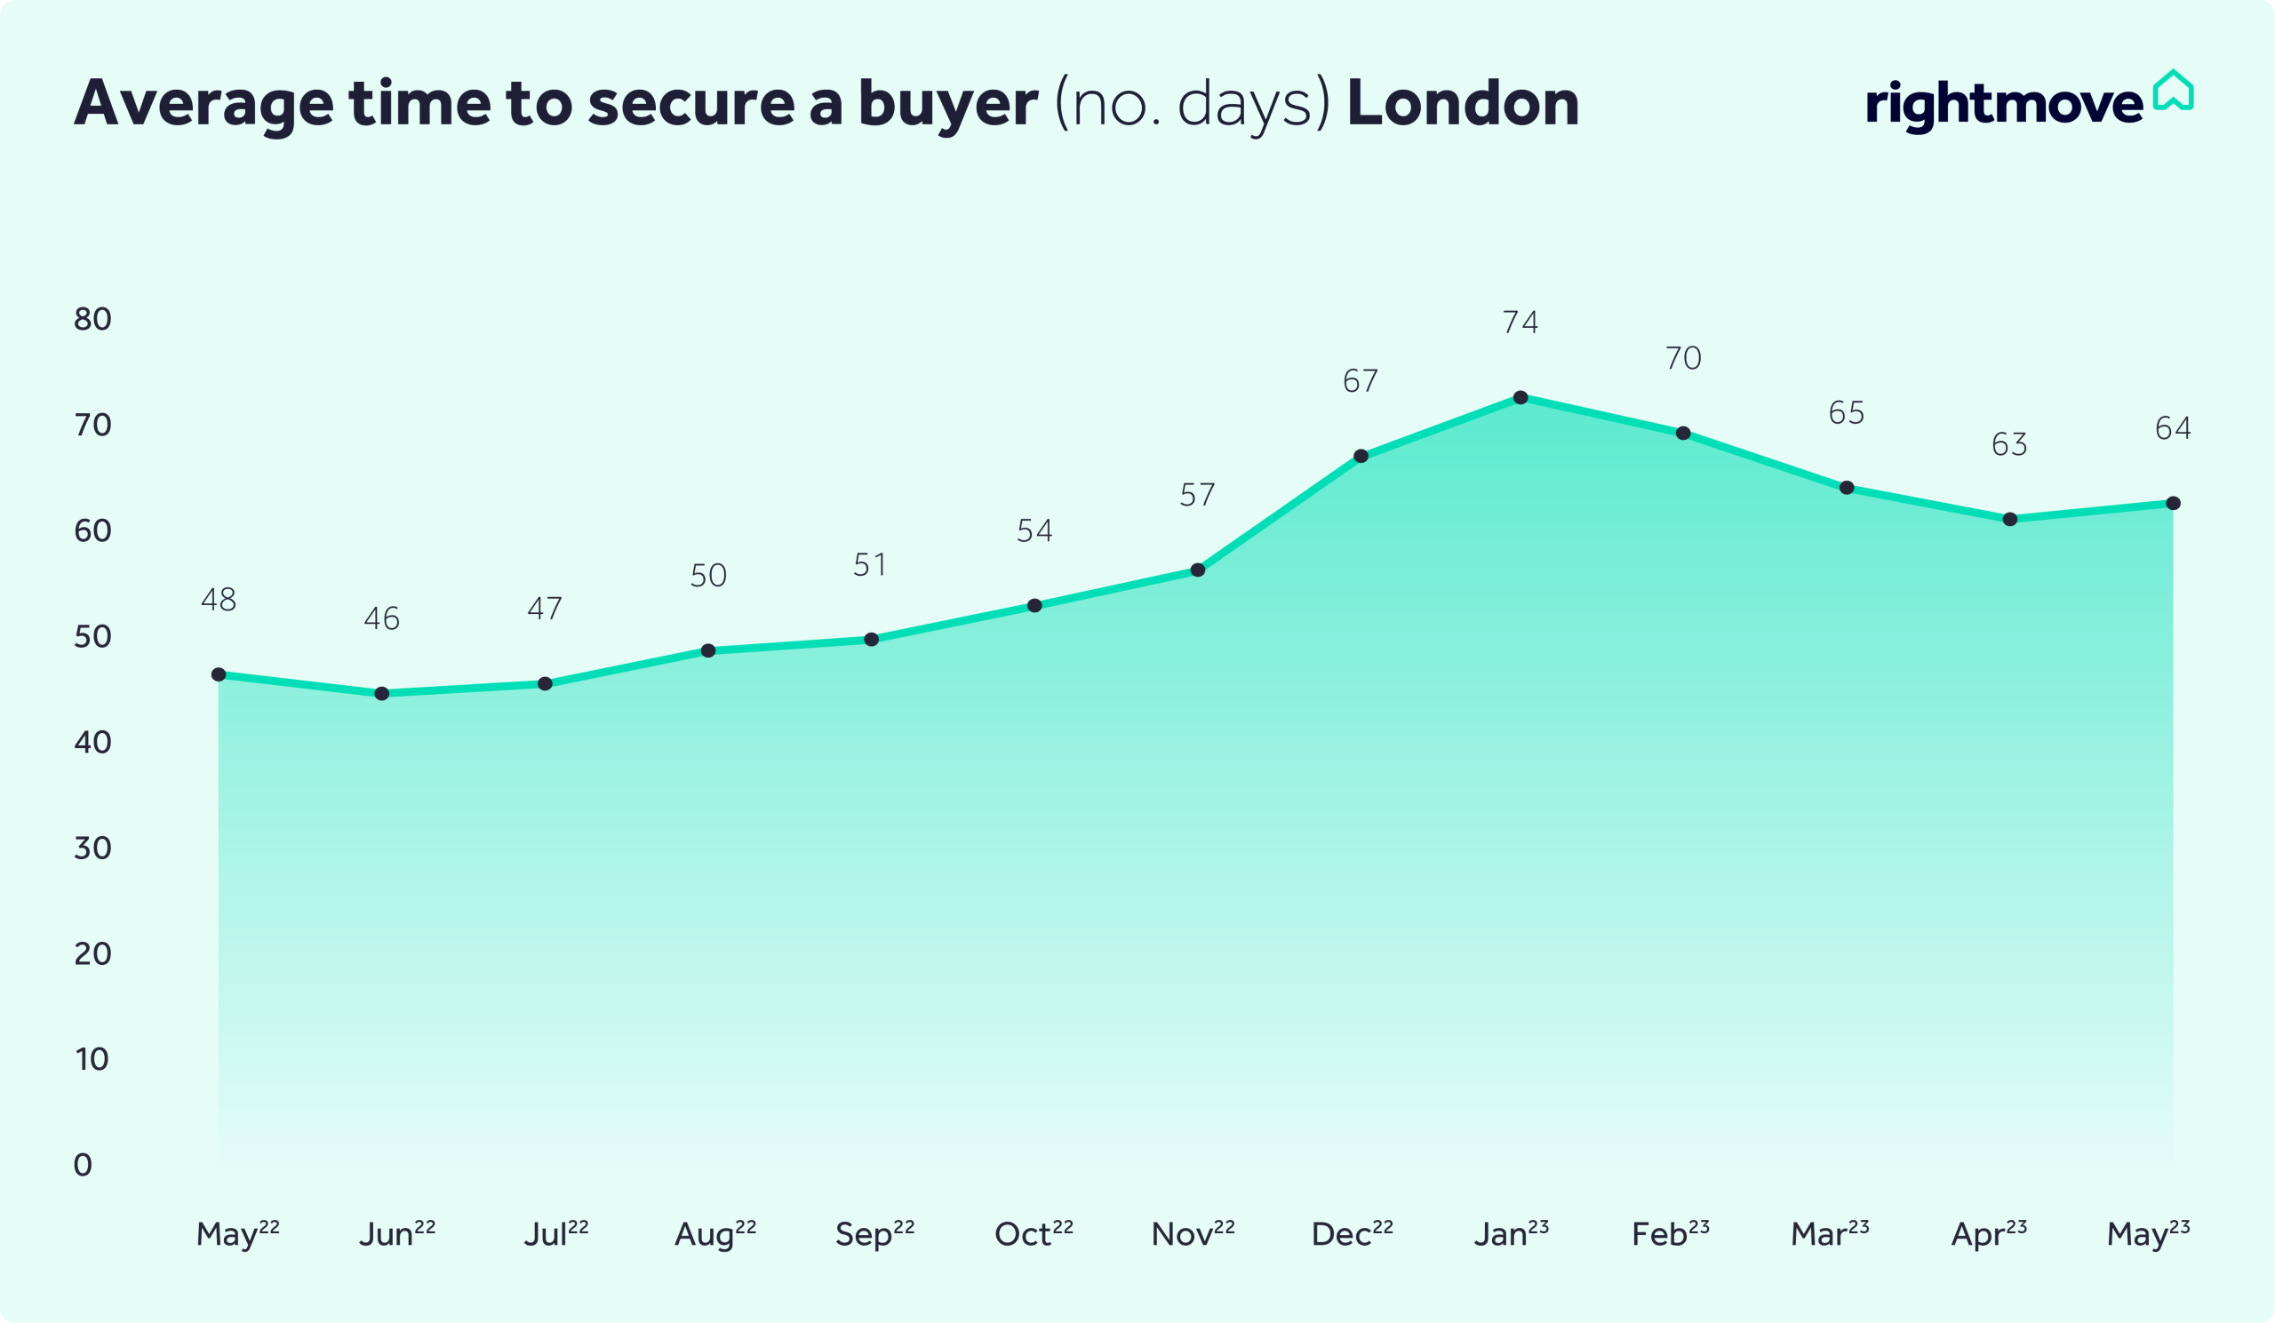

Slide 27
The Economy: Housing Market
Start of 2023 - Predictions that prices would fall 5-12% in 2023
Nationwide index shows UK fall of 3.5% in 12 months to June 2023
Was 3.4% in May, 2.7% in April - largest annual drops since 2009
Other Key indicators
Several previous monthly falls according to Nationwide & Halifax data (peak was in August 2022 – prices now 4% lower than the peak)
Mortgage approvals have been at their weakest since January 2009
Fall in buyer interest – fewer FTB and BTL purchases

Slide 28
Podcast, Webinars & NRLA Membership
Listen to NRLA Podcast & Watch Webinars
Google ‘Listen Up Landlords’
Google ‘Inside Property’ for legacy editions
Webinar recordings at www.nrla.org.uk
Join The NRLA
Google ‘Join the NRLA’
£85 per year by direct debit
Discount code – 59

Slide 29
NRLA Advice Line 0300 131 6400 Your NRLA London Reps
Richard Blanco NRLA London Representative (East & North East)
Yvonne Baisden NRLA London Representative (West & North West)
Karen Gregory NRLA London Representative (South London)

