Slide 1
Landlord Forum
Julia Morris
Assistant Director of Regulatory Services
18 July 2024

Slide 2
Private Sector Housing & Licensing
Welcome & Introductions – Julia Morris, AD Regulatory Services
Introduction to session
Licensing update, including consultation response
Dr Elsa Noterman and Dr Theo Barry Born – study on bidding processes and listed rents
Ben Reeve-Lewis – Tenancy agreements
Housekeeping
This presentation will be loaded onto the Council’s Landlord Forum web page – further information regarding the property licensing consultation can be viewed on the web pages at https://www.walthamforest.gov.uk/consultations/property-licensing-consultation

Slide 3
Private Sector Housing & Licensing – Consultation ended on the 10th March 2024
Open access online consultation questionnaire: A total of 544 responses were received, including from 398 landlords and 10 letting/managing agents.
Telephone survey of residents including tenants: A demographically representative telephone survey of over 1,000 residents, including private rented tenants living in Waltham Forest was conducted during the consultation to increase the reach of the consultation and ensure this group of people were adequately represented.
Online Landlord forum events: The first online landlord forum was held on the 23rd January 2024 at 7pm to 9pm involving 48 landlords, agents and landlord representative bodies. The second online landlord forum was held on the 22nd February 2024 at 7pm to 8.30pm involving 32 landlords, agents and landlord representative bodies.
In-person public meeting (with option to join online): Held on the 28th February 6pm to 7.30pm at the Council Chamber, involving 49 residents, landlords, agents and landlord representative bodies.
Private Tenant focus groups: Two online focus groups were held on Tuesday 5th March 2024 with a total of 16 private rented tenants to have in-depth discussions with private tenants about the proposals

Slide 4
Private Sector Housing & Licensing - Consultation
Stakeholders: Over 500 stakeholders were directly contacted and invited to respond to the consultation, including local councillors and MPs, neighbouring and nearby London boroughs, public sector and community/voluntary organisations, social housing providers, local letting agents, housing developers, and tenant and landlord representative bodies. This included an initial e-mail or letter, and follow-up letters/emails/calls to key stakeholders to remind them to participate. In total, 26 stakeholders responded, including Barking and Dagenham Council, Barnet Council, Enfield Council, Hackney Council, Haringey Council, Lewisham Council, Newham Council, Redbridge Council, Waltham Forest Housing Association (WFHA), Greater London Authority, and National Residential Landlords Association, as well as local property related businesses, housing association representatives and charity/voluntary and community sector representatives
A dedicated phone and e-mail address were available to residents, landlords and organisations to ask questions about the proposals and consultation or receive help to respond to the consultation.

Slide 5
Private Sector Housing & Licensing - Consultation
Overall, 59% of respondents (to both the on-line consultation questionnaire and telephone survey) agree with the council’s proposal to re-introduce Selective Licensing in Waltham Forest (except Hatch Lane & Highams Park North and Endlebury wards) to regulate privately rented property conditions and management and help tackle anti-social behaviour. 26% disagree.
71% of tenants/residents agree and 13% disagree. This compares with 21% of landlords/agents that agree and 64% that disagree with the proposal to re-introduce Selective Licensing.

Slide 6
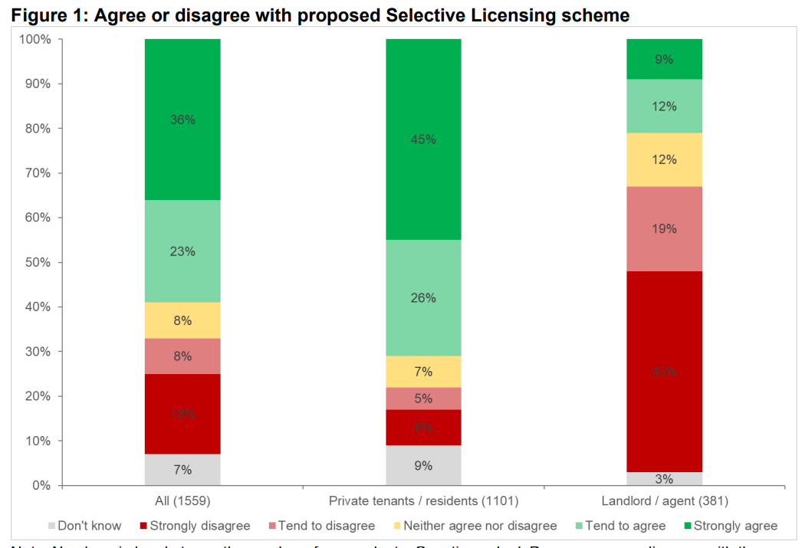
Private Sector Housing & Licensing - Consultation

Slide 7
Private Sector Housing & Licensing - Consultation
Overall, 63% of respondents agree with the council’s proposal to re-introduce Additional Licensing for Houses in Multiple Occupation (HMOs) in all of Waltham Forest to regulate property conditions and management of HMOs and help tackle anti-social behaviour. 21% disagree.
69% of tenants/residents agree and 17% disagree. This compares with 41% of landlords/agents that agree and 32% that disagree with the proposal to introduce Additional Licensing.

Slide 8
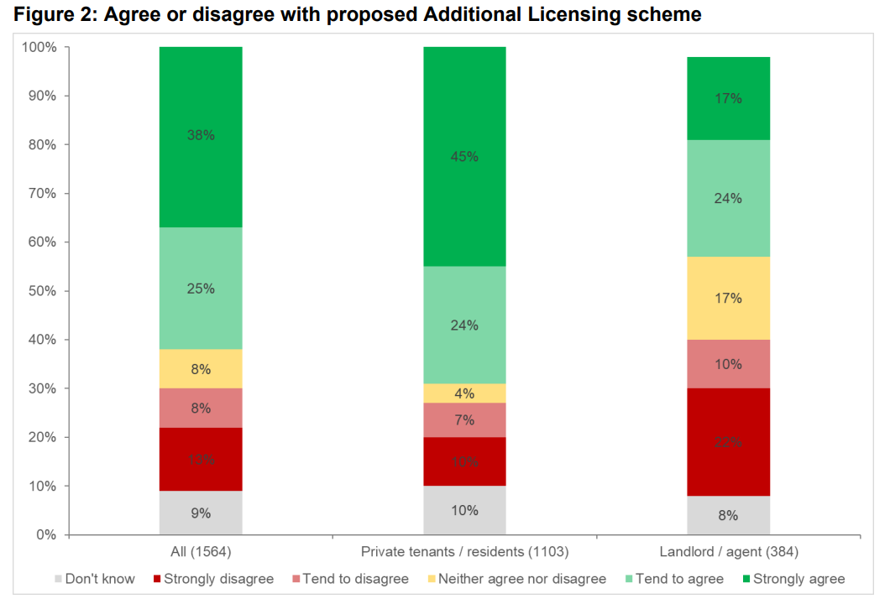
Private Sector Housing & Licensing - Consultation

Slide 9
Private Sector Housing & Licensing – Consultation responses Changes made in response to consultation feedback
In response to the consultation feedback, the main change that the Council has made relates to the inclusion of an additional discount of £95 against the cost of a full licence fee for properties that have an EPC rating of C. In making this change, the Council listened carefully to representations to the effect that applications that relate to homes which have a relatively good EPC energy rating of C should also attract a discounted application fee. In particular, the council accepted that, given the relative old age profile of its privately rented stock, it can be challenging 5 of 133 to achieve an EPC of B or above given the nature of the original building construction and other constraints. Eligibility for all EPC-related discounts will be subject to specified eligibility criteria.

Slide 10
Private Sector Housing & Licensing – Consultation responses
Several responders made requests, varying in nature, for the Council to provide more support for landlords and private sector tenants as part of the administration and operation of any future licensing schemes. Whilst the Council has not made any specific changes as regards the essential parameters of its proposed schemes (i.e. the geographical areas covered, scheme objectives, fee structure and licence conditions) the Council will additionally commit to keeping the administration and operation of any future licensing schemes under regular review in order to identify any areas or issues where it could provide additional support. For example, an issue that was raised at one of the Landlord Forum events was the ability for licence applicants to re-apply for a licence, as opposed to making a new application, with a consequent reduction on the amount of information that was required to accompany an application thereby saving time. There is a facility for landlords to re-apply for a licence before an existing licence has expired and the Council will ensure that landlords and agents have access to information about this.

Slide 11
Private Sector Housing & Licensing – Consultation responses. Some of the positive comments to support the proposed schemes.
I welcome the Council’s proposals to continue these licensing schemes. I think that it is entirely reasonable to expect landlords to proactively manage their properties for the benefit of their tenants and the wider community. I actually think there should be a national licensing scheme but realise this is outside Waltham Forest’s control. Without these licensing schemes, I fear there would be a deterioration in housing standards and environmental quality in the borough.
Neighbouring boroughs have large scale property licensing already in place, so it makes sense for Waltham Forest to have one too to prevent problem landlords and tenants transferring to Waltham Forest. Having a cohesive approach amongst neighbouring boroughs should raise standards, promote community safety, and go a long way to meet collective objectives across the whole region.

Slide 12
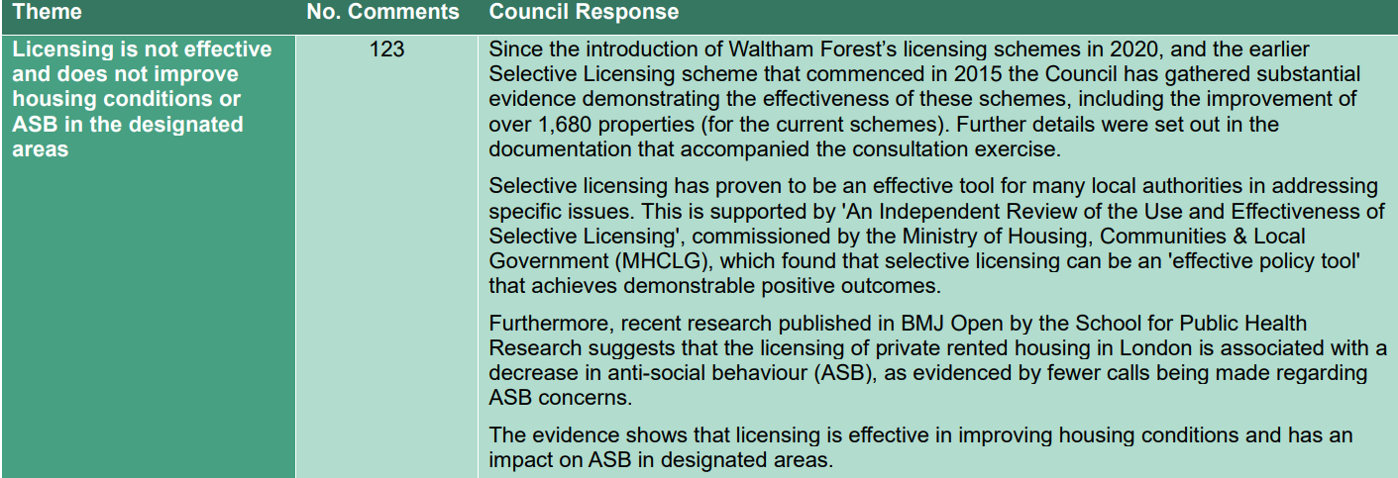
Private Sector Housing & Licensing - Consultation

Slide 13
Private Sector Housing & Licensing - Consultation

Slide 14
Private Sector Housing & Licensing - Consultation

Slide 15
Private Sector Housing & Licensing - Consultation
The full consultation report and consultation response document can be found here https://www.walthamforest.gov.uk/consultations/property-licensing-consultation

Slide 16
Private Sector Housing & Licensing Next Steps
Cabinet Approval was granted on the 9th July 2024 for both the Additional Licensing scheme and Selective Licensing Scheme
The New Additional Licensing scheme will commence on the 1st April 2025 when the current scheme ends.
You do not need to make an application until your current licence ends (or before if you are using the renewal process)
The Council will now make a submission to the MHCLG for government approval for the New Selective Licensing Scheme.

Slide 17
Private Sector Housing & Licensing The confirmed fee structure

Slide 18
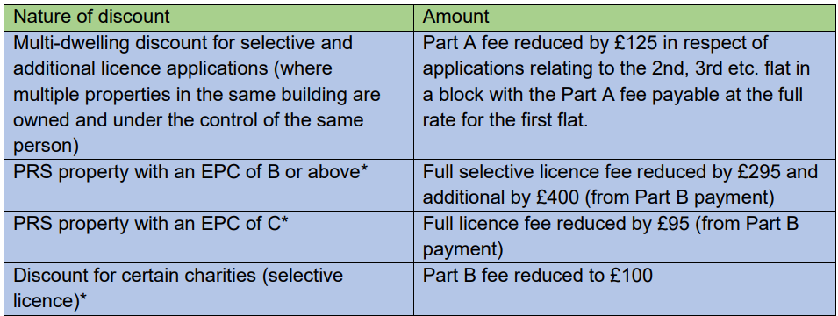
Private Sector Housing & Licensing The confirmed fee structure

Slide 19
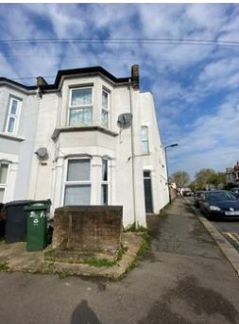
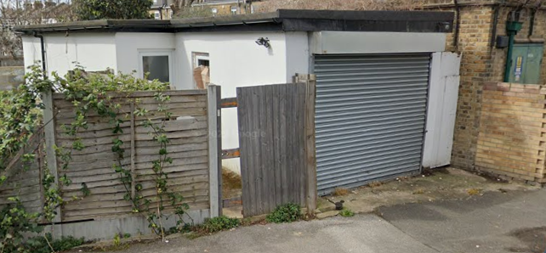
Private Sector Housing & Licensing
First Banning Order
Mamataj Begum Konica convicted of 7 offences at Thames Magistrates Court on the 22 November 2022.
Offences at 81a St Georges Road E10, that included a ground floor flat, and annexe (converted garage with no planning permission).
Offences included.
Non-licensing of Mandatory HMO x 2
Management regs, including failing to maintain fire alarms
Failure to protect the occupiers from injury, lack of fire regulations
Disrepair
The number of offences meant that the Council could apply for a Banning order, the process was delayed by Ms Konica but in June the banning order was granted until 30 June 2027, this prevents Ms Konica from
a. Letting housing in England;
b. Engaging in English letting agency work;
c. Engaging in English property management work; or
d. Doing one or more of those things.

Slide 20
Private Sector Housing & Licensing Questions and topics requested.
Questions | Response
Breakdown of income and costs of the scheme | As this is a 5-year scheme this will be presented when the scheme ends in 2025
Refunds on unused portion of the licence fee | You pay for a licence regardless of the term, there are no refunds if you sell your property or no longer rent it out.
Tenants going online and state they are no longer at the property without providing proof. | This question related to Council Tax so I will refer to them to seek a resolution.
Local repairs how to access trades people. | We are not allowed to recommend but consider https://www.checkatrade.com or https://walthamforestservicestore.co.uk
Current Market rents and demands | Possible information in the Renters Rights Bill
Upcoming new housing laws – change of government etc | Kings' speech of 17th July, more detail to follow. Ben to discuss.

Slide 21
Private Sector Housing & Licensing Contact us
https://www.walthamforest.gov.uk/housing/private-sector- housing/private-rented-property-licensing-prpl
propertylicensing@walthamforest.gov.uk
020 8496 4949

