Slide 1
Tenancy agreements

Slide 2
Do you need to give a written contract to a renter in order to create a tenancy?
No you dont unless the duration of the tenancy is intended to be for more than 3 years, in which case it ,must be in writing, signed by both parties and it must be registered at Land registry.
S54 Law of Property Act 1954 - a tenancy will still exist by virtue of the legal doctrine of “Parol”
But the fact that a tenancy has been created by virtue of Parol, does not give you contractual clauses to rely upon in legal action.

Slide 3
Written tenancy agreement- pros and cons.
If you dont issue a written contract you can’t draw down upon any deposit because deposits are governed by contractual clauses.
If the tenant is in rent arrears it is difficult to prove an arrears claim in court when seeking possession.
You cant use the accelerated court procedure with no written contract, even with s21 notices.
You cant get possession under Ground 12 “Breach of contract” if you dont have any written contract to refer to.

Slide 4
Tenancy or licence
A person can occupy rented accommodation under either a licence or a tenancy
A tenant cannot be evicted without a court order, which they are entitled to defend
Most licensees also cannot be evicted without a court order but they cannot defend an application, other than by proving they do not occupy under a licence.

Slide 5
How is a tenancy created with no written agreement?
The case of Street v.Mountford (1986) creates the 3 determinative factors
Is the arrangement that the occupier pays rent or provides a service in return for the accommodation?
Is this for a clear term? Ie weekly rent or monthly rent.
Does the occupier have exclusive possession?
If all 3 factors are in place then it will be a tenancy, even without a contract

Slide 6
Street v. Mountford
“The manufacture of a five pronged implement for manual digging results in a fork, even if the manufacturer insists he has made a spade”….Lord Templeman
In plain language if the conditions for a tenancy are met then a tenancy it will be and no amount of calling the arrangement a licence will make it one.
Also, a landlord does not het to choose whether to create a licence or a tenancy - its all down to the three hallmarks in Street v. Mountford.

Slide 7
Consumer protection and sham agreements
Regulation 5.2 of the Consumer Protection from Unfair Trading Regulations 2008.
A commercial practice is a misleading action if it satisfies the conditions in either paragraph (2) or paragraph (3).
(2) A commercial practice satisfies the conditions of this paragraph—
(a) if it contains false information and is therefore untruthful in relation to any of the matters in paragraph (4) or if it or its overall presentation in any way deceives or is likely to deceive the average consumer in relation to any of the matters in that paragraph, even if the information is factually correct; and
(b) it causes or is likely to cause the average consumer to take a transactional decision he would not have taken otherwise.

Slide 8
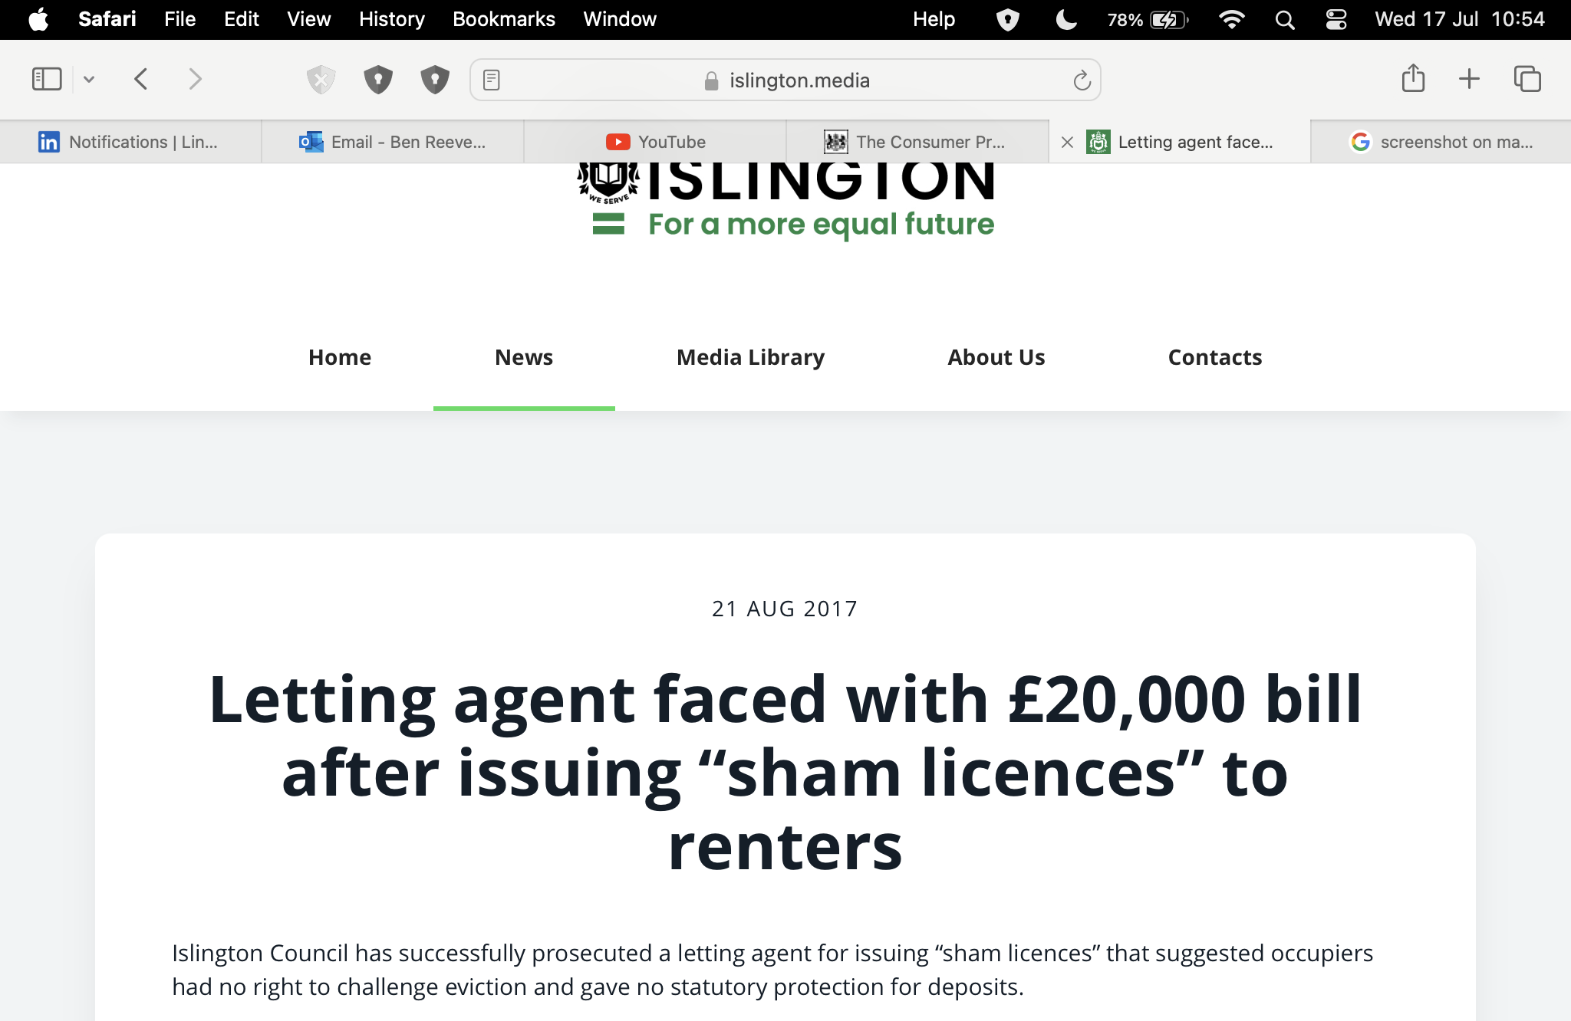
L B Islington v. Green Live Estates Ltd (2017)

Slide 9
From a recent tenancy agreement
This Licence is not intended to confer exclusive possession upon the Licensee, nor is it intended to create the relationship of landlord and tenant between the parties. The Licensee shall not be entitled to an assured tenancy or a statutory periodic tenancy under the Housing Act 1988 or to any other statutory security of tenure now or upon the determination of the Licence. The Licensee accepts that this Licence does not confer any statutory protection and/or rights that would otherwise be applicable to an assured tenancy or a statutory periodic tenancy under the Housing Act 1988.

Slide 10
Clauses in contracts

Slide 11
What type of clauses are allowed?
You can agree anything you want with a tenant but in the event of seeking a possession order for a breach of contract the court would have to be satisfied that the clause itself was not an unfair term.
“A standard term is unfair if it creates a significant imbalance in the parties' rights and obligations under the contract, to the detriment of the consumer, contrary to the requirement of good faith”. Unfair Terms in Consumer Contracts 1999

Slide 12
What type of clauses are allowed?
You cant contract out of statute - in other words if there is a law governing something you cant have a clause saying it doesn’t apply.
For example, a landlord is under a statutory duty to maintain and repair the structure of the building (s11 Landlord and Tenant Act 1985) so you can’t have a clause saying you aren’t responsible for repairs to the structure, because the law says you are.
You cant impose arbitrary penalties in the contract for specific non performance, for instance fining tenants for having overnight guests

Slide 13
What type of clauses are allowed?
You cant have clauses that interfere with “Normal tenant-like behaviour.”
Having a party on its own is a normal, tenant like thing to do. However, if the party causes nuisance or damage then that is a separate issue.
A prohibition on overnight guests may also be considered an unfair and therefore unenforceable clause. It is a perfectly normal tenant like thing to have a person stay over. However if that person causes nuisance or damage then the tenant would be responsible.

Slide 14
Example of a recent nonsense clause
“The occupier is prohibited from hanging around causing problems”.
Look at this from a legal perspective:-
Firstly: “Hanging around” - specifically hanging around where? In the house? In the garden? In the street? How far away from the house?
Secondly: Define “Causing problems”. Specifically what does that mean? Drug dealing? Begging? Fighting? Being drunk?
This is a great example of a nonsense clause that would gain nothing more than a pained expression from a judge in proceedings.

Slide 15
Make sure your clauses are clear and unambiguous
Be aware of the legal doctrine of Contra Proforentum also known as "interpretation against the draftsman”.
Where a promise, agreement or term is ambiguous, the preferred meaning should be the one that works against the interests of the party who provided the wording.
This legal doctrine is also now a statutory matter included in the Consumer Rights Act 2015

Slide 16
In conclusion
There are loads of reliable, legally sound tenancy agreements available - use one.
Join the NRLA, they have model contracts and can provide advice on all these matters for less than £100 a year. A solicitor would likely charge you £200 an hour for the same advice.
The Renter’s Reform Bill was reborn just yesterday in the Kings speech as the Renter’s Rights Bill, there is talk of changing the law, that will require landlords to issue written tenancy agreements.
Dont go cheap. Cheap is rarely cheerful.

